Slide 1
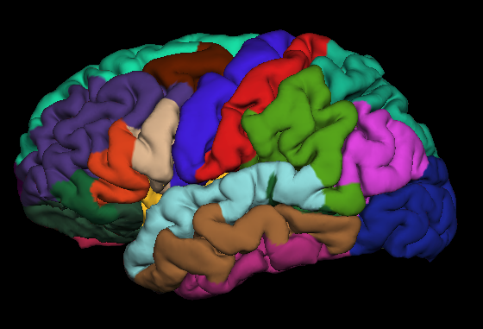
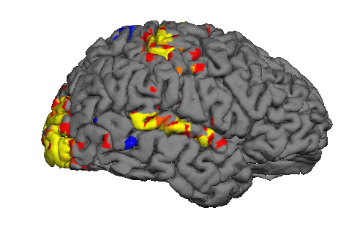
Multimodal Integration: Registration
Notes:
Are we advocating : http://freesurfer.net/?

Slide 2
Outline
Spatial Transformation
Motion Correction
Registration: Automatic and Manual
MultiModal Integration
DTI Integration
fMRI Integration
Viewing on Volume and Surface
ROI analyses
Surface-based group analysis

Slide 3
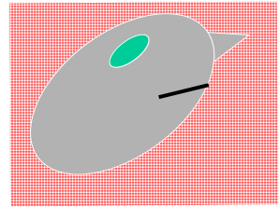
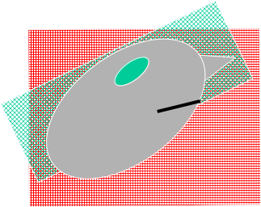
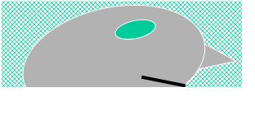
Spatial Transformations
Anatomical (1x1x1.1mm, 256x256x128, Sag)
Scanner Acquisition
fMRI/DTI/PET (3x3x5mm, 64x64x30, Axial)
Notes:
Red structural , Green DTI lower resolution
Not in alignment (voxels do not correspond, different location, different voxel sizes)
Map DTI or FMRI into anatomical space to know which voxel belongs to e.g. hippocampus

Slide 4
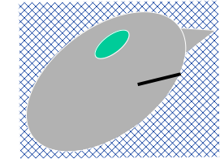
Spatial Transformations
Native Anatomical Space (1x1x1.1mm, 256x256x128, Sag)
Conformed Anatomical Space (1x1x1mm, 256x256x256, Cor)
“Anatomical Space”
orig.mgz
surfaces
parcellations
segmentations

Slide 5
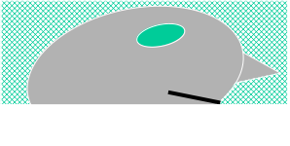
Spatial Transformations
“Anatomical Space”
Native fMRI/DTI/PET Space (3x3x5mm, 64x64x30, Axial)
???
Conformed Anatomical Space (1x1x1mm, 256x256x256, Cor)

Slide 6
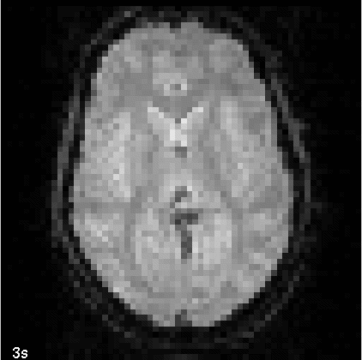
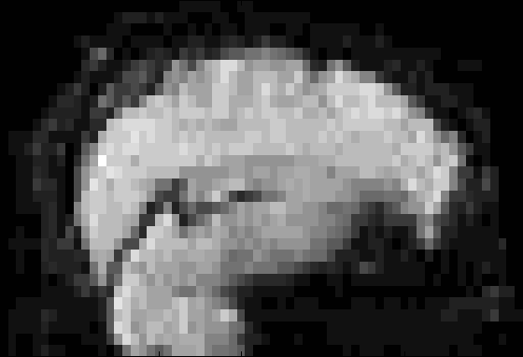
fMRI/DTI/PET Have Multiple Frames/Time Points
Movement!
Notes:
During the acquisition subject is going to move around a bit.
First we need to motion correct the time series data

Slide 7
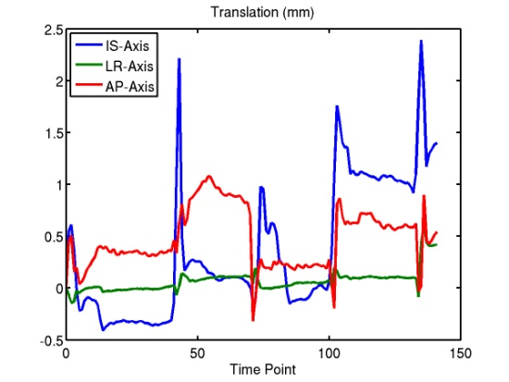
Motion Correction
Template
Target/Reference
Input
Time Point
Difference
(Error)
Adjust translation and rotation of input time point to reduce absolute difference.
Notes:
For example we align all time points to a target time points (based on intensity). Different tools for that.
(*) More info about motion correction will be given by Isik the next day in FSFAST

Slide 8
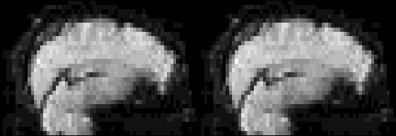
Motion Correction
Raw time series
Corrected time series
Motion correction reduces motion
All frames/time points should be in alignment
Not perfect
Notes:
After that motion should be reduced. Not perfect.

Slide 9
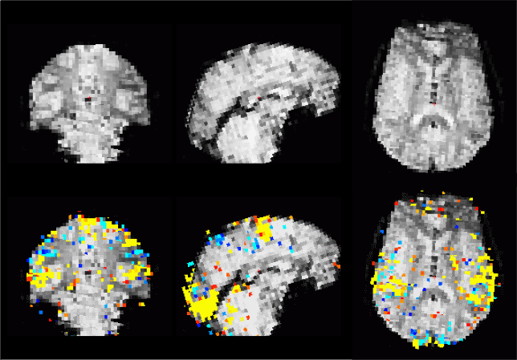
fMRI/DTI/PET “Reference”
Functional
Template
Template
+
fMRI map
Usually template/reference/target used for motion correction
Notes:
Motor paradigm significances (fMRI). After analysis this map is aligned with the template (target time point for motion correction, image from the subject! No global template).

Slide 10
Registration
FreeSurfer Anatomical (orig)
Unaligned Template
Aligned Template
Note: Registering the reference functional volume to the anatomical
volume is sufficient to register the reference to the surface.
Notes:
Left anatomical image, Green line is WM surface.
Green line does not align well with functional volume (middle).
After alignment, green surface hugs the boundary of the functional image and WM (sometimes hard to see).

Slide 11
FreeSurfer Registration
Anatomical and Reference Volume
FreeSurfer
Subject-Specific
Volumes
Surfaces
Thickness
ROIs
Reference Volume
fMRI
DTI
ASL
PET
…
Registration
Reference/Template Volume:
In voxel-for-voxel registration with parameter map
Best gray-white contrast
Notes:
Again, you have freesurfer subject-specific volumes, surfaces, thickness, ROIs… and you have a template volume for fMRI, DTI, PET or ASL… and you just need to apply registration to align them.

Slide 12
Automatic Registration
> bbregister \
--s bert \
--mov mmtemplate.nii \
--bold \
--lta register.lta
→ Command name
→ FreeSurfer subject name
→ Multimodal template volume
→ Multimodal contrast
→ Output registration file
BB = Boundary-based
Registers reference/template to conformed anatomical of given subject (bert)
Registration is initialized with mri_coreg, (or –init-fsl, --init-spm, --init-header)
6 DOF, runtime about 5 min
Accurate and Robust Brain Image Alignment using Boundary-based Registration.
Greve, Fischl. NeuroImage 48(1):63-72, 2009.
Notes:
Aligns surfaces with the gray white boundary .
First you need to do full FreeSurfer processing on anatomical to get surfaces!
--bold tells it that GM is brighter than WM

Slide 13
Manual Registration
> freeview -v template.nii $SUBJECTS_DIR/fbirn-anat-101.v4/mri/orig.mgz:visible=0 \
-f $SUBJECTS_DIR/fbirn-anat-101.v4/surf/lh.white:edgecolor=green \
$SUBJECTS_DIR/fbirn-anat-101.v4/surf/rh.white:edgecolor=green \
-viewport coronal
Turn the orig volume on/off or change opacity of top volume to see current quality of alignment
Explore the Translate and Rotate tabs
To restart the process, use “Restore to Original”
Use the “Save Reg” button to save the registration matrix
Use the “Save As” button to save the resampled volume in the new coordinate system (will also save a registration file automatically)
freeview --help
Notes:
Notice how the surfaces do not line up with the anatomy in the functional volume.
You can turn the orig volume on and off to see how much the registration is off.
To do manual registration in freeview, select the volume you want to adjust (in this case, choose template) and then go to the 'Tools' menu and select 'Transform Volume'. Hit 'OK' to the warning that pops up.
Select the 'Translate' tab and play around with the sliders until the surfaces follow the anatomy better.
You could play with the Rotation, as well. When you are happy with your results, save the registration file and/or the resampled volume. If you would like to start over, you can choose 'Restore to Original'.

Slide 14
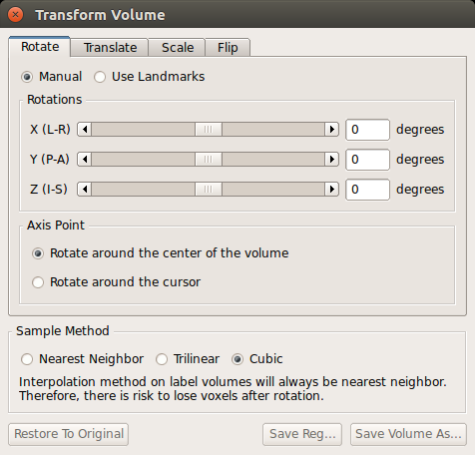
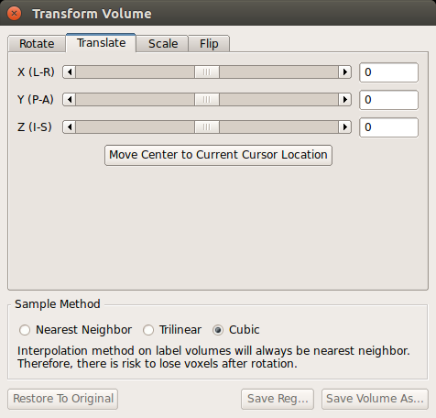
Manual Registration
Visually inspect registration
Manually edit registration (6 DOF)
cf Manual Talairach registration
Yellow line is white surface
freeview --help

Slide 15
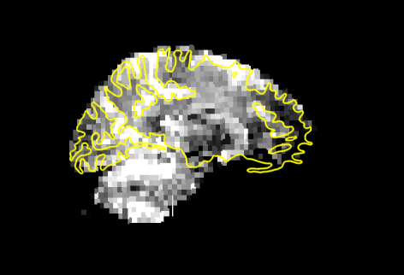
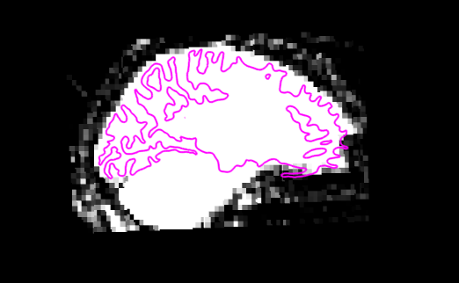
Manual Registration
Rigid = 6 DOF = No stretching
Use CSF to get a sense of where the folds are
Avoid using B0 distortion regions
Avoid using ventricles
Warning about “edge” of the brain
Same Subject, Left-Right Flips
Notes:
Usually it is not a good idea to apply stretching, so we only do rigid.
See bright and dark patches (CSF) to see where surface is.
Don’t align ventricles, align surfaces.
At the edge we are loosing some signal (brighten the image to see), so it is often OK if the green surface goes slightly outside (which is counter intuitive as the WM is expected to be inside).
If you have a different subject or left-right flip, you cannot get the surfaces to align to the folds.

Slide 16
Freesurfer Registration output
> cat register.dat.mincost
It gives 4 values:
Registration quality measure: measure of the contrast between cortical GM and WM, with a non-linear function applied so that closer to 0 is better.
0 : perfectly registered
1 : not registered
< 0.5 is typically a good registration: to be sure, check visually!
mean of WM just below the surface
mean of GM just above the surface
percent contrast
Accurate and Robust Brain Image Alignment using Boundary-based Registration.
Greve, Fischl. NeuroImage 48(1):63-72, 2009.
Notes:
There is an output of the registration that gives you a measure of the quality of the registration.
It is in the file register.dat.mincost, and it is a value between 0 and 1, being close to 0 a good registration and close to 1 a bad registration. Typically values below 0.5 indicate a good registration, although to be sure you would have to check visually.

Slide 17
Freesurfer Registration output
Simple text file
Default format: .lta (still supporting .dat)
4x4 Matrix to encode the transformation
As many as 12 DOF (usually 6 = rigid)
Also source / target file information
Coordinate system not easy to explain
Notes:
Usually 6 for 3 rotations and 3 translations (rigid)

Slide 18
LTA Transform File
type = 0 # LINEAR_VOX_TO_VOX
nxforms = 1
mean = 0.0000 0.0000 0.0000
sigma = 10000.0000
1 4 4
3.431372642517090e+00 -2.051215618848801e-01 -4.745870828628540e-03 2.753458404541016e+01
4.565358161926270e-03 1.446578502655029e-01 -3.996454238891602e+00 1.582961425781250e+02
-2.051111757755280e-01 -3.428324222564697e+00 -1.683440804481506e-01 2.647823486328125e+02
0.000000000000000e+00 0.000000000000000e+00 0.000000000000000e+00 1.000000000000000e+00
src volume info
valid = 1 # volume info valid
filename = /home/nmrclass/tutorial_data/buckner_data/tutorial_subjs/multimodal/fmri/fbirn-101/template.nii
volume = 64 64 35
voxelsize = 3.437500000000000e+00 3.437499761581421e+00 4.000000000000000e+00
xras = -9.972996711730957e-01 -7.120382040739059e-02 1.798351481556892e-02
yras = 6.254287064075470e-02 -9.518167972564697e-01 -3.002218902111053e-01
zras = 3.849399834871292e-02 -2.982859909534454e-01 9.537000060081482e-01
cras = 1.612358093261719e+00 1.616348266601562e+00 4.727973937988281e+00
dst volume info
valid = 1 # volume info valid
filename = /home/nmrclass/tutorial_data/buckner_data/tutorial_subjs/fbirn-anat-101.v6/mri/orig.mgz
volume = 256 256 256
voxelsize = 1.000000000000000e+00 1.000000000000000e+00 1.000000000000000e+00
xras = -1.000000000000000e+00 0.000000000000000e+00 0.000000000000000e+00
yras = 0.000000000000000e+00 0.000000000000000e+00 -1.000000000000000e+00
zras = 0.000000000000000e+00 1.000000000000000e+00 0.000000000000000e+00
cras = 0.000000000000000e+00 0.000000000000000e+00 0.000000000000000e+00
subject fbirn-anat-101.v6
fscale 0.100000
Notes:
http://surfer.nmr.mgh.harvard.edu/fswiki/FsTutorial/LtaFormat

Slide 19
LTA Transform File
type = 0 # LINEAR_VOX_TO_VOX
nxforms = 1
mean = 0.0000 0.0000 0.0000
sigma = 10000.0000
1 4 4
3.431372642517090e+00 -2.051215618848801e-01 -4.745870828628540e-03 2.753458404541016e+01
4.565358161926270e-03 1.446578502655029e-01 -3.996454238891602e+00 1.582961425781250e+02
-2.051111757755280e-01 -3.428324222564697e+00 -1.683440804481506e-01 2.647823486328125e+02
0.000000000000000e+00 0.000000000000000e+00 0.000000000000000e+00 1.000000000000000e+00
src volume info
valid = 1 # volume info valid
filename = /home/nmrclass/tutorial_data/buckner_data/tutorial_subjs/multimodal/fmri/fbirn-101/template.nii
volume = 64 64 35
voxelsize = 3.437500000000000e+00 3.437499761581421e+00 4.000000000000000e+00
xras = -9.972996711730957e-01 -7.120382040739059e-02 1.798351481556892e-02
yras = 6.254287064075470e-02 -9.518167972564697e-01 -3.002218902111053e-01
zras = 3.849399834871292e-02 -2.982859909534454e-01 9.537000060081482e-01
cras = 1.612358093261719e+00 1.616348266601562e+00 4.727973937988281e+00
dst volume info
valid = 1 # volume info valid
filename = /home/nmrclass/tutorial_data/buckner_data/tutorial_subjs/fbirn-anat-101.v6/mri/orig.mgz
volume = 256 256 256
voxelsize = 1.000000000000000e+00 1.000000000000000e+00 1.000000000000000e+00
xras = -1.000000000000000e+00 0.000000000000000e+00 0.000000000000000e+00
yras = 0.000000000000000e+00 0.000000000000000e+00 -1.000000000000000e+00
zras = 0.000000000000000e+00 1.000000000000000e+00 0.000000000000000e+00
cras = 0.000000000000000e+00 0.000000000000000e+00 0.000000000000000e+00
subject fbirn-anat-101.v6
fscale 0.100000
Transformation matrix
Subject name
Notes:
http://surfer.nmr.mgh.harvard.edu/fswiki/FsTutorial/LtaFormat

Slide 20
Command-line Tools
Automatic Registration:
bbregister --help
mri_coreg --help
Manual Registration:
freeview --help
Transformations:
mri_vol2surf --help
mri_vol2vol --help
mri_label2vol --help
mri_surf2vol --help
Notes:
mri_coreg: more-or-less replicates spm_coreg as called by the FreeSurfer program spmregister
We also have tools to integrate FreeSurfer with FSL (knows about FS directory will find template there etc).
Transforms:
- map volume to surface,
- map volume to anatomical volume,
- map label to fMRI volume,
- map FS surface to fMRI space.
So we can go from multi-modal space to anatomical or vice versa.

Slide 21
Outline
Spatial Transformation
Motion Correction
Registration: Automatic and Manual
MultiModal Integration
DTI Integration
fMRI Integration
Viewing on Volume and Surface
ROI analyses
Surface-based group analysis

