Slide 1
Surface-based Group Analysis in FreeSurfer

Slide 2
Outline
Motivation
GLM: General Linear Model
Theory
Hypothesis
GLM with FreeSurfer
Modeling
Command-line Stream

Slide 3
Motivation
Model patterns of interactions and associations between groups
The parameters of the model provide measures of the strength of associations
A General Linear Model (GLM) focuses on estimating the parameters of the model
can be applied to new data sets to create reasonable inferences.

Slide 4
Types of Questions
Does a specific variable have a significant association with an outcome?
If we control for the effects of a second variable, is the association still significant?
Is there a group difference?
Is a specific variable related differently between groups of individuals?

Slide 5
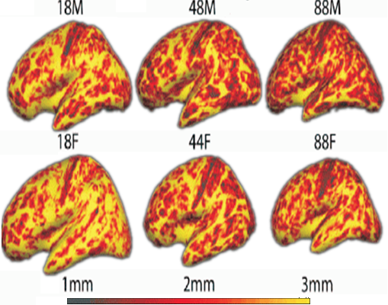
Aging Exploratory Analysis
In which areas does thickness
Change with age?
Cortical Thickness vs Aging
Salat et al, 2004, Cerebral Cortex
*

Slide 6
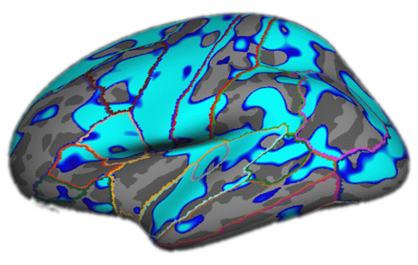
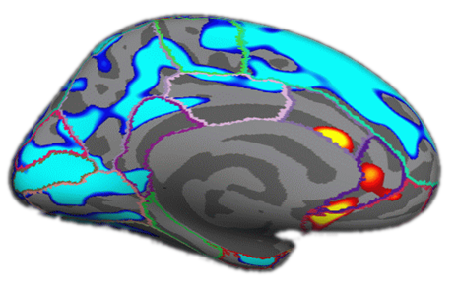
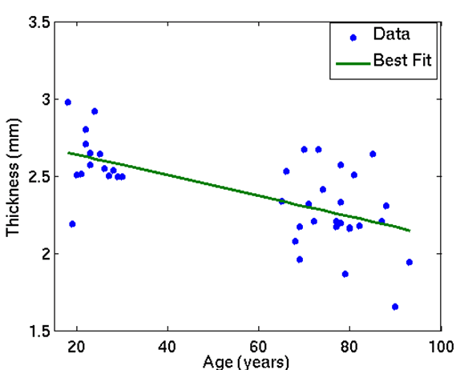
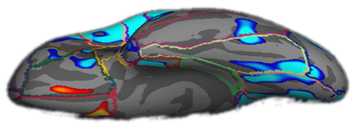
Aging Thickness Study
N=40 (all in fsaverage space)
Negative Age Correlation
p<.01
Positive Age Correlation
*

Slide 7
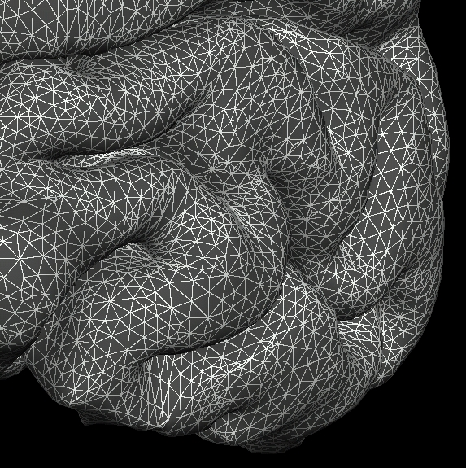
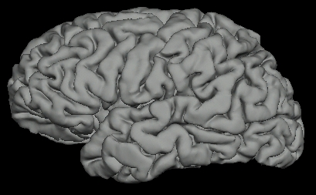
Surface-based Measures
Morphometric (e.g., thickness, area, volume)
Functional
PET
MEG/EEG
Diffusion (?) sampled just under the surface

Slide 8
Outline
Motivation
GLM: General Linear Model
Theory
Hypothesis
GLM with FreeSurfer
Modeling
Command-line Stream

Slide 9
GLM Theory
Is Thickness correlated with Age?
Thickness
Dependent
Variable,
Measurement
Subject 1
y1
Subject 2
Of course, you would
need more then two
subjects …
Thickness
IQ, Height, Weight,
etc.
y2
Age
x1
x2
Independent Variable

Slide 10
GLM: Theory
Thickness
Intercept: b
(=Offset)
Line equation:
y1
Slope: m
y2
Dependent variable
Age
x1
x2
slope
intercept
Independent variable
x and y are KNOWN, m and b are UNKNOWN
y1 = m*x1 + b → Two Equations, Two Unknowns → Solve
y2 = m*x2 + b

Slide 11
GLM: Theory
We can put this in matrix format:
Thickness
Intercept: b
(=Offset)
y1
Slope: m
y2
Age
x1
x2
Regression Coefficients (parameters)
Design Matrix
-One row per data point
-Add column of 1’s for the offset term (b)
-One set of parameters

Slide 12
GLM: Theory
We can put this in matrix format:
Outcome
Design matrix
Noise term
Regression coefficients/parameter estimates “betas”
Easy to solve:
β=inv(X’*X)*y
β=[b m]
Regression Coefficients (parameters)
Design Matrix
-One row per data point
-Add column of 1’s for the offset term (b)
-One set of parameters

Slide 13
More than two data points: Errors
GOAL: minimize the sum of the square of error terms when estimating our m and b
Thickness
Intercept: b
Easy to solve:
β=inv(X’*X)*y
Slope: m
Age

Slide 14
Outline
Motivation
GLM: General Linear Model
Theory
Hypothesis
GLM with FreeSurfer
Modeling
Command-line Stream

Slide 15
Forming a Hypothesis
Once we fit our parameters we can test our hypothesis
Is there a significant association between age and thickness?
Formal Hypothesis:
“The slope of age vs. thickness (m) is significantly different from zero”
Null hypothesis: m = 0
Thickness
Intercept: b
Compute a p-value:
between 0-1
0=Null hypothesis unlikely (good!)
1=Null hypothesis likely (bad!), or
= Too noisy to tell (also bad)
Slope: m
Age

Slide 16
p-values
p-value/significance
value between 0 and 1
depends on your sample size
closer to 0 means more significant
Smaller is better
FreeSurfer stores p-values as –log10(p):
0.1=10⁻¹→sig=1, 0.01=10⁻²→sig=2
Bigger is now better
sig.mgh files

Slide 17
Testing our Hypothesis
We still need to test for significance
We’ll use our contrast matrix C [0 1] again here in a t-test:
Contrast matrix
Regression coefficients
Design matrix
Variance of noise (var(n))
This t-value corresponds to a p-value that depends on your sample size.
This p-value is between 0 and 1, values closer to 0 indicate a more significant result.

Slide 18
Summarizing
Measurement
β=inv(X’*X)*y
Contrast matrix
Regression coefficients
Design matrix
You must specify the design matrix X and contrast matrix C
FreeSurfer can help …

Slide 19
Aging Study with Two Groups
Intercept: b1
Do groups differ in Intercept?
Do groups differ in Slope?
Is average slope different from 0?
…
Thickness
Slope: m1
Slope: m2
Age
Intercept: b2

Slide 20
Two Groups: Design Matrix
Thickness
Intercept: b1
Slope: m1
Slope: m2
number of columns = (number of groups)*(number of parameters)
Age
Intercept: b2

Slide 21
Two Groups: Contrasts
Do groups differ in Intercept?
Does b1=b2?
Does b1-b2 = 0?
C = [+1 -1 0 0], g = C*b
b1
b2
m1
m2
β
=
Four Elements in
Contrast Matrix
Four Parameters
Intercept: b1
Thickness
Slope: m1
C = [+1 -1 0 0 ]
β = [b1 b2 m1 m2]
Slope: m2
Age
Intercept: b2

Slide 22
Two Groups : Contrasts
Do groups differ in Intercept?
Does b1=b2?
Does b1-b2 = 0?
C = [+1 -1 0 0], g = C*b
b1
b2
m1
m2
β
=
Do groups differ in Slope?
Does m1=m2?
Does m1-m2=0?
C = [0 0 +1 -1], g = C*b
Intercept: b1
Thickness
Slope: m1
Slope: m2
Age
Intercept: b2

Slide 23
Two Groups : Contrasts
Do groups differ in Intercept?
Does b1=b2?
Does b1-b2 = 0?
C = [+1 -1 0 0], g = C*b
b1
b2
m1
m2
β
=
Do groups differ in Slope?
Does m1=m2?
Does m1-m2=0?
C = [0 0 +1 -1], g = C*b
Intercept: b1
Thickness
Slope: m1
Is average slope different than 0?
Does (m1+m2)/2 = 0?
C = [0 0 0.5 0.5], g = C*b
Slope: m2
Age
Intercept: b2

Slide 24
Outline
Motivation
GLM: General Linear Model
Theory
Hypothesis
GLM with FreeSurfer
Defining your model
Command-line Stream

Slide 25
Processing Stages
Specify subjects and surface measures
Assemble data (y)
Resample into Common Space
Smooth
Concatenate into one file
Model (X) and Contrasts (C) (GLM)
Fit Model (Estimate βs)
Test Hypotheses (p-values, sig)
Correct for multiple comparisons [Next talk!]
Visualize
Publish!

Slide 26
Specifying Subjects
Subject ID
$SUBJECTS_DIR
bert
fred
jenny
margaret …
SUBJECTS_DIR environment variable
Notes:
Set SUBJECTS_DIR, issue a command (mksubjdirs) to create directory structure. Convert (using mri_convert) data to COR format and store in mri/RRR, run recon-all. Typically, we acquire 3 high-quality T1 volumes to use as input to reconstruction (128-slice sagital, 1 mm in-plane resolution).

Slide 27
FreeSurfer Directory Tree
bert
bem stats morph mri rgb scripts surf tiff label
orig T1 brain wm aseg
Subject ID
lh.aparc_annot
rh.aparc_annot
lh.white
rh.white
lh.thickness
rh.thickness
lh.sphere.reg
rh.sphere.reg
SUBJECTS_DIR environment variable
Notes:
Set SUBJECTS_DIR, issue a command (mksubjdirs) to create directory structure. Convert (using mri_convert) data to COR format and store in mri/RRR, run recon-all. Typically, we acquire 3 high-quality T1 volumes to use as input to reconstruction (128-slice sagital, 1 mm in-plane resolution).

Slide 28
Example: Thickness Study
$SUBJECTS_DIR/bert/surf/lh.thickness
$SUBJECTS_DIR/fred/surf/lh.thickness
$SUBJECTS_DIR/jenny/surf/lh.thickness
$SUBJECTS_DIR/margaret/surf/lh.thickness
…

Slide 29
Design and Contrast Matrices
Create your own design (X) and contrast (C) matrices
Create an FSGD File
FreeSurfer creates design matrix
You still have to specify contrasts
This talk is for
using the FSFG files

Slide 30
FreeSurfer Group Descriptor (FSGD) File
Simple text file
List of all subjects in the study
Accompanying demographics
Automatic design matrix creation
You must still specify the contrast matrices
Note: Can specify design matrix explicitly with --design

Slide 31
FSGD Format
GroupDescriptorFile 1
Class Male
Class Female
Variables Age Weight IQ
Input bert Male 10 100 1000
Input fred Male 15 150 1500
Input jenny Female 20 200 2000
Input margaret Female 25 250 2500
One Discrete Factor (Gender) with Two Levels (M&F)
Three Continuous Variables: Age, Weight, IQ
Class = Group
Note: Can specify design matrix explicitly with --design

Slide 32
FSGDF → X (Automatic)
Female Group
Male Age
Male Group
Female Age
1 0 10 0 100 0 1000 0
1 0 15 0 150 0 1500 0
0 1 0 20 0 200 0 2000
0 1 0 25 0 250 0 2500
X =
Age
Weight
IQ
DODS – Different Offset, Different Slope. Different Offset Same Slope DOSS also possible, see https://surfer.nmr.mgh.harvard.edu/fswiki/DodsDoss

Slide 33
Contrasts – You create
Female Group
Male Age
Male Group
Female Age
1 0 10 0 100 0 1000 0
1 0 15 0 150 0 1500 0
0 1 0 20 0 200 0 2000
0 1 0 25 0 250 0 2500
X =
Age
Weight
IQ
}
C = [-1 1 0 0 0 0 0 0 ]
Tests for the difference in intercept/offset between groups
}
C = [ 0 0 -1 1 0 0 0 0 ]
Tests for the difference in age slope between groups
Create contrast files with simple text editor

Slide 34
Normalizing Covariates
GroupDescriptorFile 1
Class Male
Class Female
Variables Age Weight IQ
Input bert Male 10 100 1000
Input fred Male 15 150 1500
Input jenny Female 20 200 2000
Input margaret Female 25 250 2500
Very Different Scales will create problems!
Normalize by subtracting mean and dividing by the standard deviation. Eg, Age mean = 17.5, stddev=6.455. So use -1.1619, -0.3873, 0.3873, 1.1619 in the FSGD file or …

Slide 35
Automatic Normalization of Covariates
GroupDescriptorFile 1
Class Male
Class Female
DemeanFlag 1
RescaleFlag 1
Variables Age Weight IQ
Input bert Male 10 100 1000
Input fred Male 15 150 1500
Input jenny Female 20 200 2000
Input margaret Female 25 250 2500
If you set Flag to 0 instead of 1, then it gets turned off

Slide 36
Another FSGD Example
Two Discrete Factors
Gender: Two Levels (M&F)
Handedness: Two Levels (L&R)
One Continuous Variable: Age
GroupDescriptorFile 1
Class MaleRight
Class MaleLeft
Class FemaleRight
Class FemaleLeft
Variables Age
Input bert MaleLeft 10
Input fred MaleRight 15
Input jenny FemaleRight 20
Input margaret FemaleLeft 25
Class = Group

Slide 37
Another Example: Interaction Contrast
Two Discrete Factors (no continuous, for now)
Gender: Two Levels (M&F)
Handedness: Two Levels (L&R)
Four Regressors (Offsets)
MR (b₁), ML (b₂), FR (b₃), FL (b₄)
b₄
b₂
D₂
L
b₃
b₁
D₁
R
GroupDescriptorFile 1
Class MaleRight
Class MaleLeft
Class FemaleRight
Class FemaleLeft
Input bert MaleLeft
Input fred MaleRight
Input jenny FemaleLeft
Input margaret FemaleRight
M
F
?
g = D₁ -D₂=0
g = (b₃-b₁)- (b₄-b₂)
= -b₁+b₂+ b₃-b₄
C = [-1 +1 +1 -1]

Slide 38
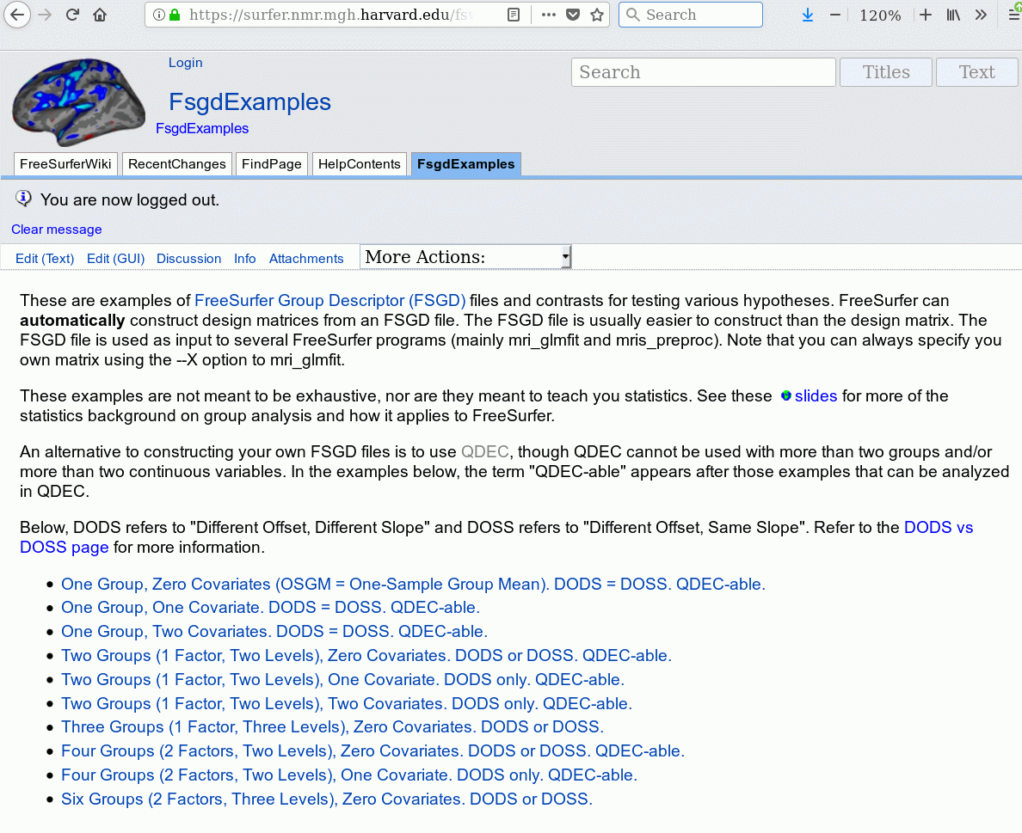
FSGD Examples
https://surfer.nmr.mgh.harvard.edu/fswiki/FsgdExamples

Slide 39
Factors, Levels, Groups
Usually each Group/Class:
Has its own Intercept
Has its own Slope (for each continuous variable)
Different Offsets Different slopes (DODS):
NRegressors = NClasses * (NVariables+1)
Different Offsets Same slope (DOSS)
Nregressors = NClasses + Nvariables
Why is this important? Because you will need to create contrast matrices, and
the contrast matrix must have Nregressor elements.

Slide 40
Factors, Levels, Groups, Classes
Continuous Variables/Factors: Age, IQ, Volume, etc.
Discrete Variables/Factors: Gender, Handedness, Diagnosis
Levels of Discrete Variables:
Handedness: Left and Right
Gender: Male and Female
Diagnosis: Normal, MCI, AD
Group or Class: Specification of All Discrete Factors
Left-handed Male MCI
Right-handed Female Normal

Slide 41
Outline
Motivation
GLM: General Linear Model
Theory
Hypothesis
GLM with FreeSurfer
Defining your model
Command-line Stream

Slide 42
Command-line stream: Processing Stages
Assemble data
Resample into Common Space
Smooth
Concatenate into one file
Fit Model (Estimate)
Correct for multiple comparisons [Next talk!]
Visualize

Slide 43
Command-line stream: Assemble Data
mris_preproc --help
--fsgd FSGDFile : Specify subjects thru FSGD File
--hemi lh : Process left hemisphere
--meas thickness : subjectid/surf/hemi.thickness
--target fsaverage : common space is subject fsaverage
--o lh.thickness.mgh : output “volume-encoded surface file”
Lots of other options!
Output: lh.thickness.mgh – file with stacked thickness maps for all subjects
Input to Smoother or GLM
Can use –meas area and –meas volume

Slide 44
Command-line stream: Assemble Data
Surface smoothing
mri_surf2surf --help
Loads stacked lh.thickness.mgh
2D surface-based smoothing
Specify FWHM (eg, fwhm = 10 mm)
Saves “stack” lh.thickness.sm10.mgh
One “frame” for each subject

Slide 45
Command-line stream: Processing Stages
Assemble data
Resample into Common Space
Smooth
Concatenate into one file
Fit Model (Estimate)
Correct for multiple comparisons [Next talk!]
Visualize

Slide 46
Command-line stream: Fit Model
mri_glmfit
Reads in FSGD File and constructs X
Reads in your contrasts (C1, C2, etc.)
Loads data (lh.thickness.sm10.mgh)
Fits GLM (ie, computes b)
Computes contrasts (g=C*b)
t or F ratios, significances
Significance -log10(p) (.01 → 2, .001 → 3)

Slide 47
mri_glmfit
mri_glmfit
--y lh.thickness.sm10.mgh
--fsgd gender_age.txt
--C age.mtx –C gender.mtx
--surf fsaverage lh
--cortex
--glmdir lh.gender_age.glmdir
Input file (output from smoothing).
Stack of subjects, one frame per subject.
mri_glmfit --help

Slide 48
mri_glmfit
mri_glmfit
--y lh.thickness.sm10.mgh
--fsgd gender_age.txt
--C age.mtx –C gender.mtx
--surf fsaverage lh
--cortex
--glmdir lh.gender_age.glmdir
FreeSurfer Group Descriptor File (FSGD)
Group membership
Covariates
mri_glmfit --help

Slide 49
mri_glmfit
mri_glmfit
--y lh.thickness.sm10.mgh
--fsgd gender_age.txt
--C age.mtx –C gender.mtx
--surf fsaverage lh
--cortex
--glmdir lh.gender_age.glmdir
Contrast Matrices
Simple text/ASCII files
Test hypotheses
You must create these by hand!
mri_glmfit --help

Slide 50
mri_glmfit
mri_glmfit
--y lh.thickness.sm10.mgh
--fsgd gender_age.txt
--C age.mtx –C gender.mtx
--surf fsaverage lh
--cortex
--glmdir lh.gender_age.glmdir
Perform analysis on left hemisphere of fsaverage subject
Masks by fsaverage cortex.label
Computes FWHM in 2D
mri_glmfit --help

Slide 51
mri_glmfit
Output directory:
lh.gender_age.glmdir/
beta.mgh – parameter estimates
rvar.mgh – residual error variance
etc …
age/
sig.mgh – -log10(p), uncorrected
gamma.mgh, F.mgh
gender/
sig.mgh – -log10(p), uncorrected
gamma.mgh, F.mgh
mri_glmfit
--y lh.thickness.sm10.mgh
--fsgd gender_age.txt
--C age.mtx –C gender.mtx
--surf fsaverage lh
--cortex
--glmdir lh.gender_age.glmdir
mri_glmfit --help

Slide 52
GLM Analysis Using Aseg/Aparc Stats Files
Use “--table table.txt” instead of “--y” to specify input
The rest of the command-line is the same as you would use for a group study (eg, FSGD file and contrasts).
Output is text file sig.table.dat that lists the significances (-log10(p)) for each ROI and contrast.
mri_glmfit
--table aparc_lh_vol_stats.txt
--fsgd gender_age.txt
--C age.mtx --C gender.mtx
--glmdir roi.gender_age.glmdir

Slide 53
Command-line stream: Processing Stages
Assemble data
Resample into Common Space
Smooth
Concatenate into one file
Fit Model (Estimate)
Correct for multiple comparisons [Next talk!]
Visualize

Slide 54
Command-line stream: Processing Stages
Assemble data
Resample into Common Space
Smooth
Concatenate into one file
Fit Model (Estimate)
Correct for multiple comparisons [Next talk!]
Visualize

Slide 55
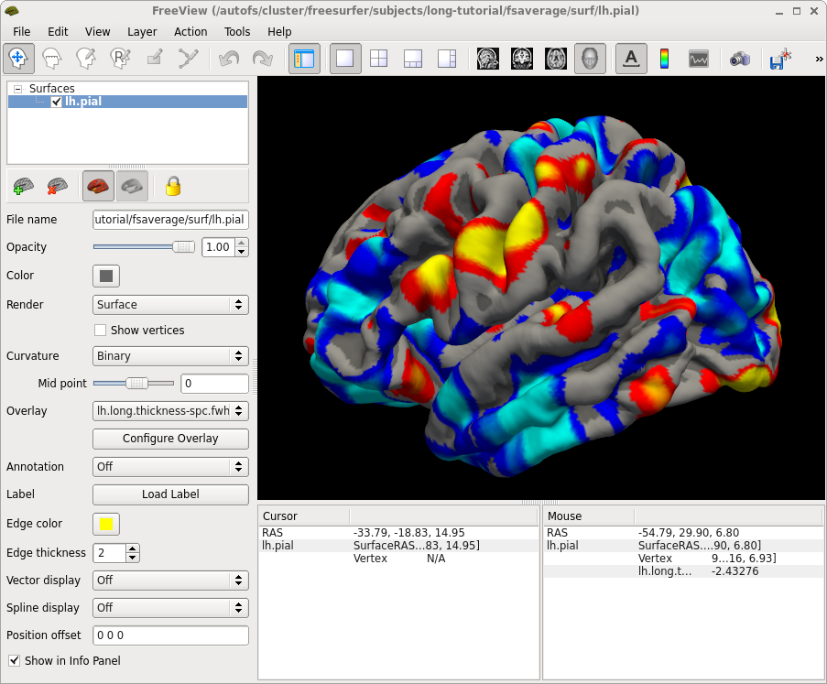
Visualization with freeview
freeview –f $FREESURFER_HOME/subjects/fsaverage/surf/lh.pial:overlay=sig.mgh
Use “Configure Overlay” tool to change thresholds for visualization (recall: lower threshold of 1.3 will only display regions where p<0.05)

Slide 56
Tutorial
Create an FSGD File and contrasts for a thickness study
Age and Gender
Run
mris_preproc
mri_surf2surf
mri_glmfit

Slide 58
Matrix Multiplication
y1
y2
y3
y4
x1
1 x2
x3
1 x4
b
m
=
*
y1 =
1*b
+ x1*m
y2 =
+ x2*m
1*b
System of Linear Equations
y3 =
+ x3*m
1*b
y4 =
1*b
+ x4*m
Four equations
Two unknowns

Slide 59
More than two data points: Errors
Matrix Formulation
Thickness
Intercept: b
Slope: m
Age
System of Linear Equations
Model Error, noise
Residuals: eres.mgh
Notes:
No matter how many data points you have, there is still only one slope and one intercept.

Slide 60
GLM: summarizing
Matrix Formulation
Thickness
Intercept: b
Two parameters
One row per subject
X is an independent variable (age)
Column of 1’s is the ‘offset’ term
(to multiply by b)
Slope: m
Age
System of Linear Equations
Outcome
Design matrix
Noise term
Regression coefficients/parameter estimates
= “betas” → beta.mgh (mri_glmfit output)

Slide 61
Testing Our Hypothesis
We test for significance and the direction of the effect
We do this with a contrast matrix C that isolates our parameter of interest
With C and β we compute g, which tells us the direction of our effect
If g is negative, then the direction of our effect (slope) is also negative
In our example, our hypothesis is about the slope m
Our contrast matrix will be [0 1]
β
Contrast matrix

Slide 62
Putting it all together
We measure y (eg, thicknesses)
We used our empirical data to form a design matrix: X
We fit regression coefficients (b and m) to our X,y data
We created a contrast matrix: C to test our hypothesis for:
Direction of effect: g = C*β
Significance of effect: t-test

