Slide 1
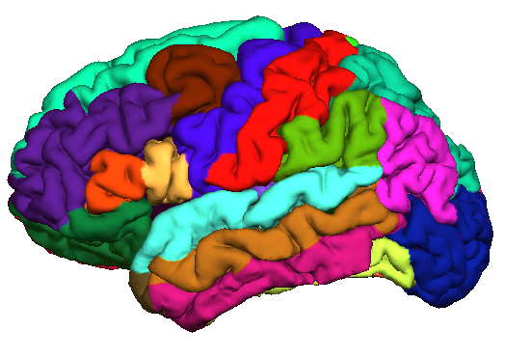



Longitudinal FreeSurfer

Slide 2
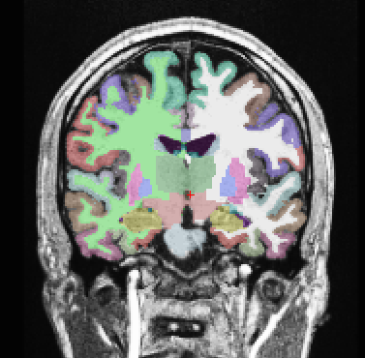
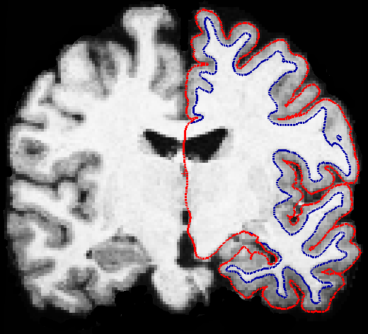
What can we do with FreeSurfer?
measure volume of cortical or subcortical structures
compute thickness (locally) of the cortical sheet
study differences of populations (diseased, control)

Slide 3
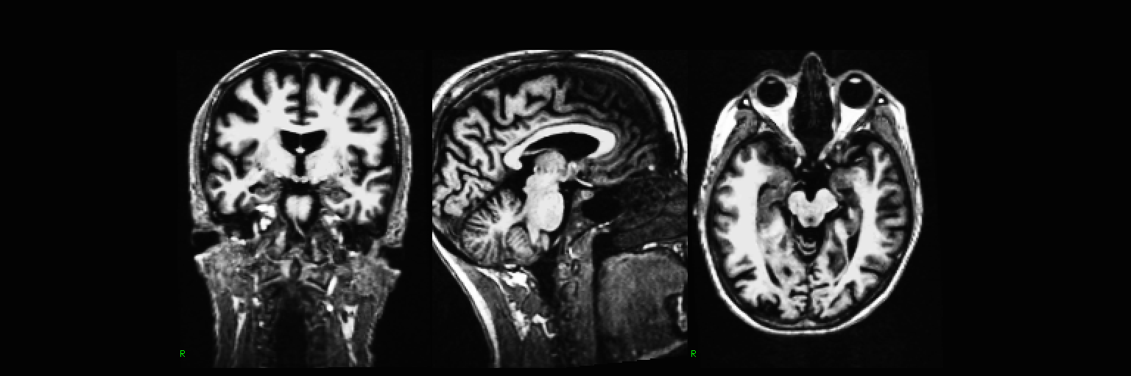
Neurodegenerative disease:
14 time points, 6 years, Huntington’s Disease

Slide 4
We'd like to:
exploit longitudinal information
(same subject, different time points)
Why longitudinal?
to reduce variability on intra-individual morph estimates
to detect small changes, or use less subjects (power)
for marker of disease progression (atrophy)
to better estimate time to onset of symptoms
to study effects of drug treatment
...

Slide 5
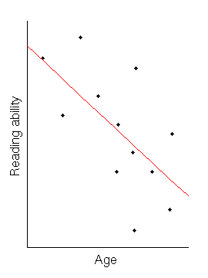
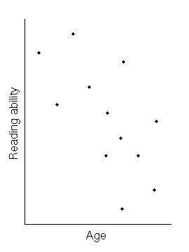
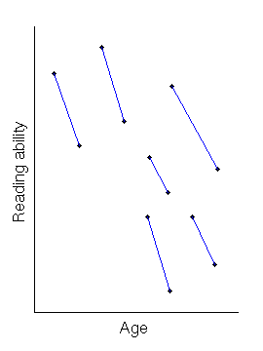
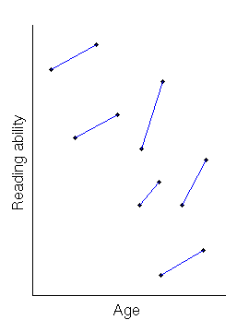
Example 1

Slide 6
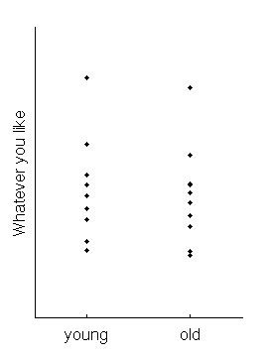
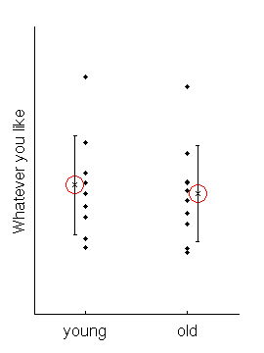
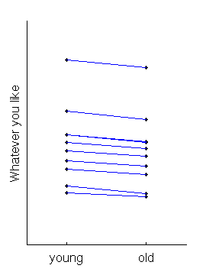
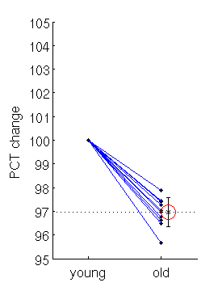
Example 2

Slide 7
Challenges in Longitudinal Designs
Over-Regularization:
  Temporal smoothing
  Non-linear warps
  Potentially underestimating change
Bias
  Interpolation Asymmetries [Yushkevich et al. 2010]
  Asymmetric Information Transfer
  Often overestimating change
Limited designs:
  Only 2 time points
  Special purposes (e.g. only surfaces, WM/GM)

Slide 8
How can it be done?
Stay unbiased with respect to any specific time point by treating all the same
Create a within subject template (base) as an initial guess for segmentation and reconstruction
  Initialize each time point with the template to reduce variability in the optimization process
  For this we need a robust registration (rigid) and template estimation
Reuter et al. NeuroImage 2011 & 2012

Slide 9
Robust Registration
Goal: Highly accurate inverse consistent registrations
In the presence of:
  Noise
  Gradient non-linearities
  Movement: jaw, tongue, neck, eye, scalp ...
  Cropping
  Atrophy (or other longitudinal change)
We need:
Inverse consistency keep registration unbiased‏
Robust statistics to reduce influence of outliers
Reuter, Rosas, Fischl. NeuroImage 2010

Slide 10
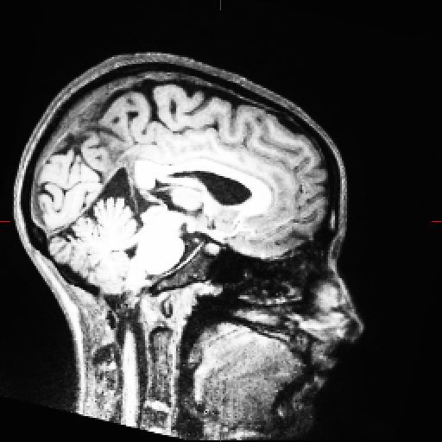
Robust Registration
Target
Target

Slide 11
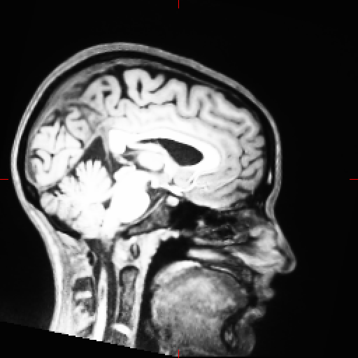

Robust Registration
Registered Src FSL FLIRT
Registered Src Robust

Slide 12
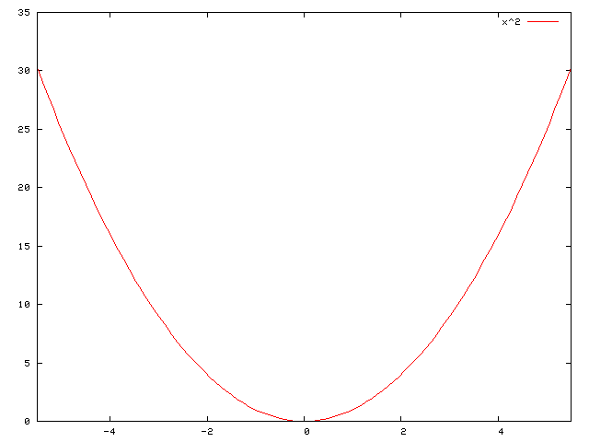
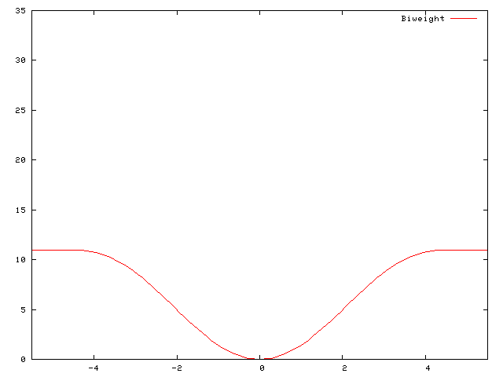
Robust Registration
Limited contribution of outliers [Nestares&Heeger 2000]
Square
Tukey's Biweight

Slide 13
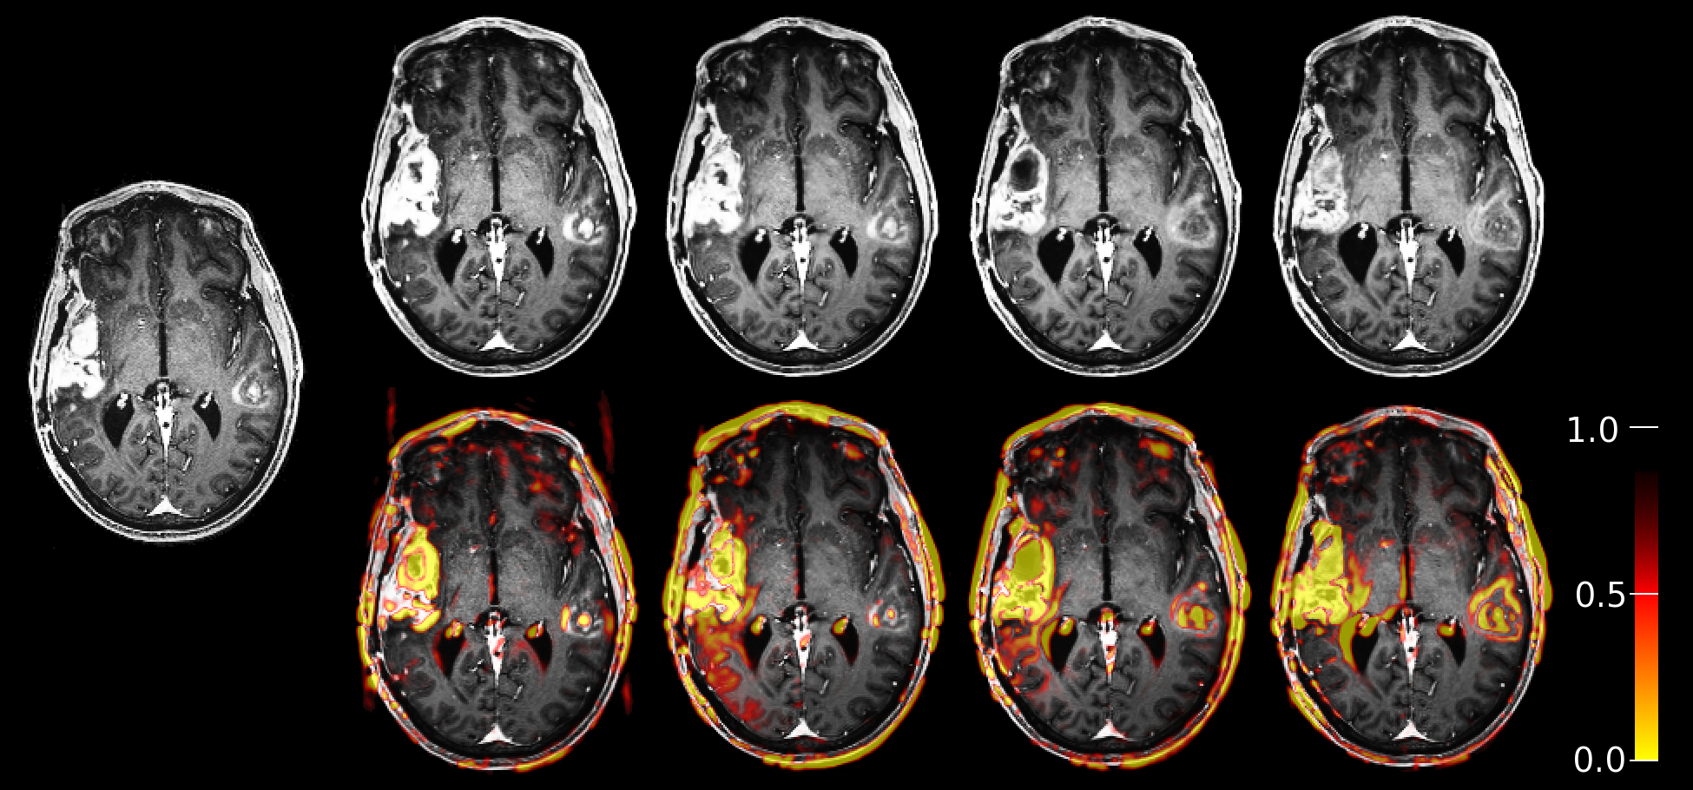
Robust Registration
Tumor data with significant intensity differences in the
brain, registered to first time point (left).

Slide 14
Robust Registration
Inverse consistency:
  a symmetric displacement model:
  resample both source and target to an unbiased half-way space in intermediate steps (matrix square root)
Source
Half-Way
Target

Slide 15
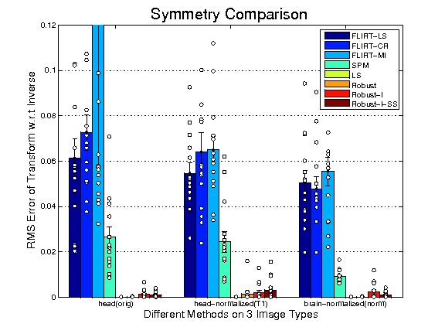
Robust Registration
Inverse consistency of different methods on original (orig), intensity normalized (T1) and skull stripped (norm) images.
LS and Robust:
nearly perfect symmetry (worst case RMS < 0.02)
Other methods:
several alignments with RMS errors > 0.1

Slide 16
Robust Registration
mri_robust_register is part of FreeSurfer
can be used for pair-wise registration (optimally within subject, within modality)
can output results in half-way space
can output ‘outlier-weights’
see also Reuter et al., NeuroImage 2010 for comparison with FLIRT (FSL) and SPM coreg
for more than 2 images use: mri_robust_template

Slide 17
Robust Template Estimation
Minimization problem for N images:
Image Dissimilarity:
Metric of Transformations:
Reuter, Rosas, Fischl. NeuroImage 2012

Slide 18
Challenges
Over-Regularization (limited flexibility):
  Will avoid by only initializing processing
Bias [Reuter and Fischl 2011] , [Reuter et al. 2012]
  Will avoid by treating time points the same
Limited designs:
  Allow n time points
  Reliably estimate all of FS measurements

Slide 19
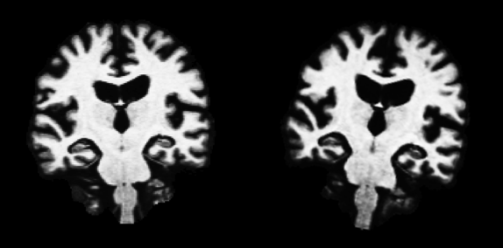
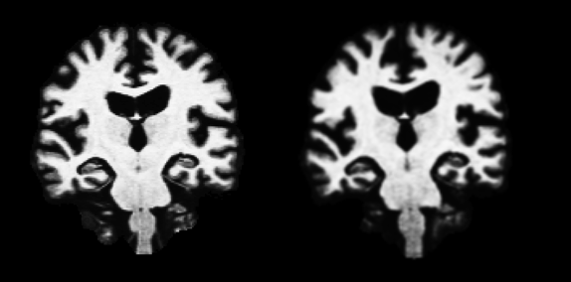
(i) Interpolation Asymmetries (Bias)
Mapping follow-up to baseline:
  Keeps baseline image fixed (crisp)
  Causes interpolation artefacts in follow-up (smoothing)
  Often leads to overestimating change

Slide 20
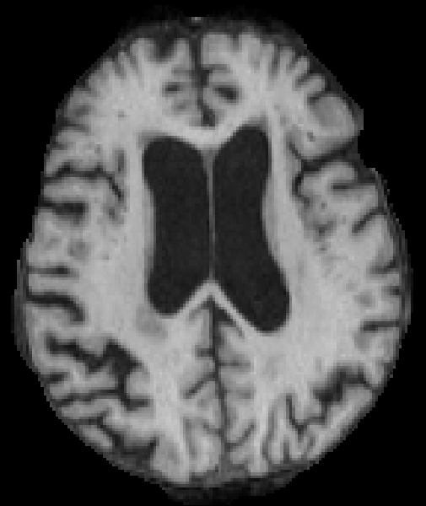

Slide 21
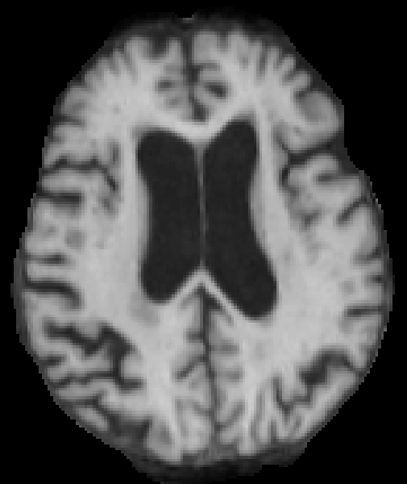

Slide 22
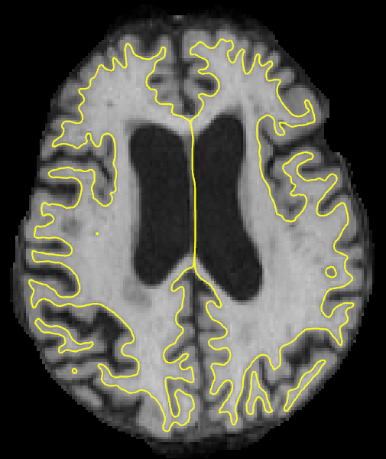

Slide 23
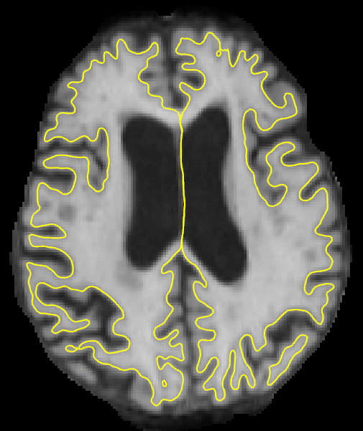

Slide 24
(i) Interpolation Asymmetries (Bias)
MIRIAD dataset: 65 subjects
First session first scan compared to twice interpolated image.
Regional: not finding it does not mean it is not there.
http://miriad.drc.ion.ucl.ac.uk

Slide 25
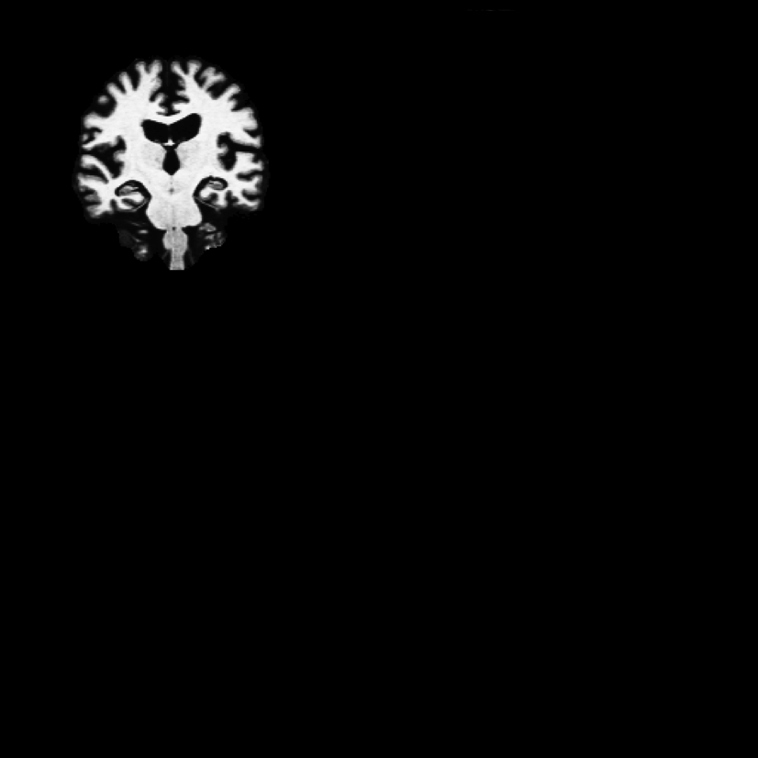
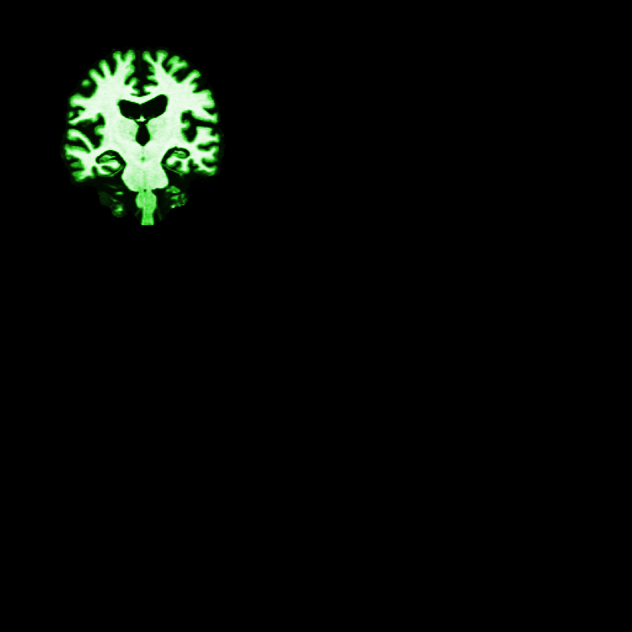
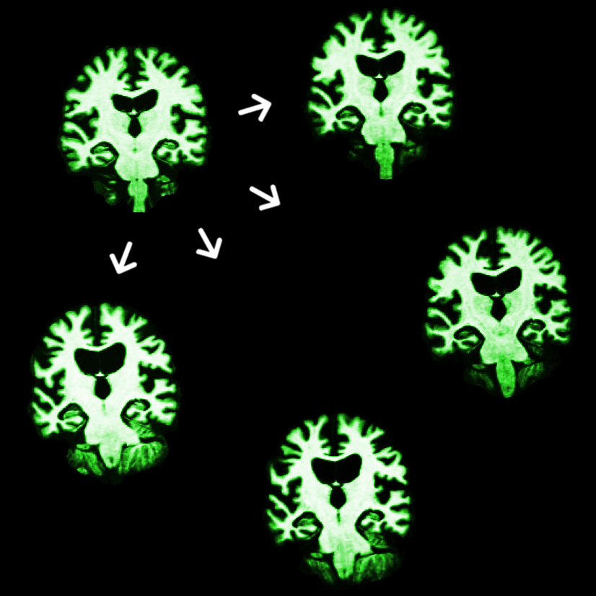
(ii) Asymmetric Information Transfer
Example:
Process baseline
Transfer results from baseline to follow-up
Let procedures evolve in follow-up
(or construct skullstrip in baseline, or Talairach transform …)
Can introduce bias!

Slide 26
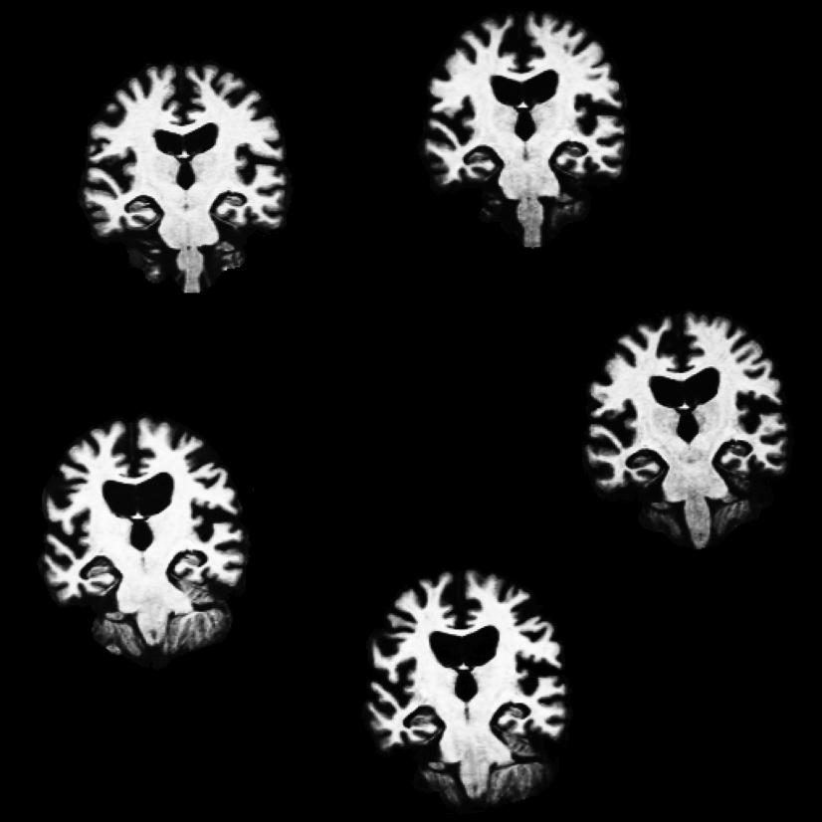
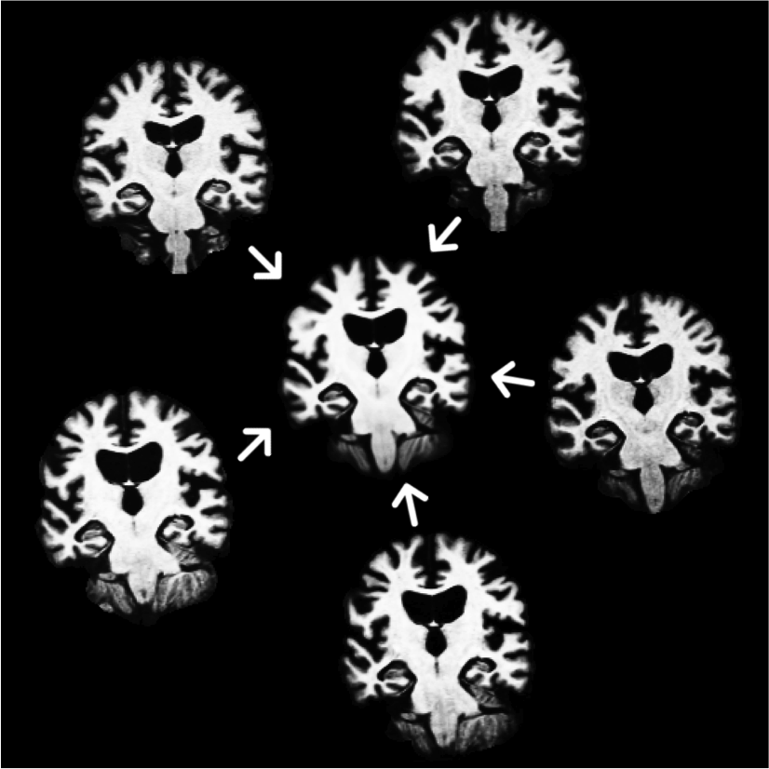
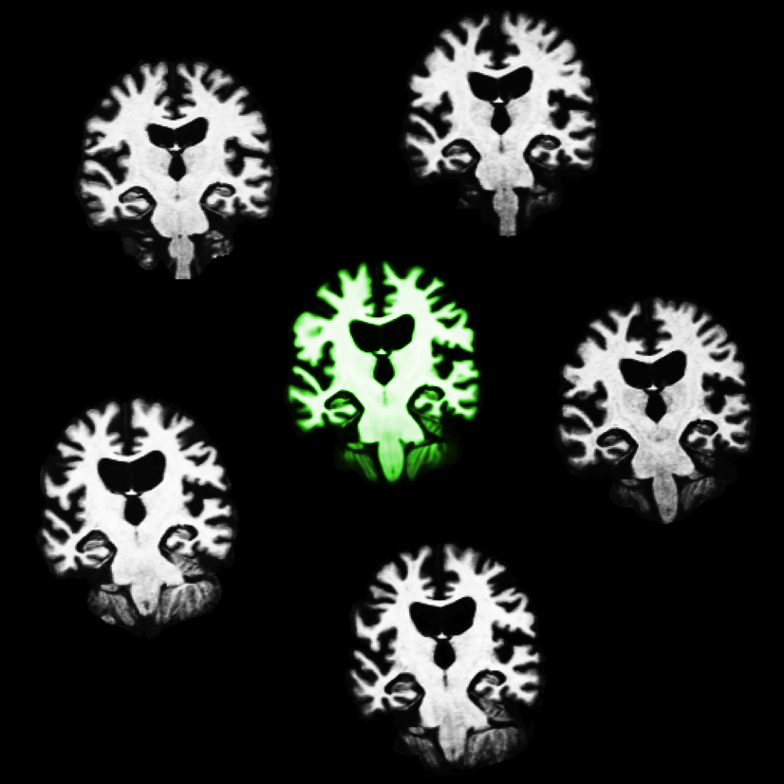
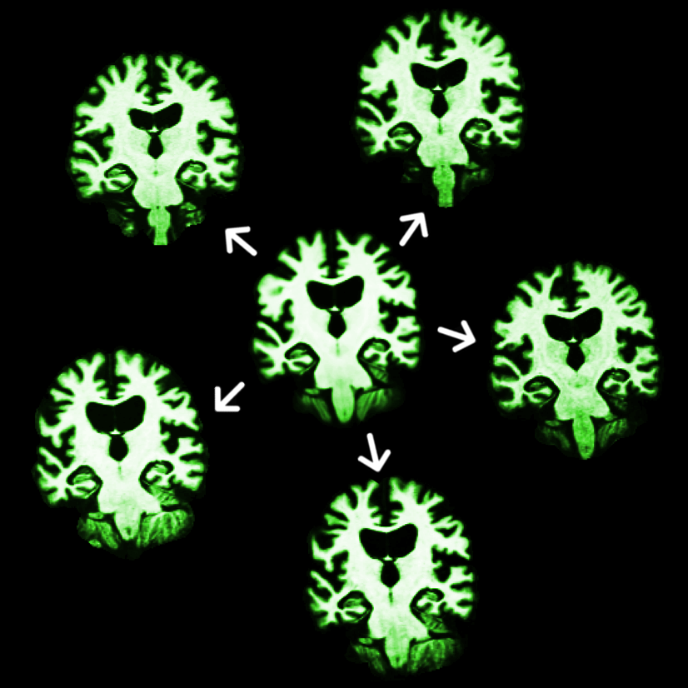
Robust Unbiased Subject Template
Create subject template (iterative registration to median)
Process template
Transfer to time points
Let it evolve there
All time points are treated the same
Minimize over-regularization by letting tps evolve freely
Reuter et al. OHBM 2010, NeuroImage 2011 & 2012

Slide 27
(ii) Asymmetric Information Transfer
Test-Retest (115 subjects, 2 scans, same session)
Subcortical
Cortical
Biased information transfer: [BASE1] and [BASE2].
Our method [FS-LONG] [FS-LONG-rev] shows no bias.

Slide 28
Review the central ideas
Idea: Would like to include some information that much of the anatomy is the same over time, but don‘t want to lose sensitivity to disease effects.
How to minimize over regularization:
  Only initialize processing, evolve freely
How to avoid processing bias:
  Treat all time points the same
Why not simply do independent processing then?
  Sharing information across time points increases reliability, statistical power!

Slide 29
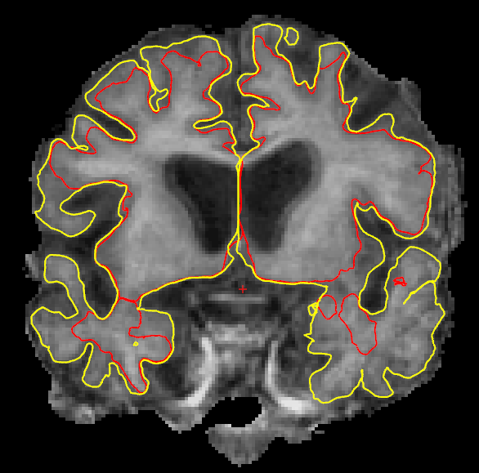
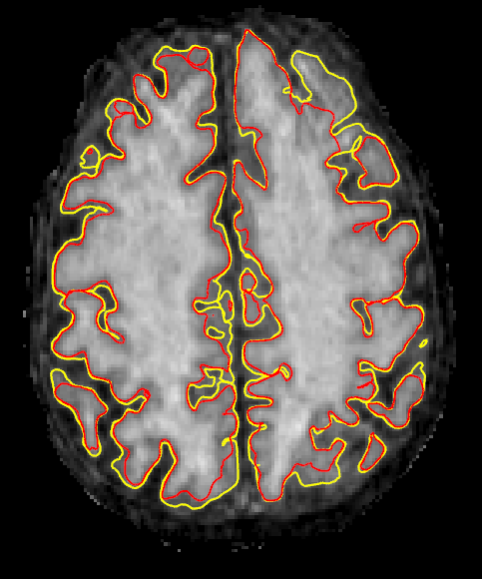
Improved Surface Placement

Slide 30
Test-Retest Reliability
Subcortical
Cortical
[LONG] significantly improves reliability
115 subjects, MEMPRAGE, 2 scans, same session
Reuter et al. NeuroImage 2012

Slide 31
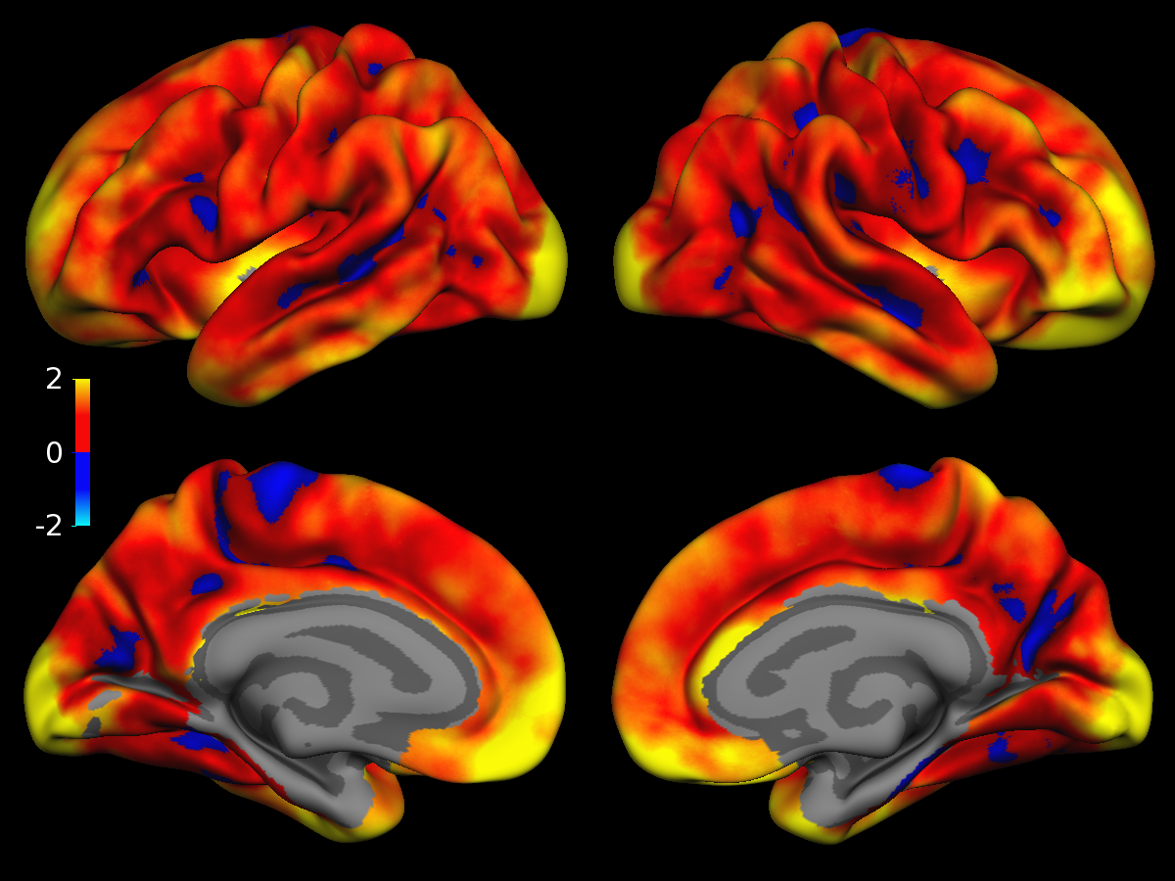
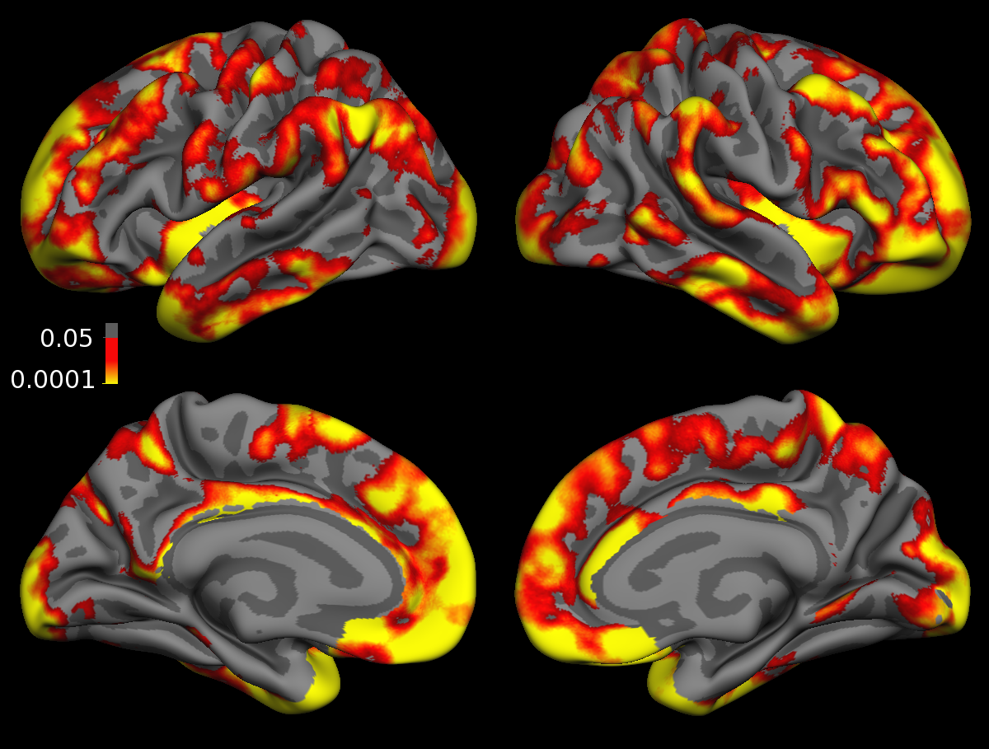
Test-Retest Reliability
Diff. ([CROSS]-[LONG])
of Abs. Thick. Change:
Significance Map
[LONG] significantly improves reliability
115 subjects, ME MPRAGE, 2 scans, same session

Slide 32
Increased Power
Sample Size Reduction when using [LONG]
(based on test-retest 14 subjects, 2 weeks)

Slide 33
Huntington’s Disease (3 visits)
(with D. Rosas)
Independent Processing
Longitudinal Processing
[LONG] shows higher precision and better discrimination power between groups (specificity and sensitivity).

Slide 34
Huntington’s Disease (3 visits)
(with D. Rosas)
Rate of Atrophy
Baseline Vol. (normalized)
Putamen Atrophy Rate is significantly different between CN and PHDfar, but baseline volume is not.

Slide 35
Robust Template for Initialization
Unbiased
Reduces Variability
Common space for:
  - TIV estimation
  - Skullstrip
  - Affine Talairach Registration
Basis for:
  - Intensity Normalization
  - Non-linear Registration
  - Surfaces / Parcellation

Slide 36
FreeSurfer Commands (recon-all)
1.CROSS (independently for each time point tpNid):
recon-all -subjid tpNid -all
2. BASE (creates template, one for each subject):
recon-all -base baseid -tp tp1id \ -tp tp2id ... -all
3. LONG (for each time point tpNid, passing baseid):
recon-all -long tpNid baseid -all
This creates the final directories tpNid.long.baseid

Slide 37
Directory Structure
Contains all CROSS, BASE and LONG data:
me1
me2
me3
me_base
me1.long.me_base
me2.long.me_base
me3.long.me_base
you1
…

Slide 38
Single time point
Since FS5.2 you can run subjects with a single time point through the longitudinal stream!
Mixed effects models can use single time point subjects to estimate variance (increased power)
This assures identical processing steps as in a subject with several time points
Commands same as above:
recon-all -subjid tp1id -all
recon-all -base baseid -tp tp1id -all
recon-all -long tp1id baseid -all

Slide 39
Final Remarks …

Slide 40
Sources of Bias during Acquisition
BAD: influence images directly and cannot be easily removed!
Different scanner hardware (head coil, pillow?)
Different scanner software (shimming algorithm)
Scanner drift and calibration
Different motion levels across groups
Different hydration levels (season, time of day)

Slide 41
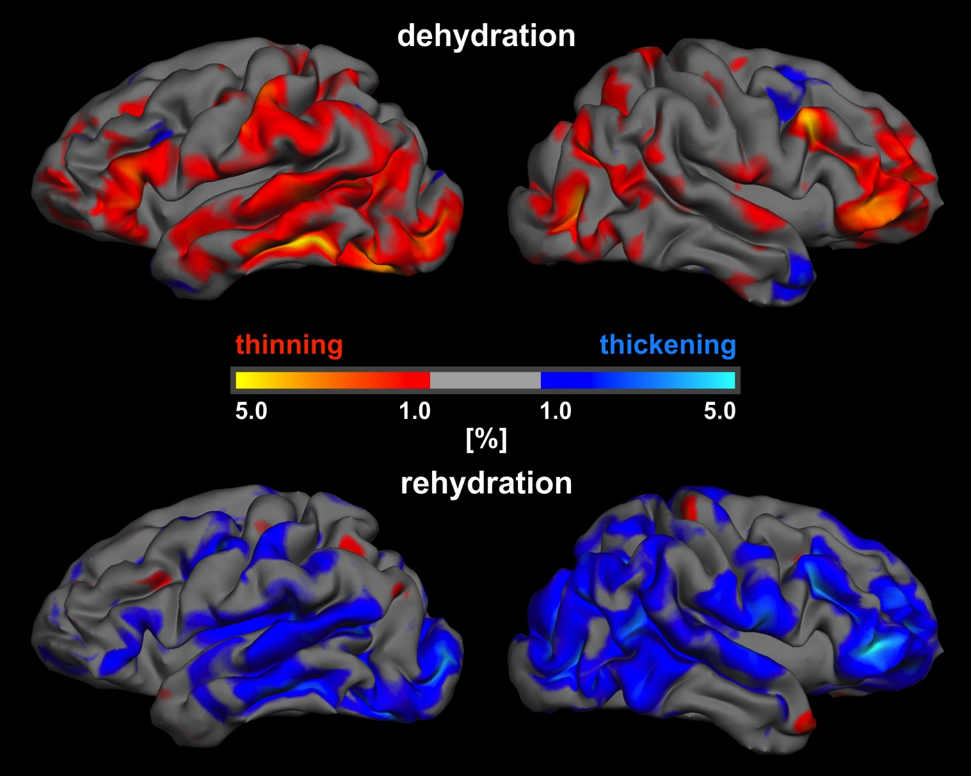
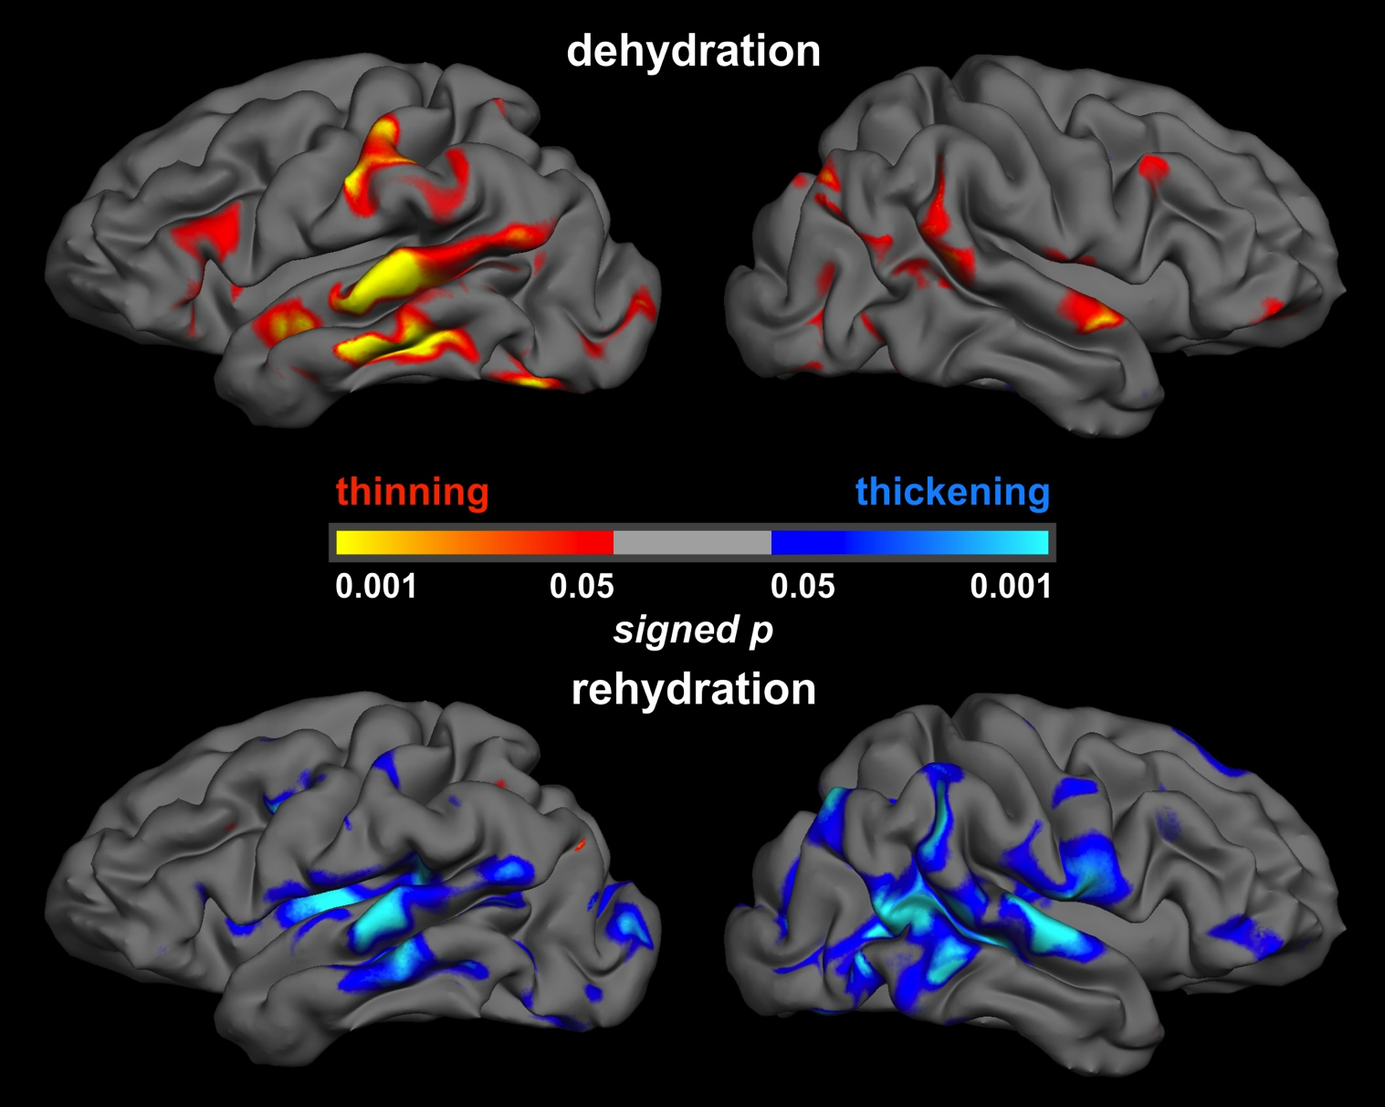
Hydration Levels
14 subjects, 12h dehydration (over night)
rehydration 1L/h
Biller et al. American Journal of Neuroradiology 2015

Slide 42
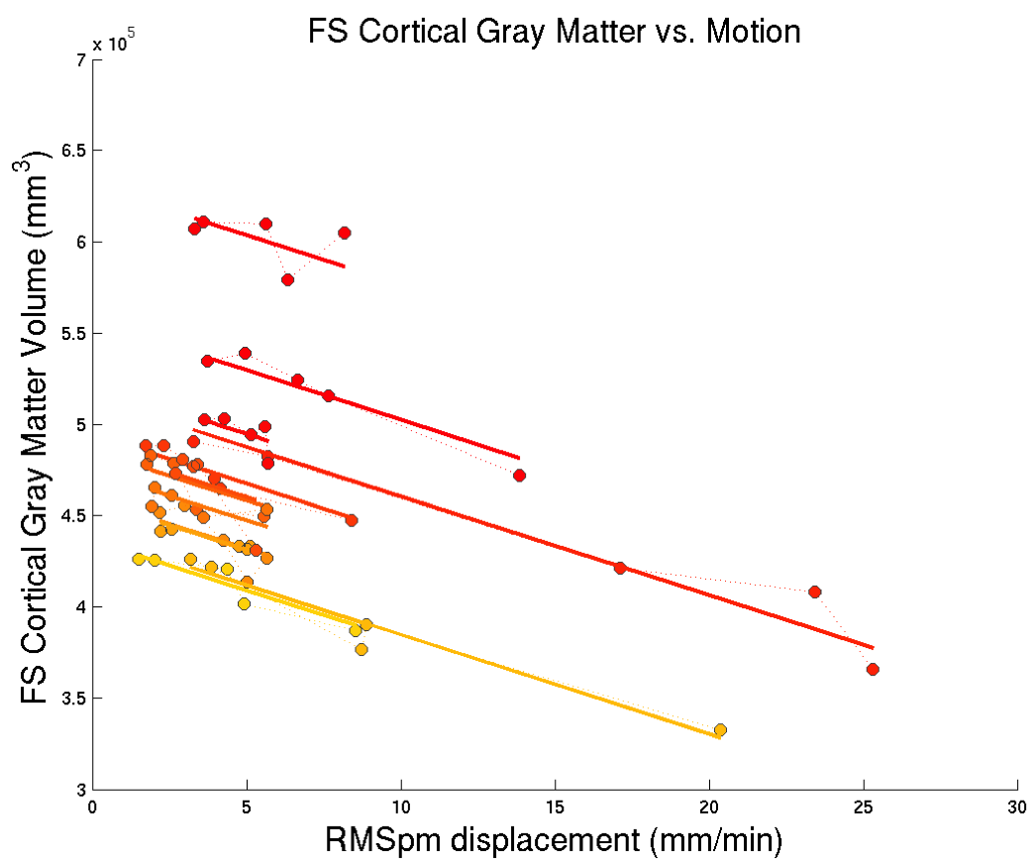
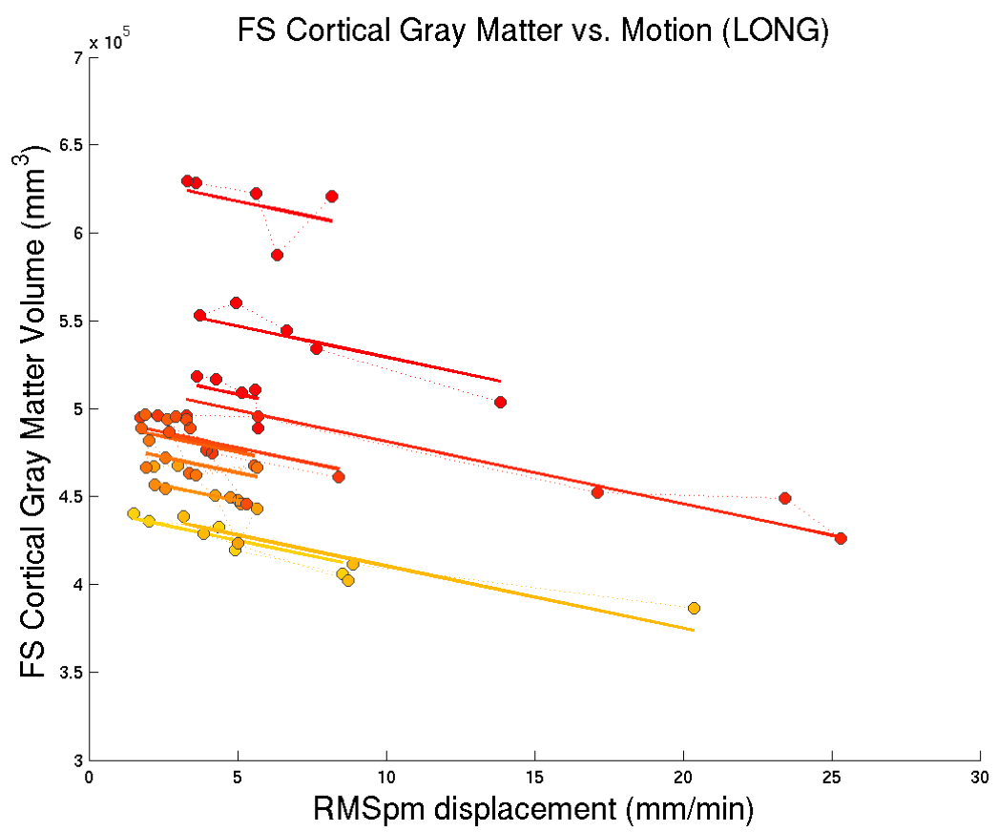
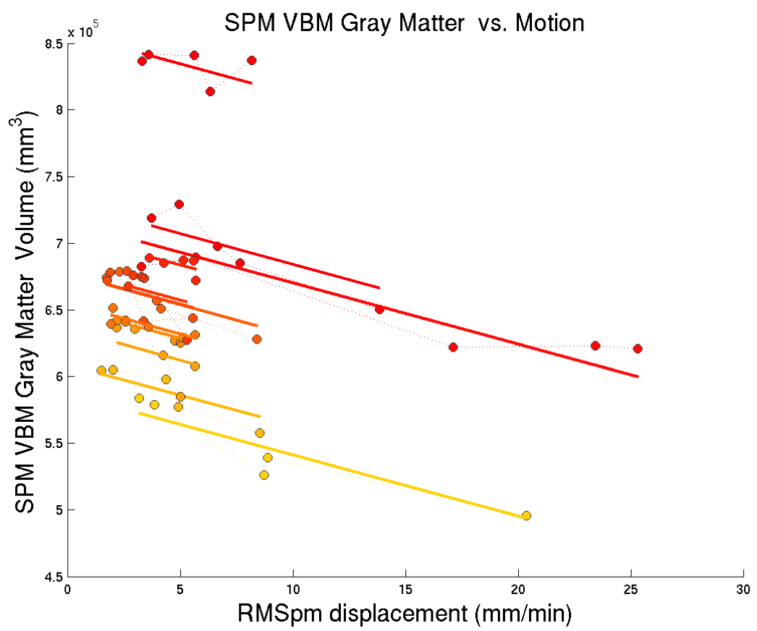
Motion Biases GM Estimates
12 volunteers
5 motion types:
  2 Still
  Nod
  Shake
  Free
Duration:
  5-15 s/min
Effect:
roughly 0.7-1% volume loss per 1mm/min increase in motion
Reuter, et al., NeuroImage 2014

Slide 43
Still to come …
    Common warps (non-linear)
    Optimized intracranial volume estimation
    Joint intensity normalization
    New thickness computation
    Joint spherical registration
http://freesurfer.net/fswiki/LongitudinalProcessing

Slide 44
Longitudinal Tutorial
How to process longitudinal data
  Three stages: CROSS, BASE, LONG
Post-processing (statistical analysis):
  (i) compute atrophy rate within each subject
  (ii) group analysis (average rates, compare)
  here: two time points, rate or percent change
Manual Edits
  Start in CROSS, do BASE, then LONGs should be fixed automatically
  Often it is enough to just edit the BASE
  See http://freesurfer.net/fswiki/LongitudinalEdits

Slide 45
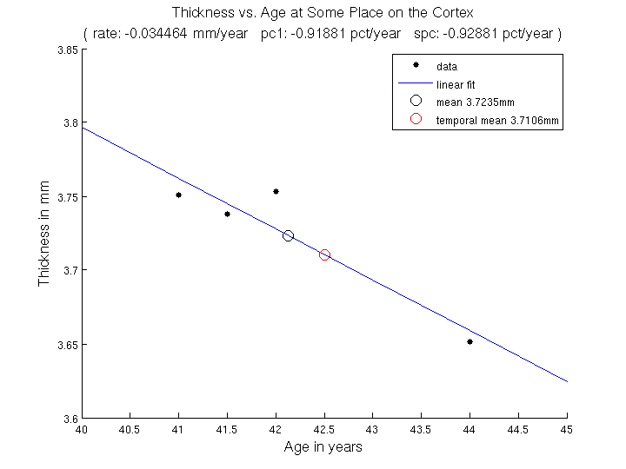
Longitudinal Tutorial
Temporal Average
Rate of Change
Percent Change (w.r.t. time 1)
Symmetrized Percent Change (w.r.t. temp. avg.)

