Slide 1
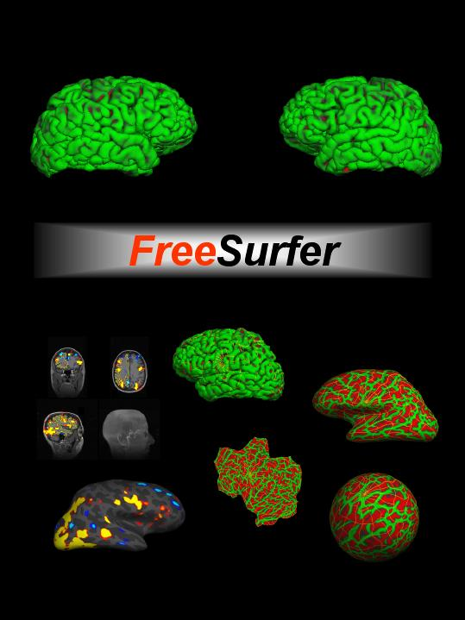
Anatomical Analysis with FreeSurfer surfer.nmr.mgh.harvard.edu
1
Notes:
Look at reconstruction steps in depth
Serves to familiarize with reconstruction steps for individual subject.
Important to be familiar with steps for intervention, QA, troubleshooting errors you may encounter.
1

Slide 2
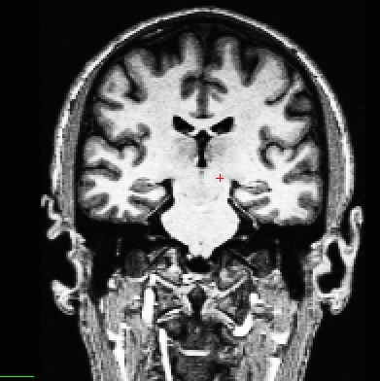
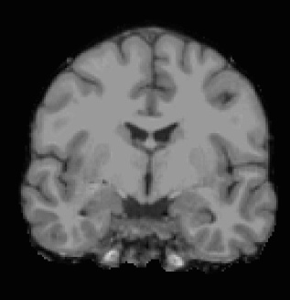
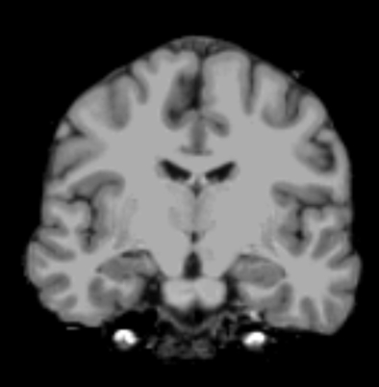
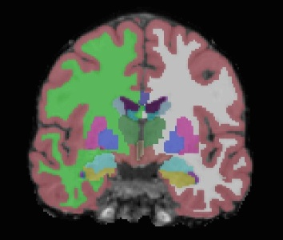
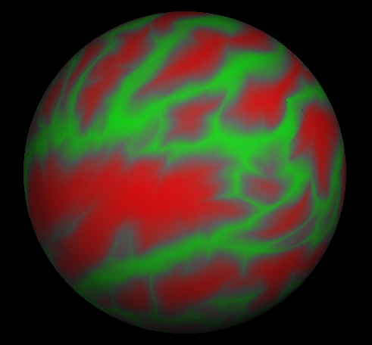
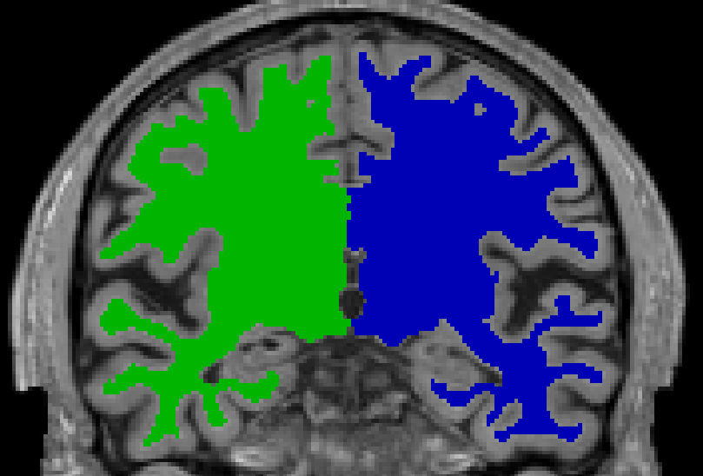
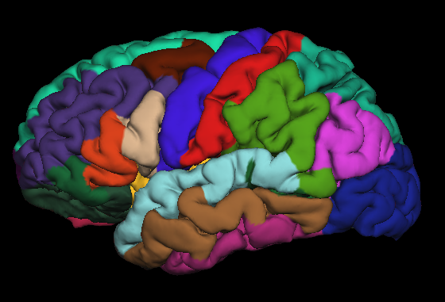
Individual Processing Stream Overview
T1 Weighted
Input
Skull Stripping
Intensity Normalization
Volumetric Labeling
Gyral Labeling
Surface Atlas
Registration
Subcortical
Mass
Stats
Surface Extraction
2
Notes:
2
-T1-weighted (wm brighter than gm)
-If higher res, gets downsampled (1mm isotropic)
-Can’t go lower than 1.5mm^3

Slide 3
Input: T1 Weighted Image
T1 Contrast: white matter brighter than gray matter
~1mm³ (no more than 1.5mm)
Higher resolution may be worse!
Full Brain
Usually one acquisition is ok
MPRAGE (ME-MP-RAGE) or SPGR
1.5T or 3T
7T might have problems
Subject age > 5 years old
Brain has no major problems (ie, tumors, parts missing)
Non-human primates possible
More MRI Pulse Sequence Parameter Details:
http://www.nmr.mgh.harvard.edu/~andre
http://adni.loni.usc.edu/methods/documents/mri-protocols
3
Notes:
3

Slide 4
Fully Automated Reconstruction
recon-all –i file.dcm –subject bert –all
4
Notes:
Command to get start reconstruction
Recon-all
Single dicom from T1 dicom series
4

Slide 5
Fully Automated Reconstruction
recon-all
–i file.dcm
–subject bert
–all
file.dcm is a single DICOM file from the T1 MRI series.
If you have more than one T1, then use:
–i file1.dcm –i file2.dcm
You can use NIFTI as well with
–i file.nii
5
Notes:
Command to get start reconstruction
Recon-all
Single dicom from T1 dicom series
5

Slide 6
Finding file.dcm is sometimes the hardest part …
DICOM files as they might look when they come off the scanner (thousands of them):
MR.1.3.12.2.1107.5.2.43.67026.201711091646082874533087 MR.1.3.12.2.1107.5.2.43.67026.2017110917191282573911820
MR.1.3.12.2.1107.5.2.43.67026.2017110916460829881533294 MR.1.3.12.2.1107.5.2.43.67026.201711091719169256012022
MR.1.3.12.2.1107.5.2.43.67026.2017110916460830223533295 MR.1.3.12.2.1107.5.2.43.67026.2017110917191928591512224
MR.1.3.12.2.1107.5.2.43.67026.2017110916460830251133297 MR.1.3.12.2.1107.5.2.43.67026.2017110917192251641412426
MR.1.3.12.2.1107.5.2.43.67026.2017110916460830839833301 MR.1.3.12.2.1107.5.2.43.67026.2017110917192596977912636
MR.1.3.12.2.1107.5.2.43.67026.201711091646083115933088 MR.1.3.12.2.1107.5.2.43.67026.201711091719291307712830
MR.1.3.12.2.1107.5.2.43.67026.2017110916460831838233312 MR.1.3.12.2.1107.5.2.43.67026.2017110917193220348113032
MR.1.3.12.2.1107.5.2.43.67026.2017110916460831854033313 MR.1.3.12.2.1107.5.2.43.67026.2017110917193543755013234
MR.1.3.12.2.1107.5.2.43.67026.2017110916460831890833314 MR.1.3.12.2.1107.5.2.43.67026.2017110917193866363913436
MR.1.3.12.2.1107.5.2.43.67026.2017110916460831999633315 MR.1.3.12.2.1107.5.2.43.67026.2017110917194188432513634
MR.1.3.12.2.1107.5.2.43.67026.2017110916460832005833316 MR.1.3.12.2.1107.5.2.43.67026.2017110917194189797813639
MR.1.3.12.2.1107.5.2.43.67026.2017110916020777318078761
You only need one, but which one is the anatomical?
recon-all
–i file.dcm
–subject bert
–all
6
Notes:
Command to get start reconstruction
Recon-all
Single dicom from T1 dicom series
6

Slide 7
Finding file.dcm is sometimes the hardest part …
DICOM files as they might look when they come off the scanner (thousands of them)
MR.1.3.12.2.1107.5.2.43.67026.201711091646082874533087 MR.1.3.12.2.1107.5.2.43.67026.2017110917191282573911820
MR.1.3.12.2.1107.5.2.43.67026.2017110916460829881533294 MR.1.3.12.2.1107.5.2.43.67026.201711091719169256012022
MR.1.3.12.2.1107.5.2.43.67026.2017110916460830223533295 MR.1.3.12.2.1107.5.2.43.67026.2017110917191928591512224
MR.1.3.12.2.1107.5.2.43.67026.2017110916460830251133297 MR.1.3.12.2.1107.5.2.43.67026.2017110917192251641412426
MR.1.3.12.2.1107.5.2.43.67026.2017110916460830839833301 MR.1.3.12.2.1107.5.2.43.67026.2017110917192596977912636
MR.1.3.12.2.1107.5.2.43.67026.201711091646083115933088 MR.1.3.12.2.1107.5.2.43.67026.201711091719291307712830
MR.1.3.12.2.1107.5.2.43.67026.2017110916460831838233312 MR.1.3.12.2.1107.5.2.43.67026.2017110917193220348113032
MR.1.3.12.2.1107.5.2.43.67026.2017110916460831854033313 MR.1.3.12.2.1107.5.2.43.67026.2017110917193543755013234
MR.1.3.12.2.1107.5.2.43.67026.2017110916460831890833314 MR.1.3.12.2.1107.5.2.43.67026.2017110917193866363913436
MR.1.3.12.2.1107.5.2.43.67026.2017110916460831999633315 MR.1.3.12.2.1107.5.2.43.67026.2017110917194188432513634
MR.1.3.12.2.1107.5.2.43.67026.2017110916460832005833316 MR.1.3.12.2.1107.5.2.43.67026.2017110917194189797813639
MR.1.3.12.2.1107.5.2.43.67026.2017110916020777318078761
Use dcmunpack, eg,
dcmunpack –src /path/to/dicoms
Example output of dcmunpack
1 Localizer 3 40 15 1.171875\1.171875 MR.1.3.12.2.1107.5.2.43.67026.2017110915514228348456487
2 AAHScout 1.37 3.15 8 1.625\1.625 ROW 540 MR.1.3.12.2.1107.5.2.43.67026.2017110915520120516357516
3 AAHScout_MPR_sag 1.37 3.15 8 1.60000002384\1.60000002384 unknown 540 MR.1.3.12.2.1107.5.2.43.67026.2017110915520123687057660
4 AAHScout_MPR_cor 1.37 3.15 8 1.60000002384\1.60000002384 unknown 540 MR.1.3.12.2.1107.5.2.43.67026.2017110915520123821357667
5 AAHScout_MPR_tra 1.37 3.15 8 1.60000002384\1.60000002384 unknown 540 MR.1.3.12.2.1107.5.2.43.67026.2017110915520123877057670
6 Localizer_aligned 3 104 15 1.171875\1.171875 ROW 260 MR.1.3.12.2.1107.5.2.43.67026.2017110915522716700857682
7 T1w_setter 4.6 9.9 2 unknown ROW 5210 MR.1.3.12.2.1107.5.2.43.67026.201711091554416141157795
8 T1w_setter 4.6 9.9 7 unknown ROW 650 MR.1.3.12.2.1107.5.2.43.67026.2017110916004795330874762
9 T1w_MPR_vNav_4e 3.55 2530 7 unknown ROW 650 MR.1.3.12.2.1107.5.2.43.67026.2017110916021229775680242
10 T1w_MPR_vNav_4e 7.27 2530 7 unknown ROW 650 MR.1.3.12.2.1107.5.2.43.67026.2017110916020532284777889
11 T1w_MPR_vNav_4e 3.55 2530 7 unknown ROW 650 MR.1.3.12.2.1107.5.2.43.67026.2017110916021487561780704
12 T1w_MPR_vNav_4eRMS 1.69 2530 7 unknown ROW 650 MR.1.3.12.2.1107.5.2.43.67026.2017110916021957542181407
13 T1w_MPR_vNav_4eRMS 1.69 2530 7 unknown ROW 650 MR.1.3.12.2.1107.5.2.43.67026.2017110916020777318078761
MP-RAGE T1 Protocol
This will be different for everyone
You will have to know what this name is
7
Notes:
Command to get start reconstruction
Recon-all
Single dicom from T1 dicom series
7

Slide 8
Finding file.dcm is sometimes the hardest part …
DICOM files as they might look when they come off the scanner (thousands of them)
MR.1.3.12.2.1107.5.2.43.67026.201711091646082874533087 MR.1.3.12.2.1107.5.2.43.67026.2017110917191282573911820
MR.1.3.12.2.1107.5.2.43.67026.2017110916460829881533294 MR.1.3.12.2.1107.5.2.43.67026.201711091719169256012022
MR.1.3.12.2.1107.5.2.43.67026.2017110916460830223533295 MR.1.3.12.2.1107.5.2.43.67026.2017110917191928591512224
MR.1.3.12.2.1107.5.2.43.67026.2017110916460830251133297 MR.1.3.12.2.1107.5.2.43.67026.2017110917192251641412426
MR.1.3.12.2.1107.5.2.43.67026.2017110916460830839833301 MR.1.3.12.2.1107.5.2.43.67026.2017110917192596977912636
MR.1.3.12.2.1107.5.2.43.67026.201711091646083115933088 MR.1.3.12.2.1107.5.2.43.67026.201711091719291307712830
MR.1.3.12.2.1107.5.2.43.67026.2017110916460831838233312 MR.1.3.12.2.1107.5.2.43.67026.2017110917193220348113032
MR.1.3.12.2.1107.5.2.43.67026.2017110916460831854033313 MR.1.3.12.2.1107.5.2.43.67026.2017110917193543755013234
MR.1.3.12.2.1107.5.2.43.67026.2017110916460831890833314 MR.1.3.12.2.1107.5.2.43.67026.2017110917193866363913436
MR.1.3.12.2.1107.5.2.43.67026.2017110916460831999633315 MR.1.3.12.2.1107.5.2.43.67026.2017110917194188432513634
MR.1.3.12.2.1107.5.2.43.67026.2017110916460832005833316 MR.1.3.12.2.1107.5.2.43.67026.2017110917194189797813639
MR.1.3.12.2.1107.5.2.43.67026.2017110916020777318078761
Use dcmunpack, eg,
dcmunpack –src /path/to/dicoms
Example output of dcmunpack
1 Localizer 3 40 15 1.171875\1.171875 MR.1.3.12.2.1107.5.2.43.67026.2017110915514228348456487
2 AAHScout 1.37 3.15 8 1.625\1.625 ROW 540 MR.1.3.12.2.1107.5.2.43.67026.2017110915520120516357516
3 AAHScout_MPR_sag 1.37 3.15 8 1.60000002384\1.60000002384 unknown 540 MR.1.3.12.2.1107.5.2.43.67026.2017110915520123687057660
4 AAHScout_MPR_cor 1.37 3.15 8 1.60000002384\1.60000002384 unknown 540 MR.1.3.12.2.1107.5.2.43.67026.2017110915520123821357667
5 AAHScout_MPR_tra 1.37 3.15 8 1.60000002384\1.60000002384 unknown 540 MR.1.3.12.2.1107.5.2.43.67026.2017110915520123877057670
6 Localizer_aligned 3 104 15 1.171875\1.171875 ROW 260 MR.1.3.12.2.1107.5.2.43.67026.2017110915522716700857682
7 T1w_setter 4.6 9.9 2 unknown ROW 5210 MR.1.3.12.2.1107.5.2.43.67026.201711091554416141157795
8 T1w_setter 4.6 9.9 7 unknown ROW 650 MR.1.3.12.2.1107.5.2.43.67026.2017110916004795330874762
9 T1w_MPR_vNav_4e 3.55 2530 7 unknown ROW 650 MR.1.3.12.2.1107.5.2.43.67026.2017110916021229775680242
10 T1w_MPR_vNav_4e 7.27 2530 7 unknown ROW 650 MR.1.3.12.2.1107.5.2.43.67026.2017110916020532284777889
11 T1w_MPR_vNav_4e 3.55 2530 7 unknown ROW 650 MR.1.3.12.2.1107.5.2.43.67026.2017110916021487561780704
12 T1w_MPR_vNav_4eRMS 1.69 2530 7 unknown ROW 650 MR.1.3.12.2.1107.5.2.43.67026.2017110916021957542181407
13 T1w_MPR_vNav_4eRMS 1.69 2530 7 unknown ROW 650 MR.1.3.12.2.1107.5.2.43.67026.2017110916020777318078761
A single DICOM file that belongs to the MPRAGE series (there might be several hundred; you only need one).
8
Notes:
Command to get start reconstruction
Recon-all
Single dicom from T1 dicom series
8

Slide 9
Finding file.dcm is sometimes the hardest part …
DICOM files as they might look when they come off the scanner (thousands of them)
MR.1.3.12.2.1107.5.2.43.67026.201711091646082874533087 MR.1.3.12.2.1107.5.2.43.67026.2017110917191282573911820
MR.1.3.12.2.1107.5.2.43.67026.2017110916460829881533294 MR.1.3.12.2.1107.5.2.43.67026.201711091719169256012022
MR.1.3.12.2.1107.5.2.43.67026.2017110916460830223533295 MR.1.3.12.2.1107.5.2.43.67026.2017110917191928591512224
MR.1.3.12.2.1107.5.2.43.67026.2017110916460830251133297 MR.1.3.12.2.1107.5.2.43.67026.2017110917192251641412426
MR.1.3.12.2.1107.5.2.43.67026.2017110916460830839833301 MR.1.3.12.2.1107.5.2.43.67026.2017110917192596977912636
MR.1.3.12.2.1107.5.2.43.67026.201711091646083115933088 MR.1.3.12.2.1107.5.2.43.67026.201711091719291307712830
MR.1.3.12.2.1107.5.2.43.67026.2017110916460831838233312 MR.1.3.12.2.1107.5.2.43.67026.2017110917193220348113032
MR.1.3.12.2.1107.5.2.43.67026.2017110916460831854033313 MR.1.3.12.2.1107.5.2.43.67026.2017110917193543755013234
MR.1.3.12.2.1107.5.2.43.67026.2017110916460831890833314 MR.1.3.12.2.1107.5.2.43.67026.2017110917193866363913436
MR.1.3.12.2.1107.5.2.43.67026.2017110916460831999633315 MR.1.3.12.2.1107.5.2.43.67026.2017110917194188432513634
MR.1.3.12.2.1107.5.2.43.67026.2017110916460832005833316 MR.1.3.12.2.1107.5.2.43.67026.2017110917194189797813639
MR.1.3.12.2.1107.5.2.43.67026.2017110916020777318078761
Use dcmunpack, eg,
dcmunpack –src /path/to/dicoms
Example output of dcmunpack
1 Localizer 3 40 15 1.171875\1.171875 MR.1.3.12.2.1107.5.2.43.67026.2017110915514228348456487
2 AAHScout 1.37 3.15 8 1.625\1.625 ROW 540 MR.1.3.12.2.1107.5.2.43.67026.2017110915520120516357516
3 AAHScout_MPR_sag 1.37 3.15 8 1.60000002384\1.60000002384 unknown 540 MR.1.3.12.2.1107.5.2.43.67026.2017110915520123687057660
4 AAHScout_MPR_cor 1.37 3.15 8 1.60000002384\1.60000002384 unknown 540 MR.1.3.12.2.1107.5.2.43.67026.2017110915520123821357667
5 AAHScout_MPR_tra 1.37 3.15 8 1.60000002384\1.60000002384 unknown 540 MR.1.3.12.2.1107.5.2.43.67026.2017110915520123877057670
6 Localizer_aligned 3 104 15 1.171875\1.171875 ROW 260 MR.1.3.12.2.1107.5.2.43.67026.2017110915522716700857682
7 T1w_setter 4.6 9.9 2 unknown ROW 5210 MR.1.3.12.2.1107.5.2.43.67026.201711091554416141157795
8 T1w_setter 4.6 9.9 7 unknown ROW 650 MR.1.3.12.2.1107.5.2.43.67026.2017110916004795330874762
9 T1w_MPR_vNav_4e 3.55 2530 7 unknown ROW 650 MR.1.3.12.2.1107.5.2.43.67026.2017110916021229775680242
10 T1w_MPR_vNav_4e 7.27 2530 7 unknown ROW 650 MR.1.3.12.2.1107.5.2.43.67026.2017110916020532284777889
11 T1w_MPR_vNav_4e 3.55 2530 7 unknown ROW 650 MR.1.3.12.2.1107.5.2.43.67026.2017110916021487561780704
12 T1w_MPR_vNav_4eRMS 1.69 2530 7 unknown ROW 650 MR.1.3.12.2.1107.5.2.43.67026.2017110916021957542181407
13 T1w_MPR_vNav_4eRMS 1.69 2530 7 unknown ROW 650 MR.1.3.12.2.1107.5.2.43.67026.2017110916020777318078761
recon-all –i MR.1.3.12.2.1107.5.2.43.67026.2017110916020777318078761
–subject bert –all
https://surfer.nmr.mgh.harvard.edu/fswiki/FsTutorial/Practice
9
Notes:
Command to get start reconstruction
Recon-all
Single dicom from T1 dicom series
9

Slide 10
Fully Automated Reconstruction
“bert” is the “name” of the subject
Creates a folder in $SUBJECTS_DIR
All output goes in this folder (~400MB)
Other subjects in $SUBJECTS_DIR
recon-all
–i file.dcm
–subject bert
–all
$SUBJECTS_DIR
bert
ernie
fsaverage …
setenv SUBJECTS_DIR /path/to/space
10
Notes:
Command to get start reconstruction
Recon-all
Single dicom from T1 dicom series
10

Slide 11
Fully Automated Reconstruction
recon-all
–i file.dcm
–subject bert
–all
-all means to do everything!
Can take 10-13 hours (next version about half that time)
Later, we will show you how to run subsets of the processing stream to make it faster when correcting errors.
11
Notes:
Command to get start reconstruction
Recon-all
Single dicom from T1 dicom series
11

Slide 12
Upon Completion…
$SUBJECTS_DIR/bert
scripts mri surf label stats
recon-all –i file.dcm –subject bert –all
~400MB
12
Notes:
12
-bert is ID, dirs underneath bert created automatically.
-Most important ones: stats, mri, scripts(logs)
-a lot of files stored here are in a format called…

Slide 13
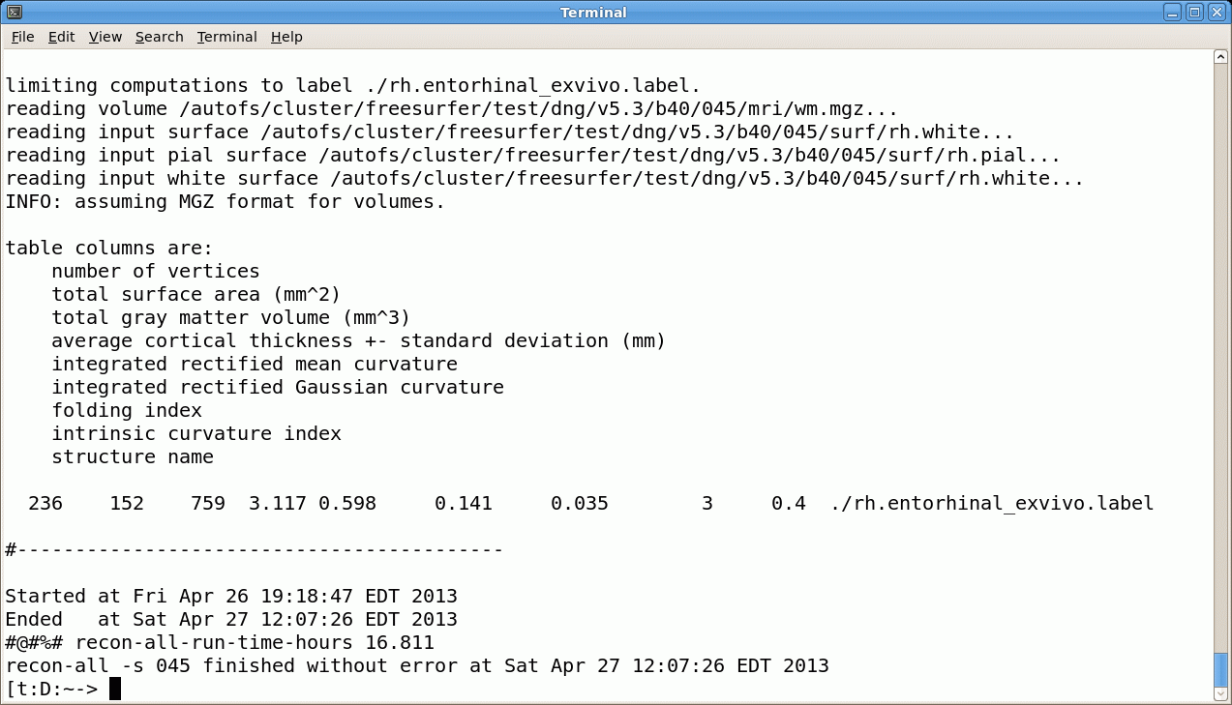
Upon Completion…
bert
scripts mri surf label stats
recon-all.log
recon-all.done
Just because it finishes “without error” does not mean that everything is ok!
Send us recon-all.log when you have problems! freesurfer@nmr.mgh.harvard.edu
13
Notes:
13
-bert is ID, dirs underneath bert created automatically.
-Most important ones: stats, mri, scripts(logs)
-a lot of files stored here are in a format called…

Slide 14
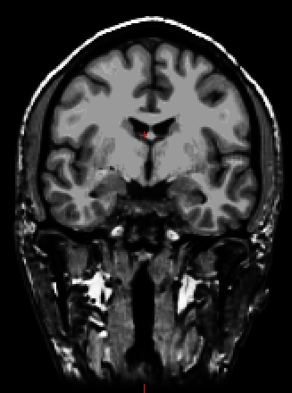
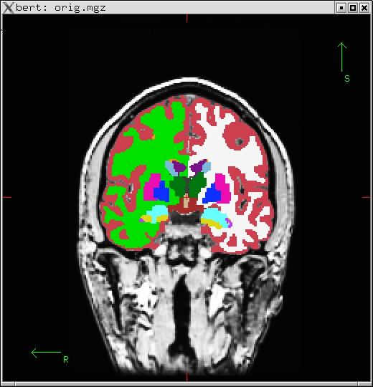
Upon Completion…
bert
scripts mri surf label stats
rawavg.mgz
orig.mgz
T1.mgz
brainmask.mgz
aseg.mgz
filled.mgz
others: nu.mgz, norm.mgz, wmparc.mgz, aparc+aseg.mgz, ribbon.mgz
mgz = “compressed mgh” format (like nifti) unique to FreeSurfer
14
Notes:
14
-bert is ID, dirs underneath bert created automatically.
-Most important ones: stats, mri, scripts(logs)
-a lot of files stored here are in a format called…

Slide 15
Upon Completion…
bert
scripts mri surf label stats
rawavg.mgz
orig.mgz
T1.mgz
brainmask.mgz
aseg.mgz
filled.mgz
Native Anatomical Space
eg, 1x1x1.2mm³ , 256x256x128
“Conformed” Anatomical Space
1x1x1mm³ , 256x256x256
15
Notes:
15
-bert is ID, dirs underneath bert created automatically.
-Most important ones: stats, mri, scripts(logs)
-a lot of files stored here are in a format called…

Slide 16
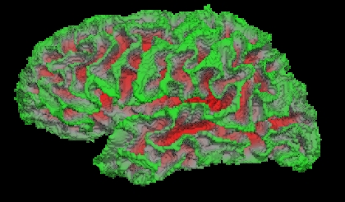
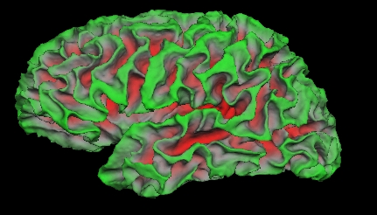
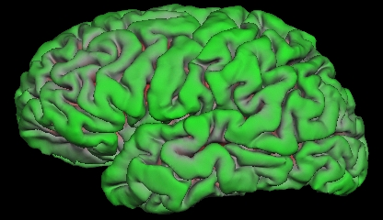
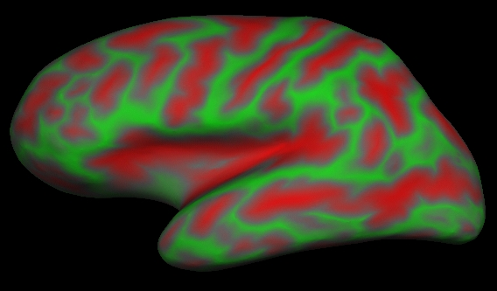
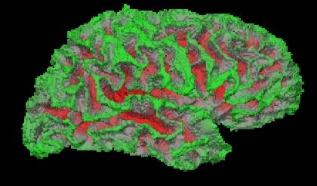
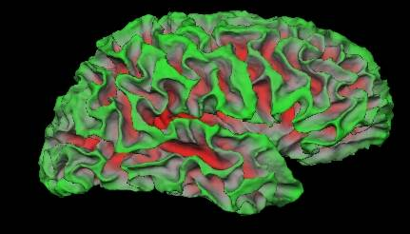
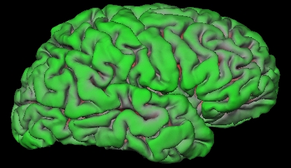
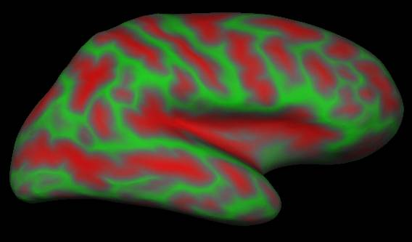
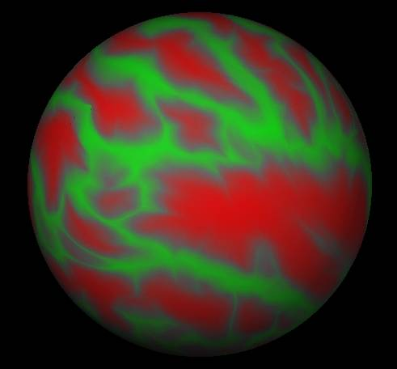
Upon Completion…
bert
scripts mri surf label stats
lh.orig
lh.white
lh.pial
lh.inflated
lh.sphere.reg
rh.inflated
rh.orig
rh.white
rh.pial
rh.sphere.reg
lh.thickness and rh.thickness, ?h.curv, ?h.sulc
16
Notes:
16
-bert is ID, dirs underneath bert created automatically.
-Most important ones: stats, mri, scripts(logs)
-a lot of files stored here are in a format called…

Slide 17
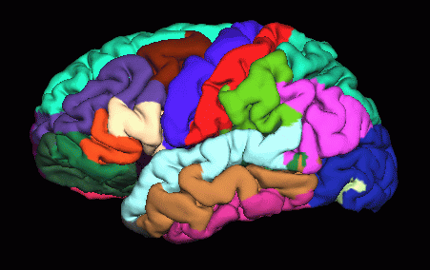
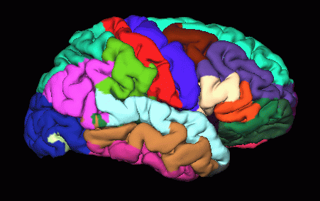
Upon Completion…
bert
scripts mri surf label stats
lh.aparc.annot
lh.aparc.a2009s.annot
rh.aparc.annot
rh.aparc.a2009s.annot
Desikan/Killiany Atlas
Destrieux Atlas
17
Notes:
17
-bert is ID, dirs underneath bert created automatically.
-Most important ones: stats, mri, scripts(logs)
-a lot of files stored here are in a format called…

Slide 18
Upon Completion…
bert
scripts mri surf label stats
aseg.stats – subcortical volumetric stats
wmparc.stats – white matter segmentation volumetric stats
lh.aparc.stats – left hemi Desikan/Killiany surface stats
rh.aparc.stats – right hemi Desikan/Killiany surface stats
lh.aparc.a2009.stats – left hemi Destrieux
rh.aparc.a2009.stats – right hemi Destrieux
stats files are text files with summary information, eg:
volume of left amygdala
average thickness in superior temporal gyrus
18
Notes:
18
-bert is ID, dirs underneath bert created automatically.
-Most important ones: stats, mri, scripts(logs)
-a lot of files stored here are in a format called…

Slide 19
Some of the Processing Steps…
19
Notes:
19

Slide 20
Conform Step
Native Anatomical Space 1x1x1.1mm, 256x256x128, Sag
Conformed Anatomical Space 1x1x1mm, 256x256x256, Cor
bert
“Anatomical Space”
orig.mgz
Surfaces
Parcellations
Segmentations
rawavg.mgz
mri
rawavg.mgz
orig.mgz
20

Slide 21
Talairach Transform
Computes 12 DOF transform matrix
Does NOT resample to Talaiarch space!
MNI305 template
Mostly used to report coordinates
bert
scripts mri surf label stats
transforms
talairach.xfm → text file with matrix
21
Notes:
computes transformation matrix, using MNI305 template, not resampling – just transform
Tells FS how to get from anatomical space -> MNI space (contains talairach labels)
Montreal Neurological Institute
21

Slide 22
Intensity Bias/Normalization
bert
mri
T1.mgz
Raw Data
Corrected (T1.mgz)
Outside of image is much brighter than inside (coils)
Worse with many coils
Makes gray/white segmentation difficult
Intensity Normalization (aka “Bias Correction”)
22
Notes:
-Remove bias from the coil. brain areas closer to coil are brighter than others, get rid of bias.
-Hard to see with human eye, demonstrates map of intensity bias. Want to make it uniform.
-No coils in middle of brain (poorer SNR, CNR).
22

Slide 23
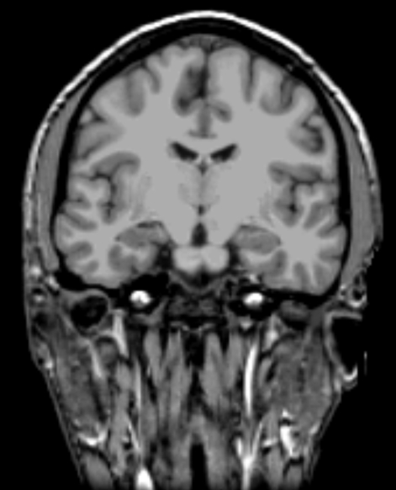
Skull Strip
Removes all non-brain
Skull, Eyes, Neck, Dura
brainmask.mgz (cf, brain.mgz)
bert
mri
brainmask.mgz
brainmask.mgz
T1.mgz
23
Notes:
remove non brain areas, gives us brainmask (work with it a lot). Again, helps with wm/gm seg

Slide 24
Automatic Volume Labeling
Used to fill in subcortical structures for creating subcortical mass
Useful in its own right
aseg.mgz
More in ROI Talk
bert
mri
ASeg Volume
Atlas:
$FREESURFER_HOME/average/RB_all_2016-05-10.vc700.gca
aseg.mgz
24
Notes:
-Automatic segmentation (multi source of info), known intensity profiles, neighborhood relations, probability of voxel label given spatial location
-get stats for subcortical structures
Several papers on FS wiki detailing sub-cortical segmentation in FS
See ROI talk online, plus tutorial
24

Slide 25
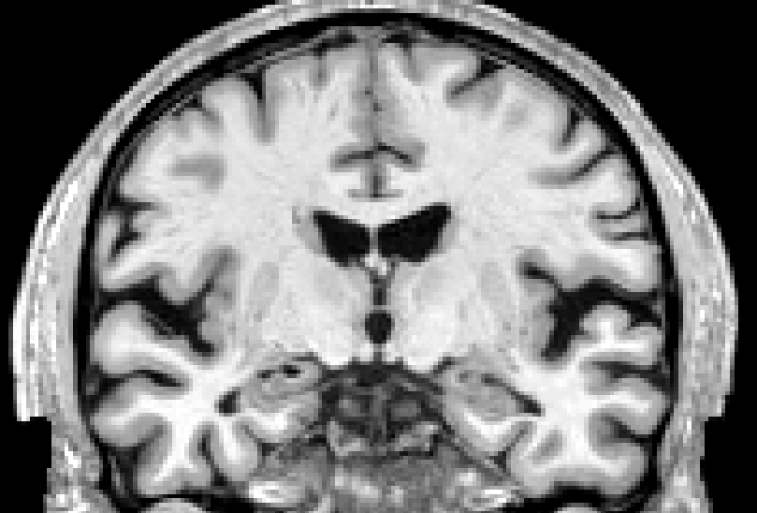
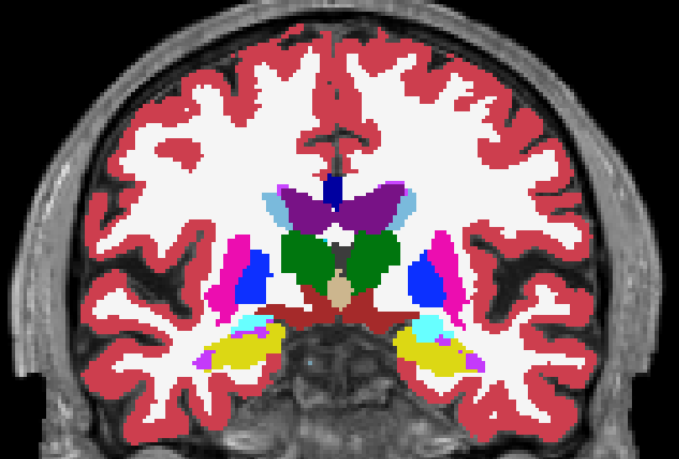
“Subcortical Mass” (filled.mgz)
Everything inside the cortical surface
WM, most subcortical GM: putamen, pallidum, thalamus, caudate, ventral DC, most non-ventricular CSF.
Excludes: hippocampus, brainstem, cerebellum, 3rd and 4th ventricles, parts of inferior lateral ventricles
Fills in any holes
Separates hemispheres (left=blue=255, right=green=128)
25
Notes:
Final step: prepare for generating wm surf
Separate mask, one side per hemi, each hemi gets separate surface.
25

Slide 26
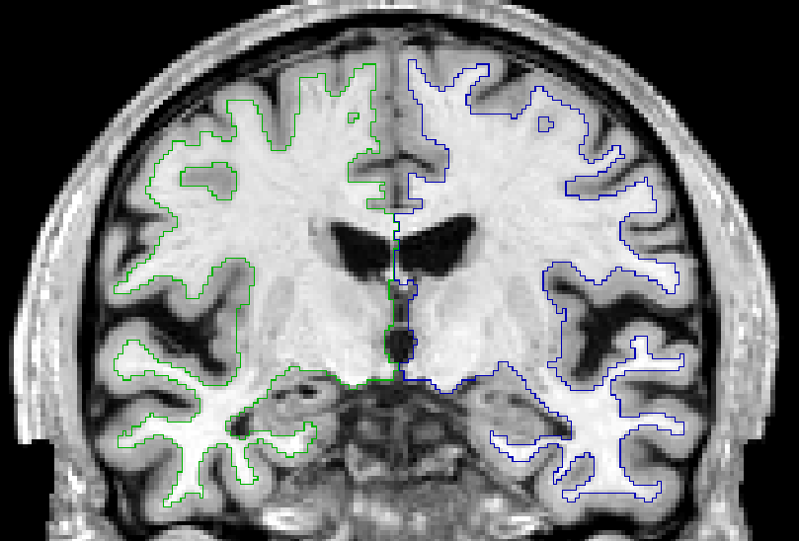
“Subcortical Mass” (filled.mgz)
bert
mri
Proto surface
Still a volume
Editable
filled.mgz
26
Notes:
Final step: prepare for generating wm surf
Separate mask, one side per hemi, each hemi gets separate surface.
26

Slide 27
Surface Extraction
Fit to filled.mgz
1mm resolution
Rough, jagged
One for each hemisphere
filled.mgz
bert
surf
lh.orig.nofix
rh.orig.nofix
lh.orig.nofix
rh.orig.nofix
27
Notes:
27
-label all wm, fills in ventricles and other structures based on aseg. Mask to extract wm.
Ventricles are filled in (as are the other subcortical structures).
Set of histograms in axial/horizontal plane, highest peak in each histo near center of image classified as wm (most voxels), checks across slices to make sure classification consistent, centers wm intensities on 110.

Slide 28
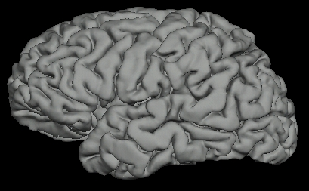
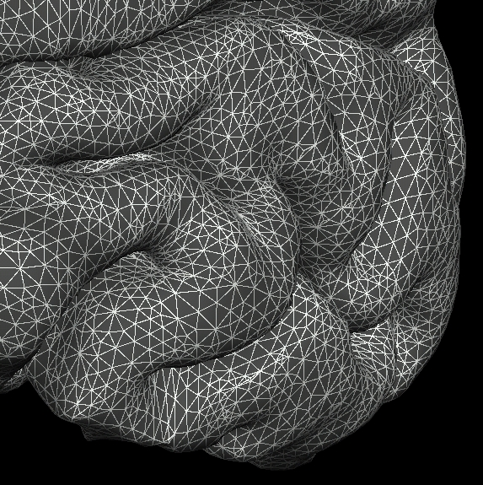
Surface Model
Mesh (“Finite Element”)
Vertex = point of triangles
Neighborhood
XYZ at each vertex
Triangles/Faces ~ 300,000
Vertices ~ 140,000
Area, Distance
Curvature, Thickness
28
Notes:
28
-mesh allows FS to get various measurements
-all triangles meet at various points called vertices – measurements stored there (area = area of all triangles)
-XYZ - each vertex has a label (important for cross-subject reg)
Once the xyz of each corner of each triangle is known, then it is possible to characterize the entire cortical surface in terms of area, distance, curvature, and thickness.
The cortical surface is represented by a finite element model using triangles to cover the cortical surface. The reconstruction is the (mostly automated) process of assigning an xyz to each corner of each triangle.

Slide 29
Volume vs Surface Model
Volume
uniform grid
voxel is an intersection of grid lines
columns, rows, slices
voxel size/distance
voxel assigned a value
XYZ
Surface
NON-uniform grid
vertex is an intersection of triangles
each vertex has an index
distance between vertices ~1mm
vertex assigned a value
XYZ
Vector of vertex values (~140,000)
29
Notes:
29

Slide 30
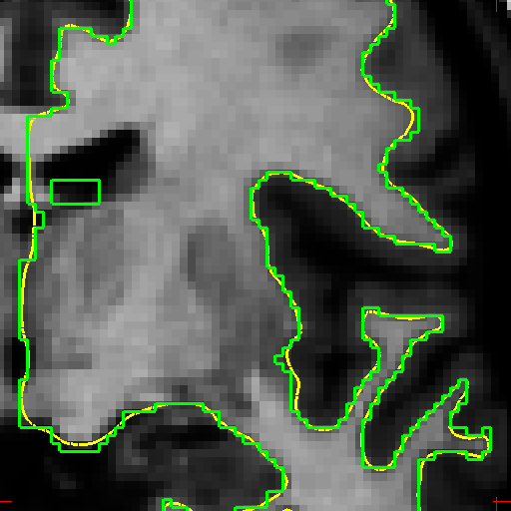
White Matter Surface
Nudge orig surface
Follow T1 intensity gradients
Smoothness constraint
Vertex identity preserved
orig surface
white surface
subject/surf/lh.white, rh.white
30
Notes:
30

Slide 31
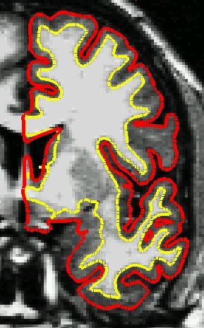
Pial Surface
Nudge white surface
Follow T1 intensity gradients
Vertex identity preserved
subject/surf/lh.pial, rh.pial
31
Notes:
Use finalized wm as starting point, pial grow out from wm surf, find fall off of gm and CSF,
31

Slide 32
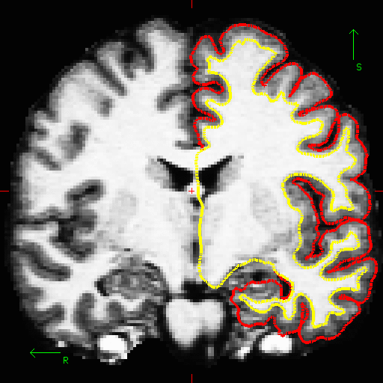
Pial surf grows from white surf

Slide 33
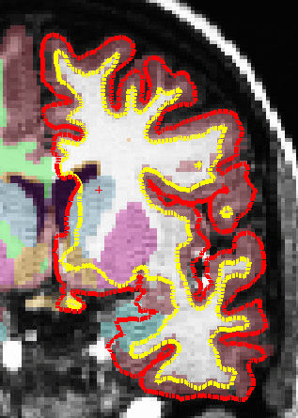
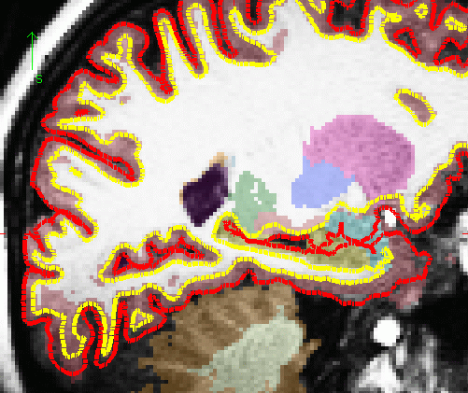
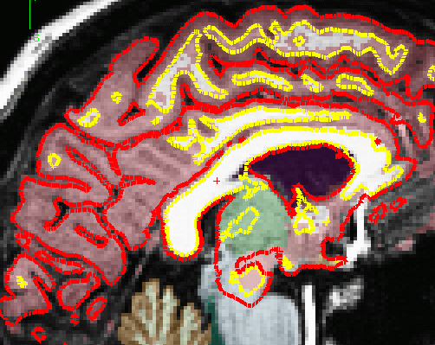
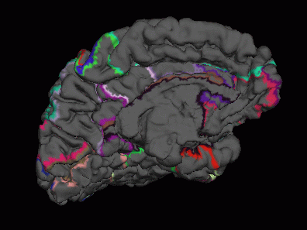
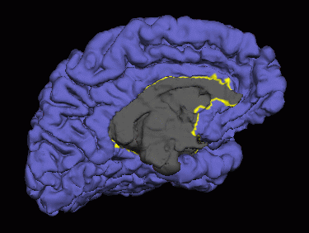
Non-Cortical Areas of Surface
Amygdala, Putamen, Hippocampus, Caudate, Ventricles, CC
?h.cortex.label
33
Notes:
certain part of medial wall not included in any cortical measures. Filled in to create continuous surface, makes certain calculations easier
image of masked out area,
view in three different planes.
33

Slide 34
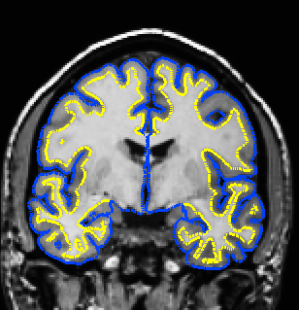
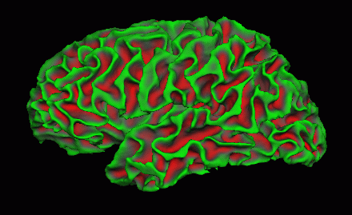
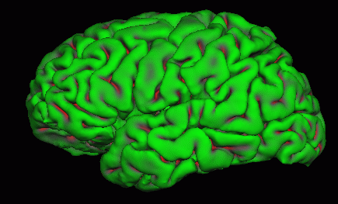
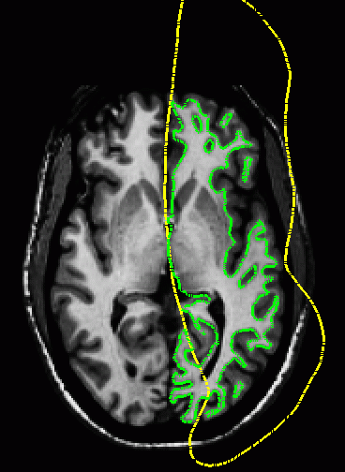
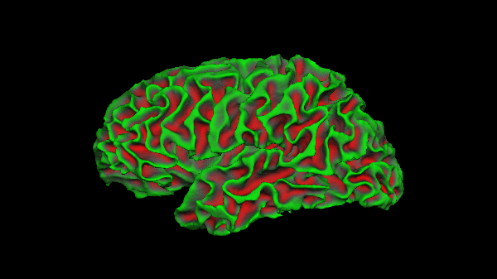
Inflation: 2D Surface in 3D Space
White Surface
Pial Surface
Nudge vertices
No intensity constraint
See inside sulci
Used for sphere
34
Notes:
34

Slide 35
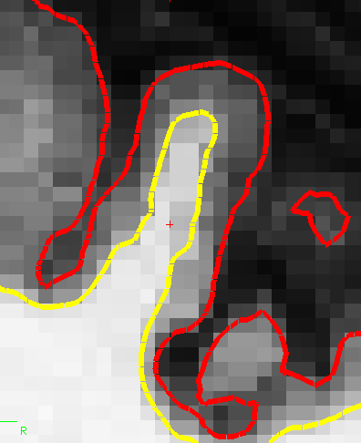
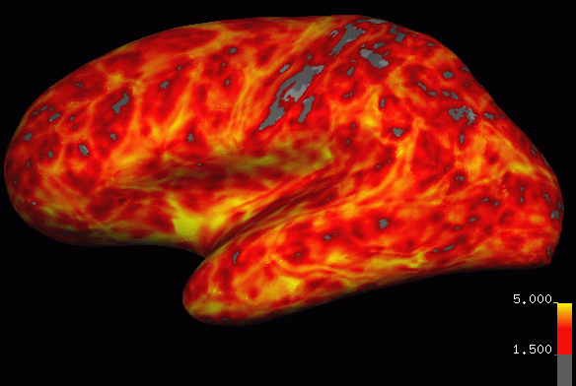
Cortical Thickness
Distance between white and pial surfaces
One value per vertex
Surface-based more accurate than volume-based
pial surface
mm
“Overlay”, “Heat map”
white/gray surface
lh.thickness, rh.thickness
35
Notes:
-Now that you have wm & pial surfs…get cort meas
-calculates cort thick, distance between vertices on wm and gm. blue dots are vertices (indicated by). dist from wm to gm, and gm to wm and takes average.
35

Slide 36
Curvature (Radial)
Circle tangent to surface at each vertex
Curvature measure is 1/radius of circle
One value per vertex
Signed (sulcus/gyrus)
subject/surf/lh.curv, rh.curv
“Overlay”, “Red/Green”
36
Notes:
-there is a curvature for pial surface and curvature for white surface at every vertex
Curvature = ratio , 1/radius of circle best matches what’s going on at each vertex in all directions
-indicates how curvy at each vertex (not sulcul depth).
How bumpy, nothing to do with sulci/gyri
36

Slide 37
Surface-based Area and Volume
Each vertex has an area (mean of triangles)
Each vertex has a thickness
Each vertex has a volume (~area*thickness)
Group Map-based analysis of area and volume
Similar to Voxel-based morphometry (VBM)
subject/surf/lh.area, lh.volume
37
Notes:
37

Slide 38
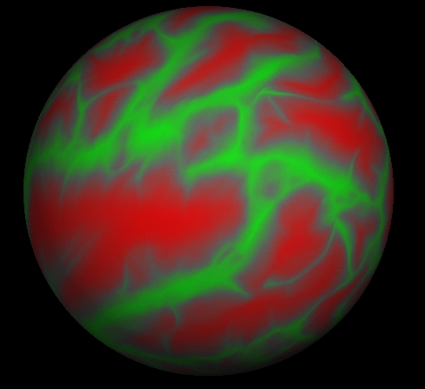
Spherical Registration
lh.sphere.reg, rh.sphere.reg
Sulcal Map
Spherical Inflation
High-Dimensional
Non-linear
Registration to
Spherical Template
lh.sphere, rh.sphere
Atlas template is called “fsaverage”
More in surface-based analysis talk.
38
Notes:
38
main reason to use FS, this stage (important slide).
Now we have surfs that can be inflated, (a) inflate to sphere, (b) align to template, (c) then put subject back into original space.
Template = fsaverage (40 adults ranging in age), we do not recommend processing MRI datasets with subjects younger than 4/5 years of age. Atlas built using adult data, prior information related to intensities and structures not representative of younger populations. Pediatric atlas is in the works (Lilla).

Slide 39
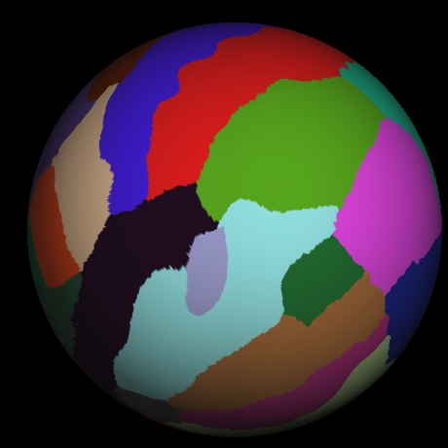
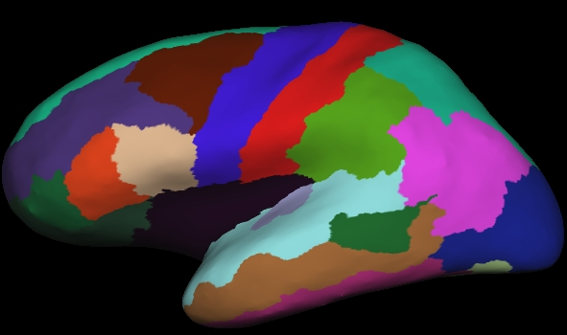
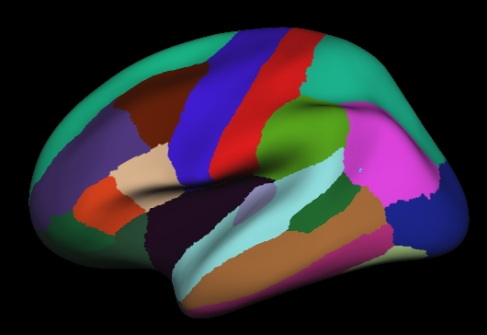
Automatic Cortical Parcellation
Spherical Atlas based on Manual Labeling
subject/label/{lh,rh}.aparc.annot
Map to Individual
Thru Spherical Reg
Fine-tune based on
individual anatomy
Note: Similar methodology to volume labeling
More in the Anatomical ROI talk
Annotation overlay
39
Notes:
-subject aligned to spherical atlas, take labels from cortparc atlas and apply to individ subject, since anatomical boundaries are matched up.
not just throwing labels on there, using individual anatomy to fine tune labels.
39

Slide 40
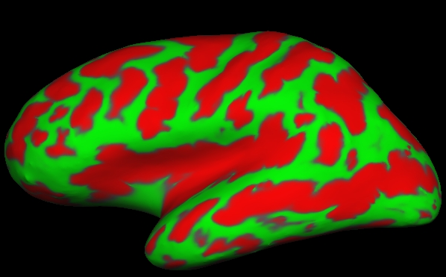
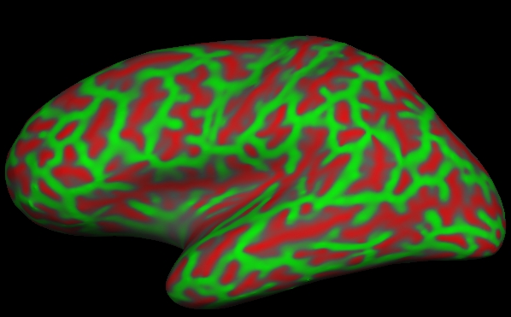
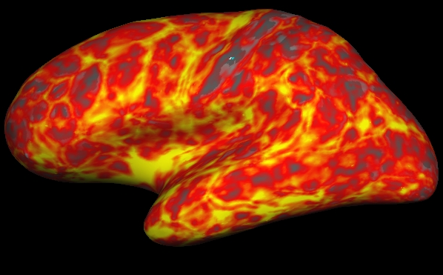
Surface Overlays
lh.sulc on inflated
lh.curv on inflated
lh.thickness on inflated
lh.sulc on pial
lh.curv on inflated
fMRI on inflated
Value for each vertex
Color indicates value
Color: gray, red/green, heat, color table
Rendered on any surface
fMRI/Stat Maps too
lh.aparc.annot on inflated
40
Notes:
40
Name some of them.
All surfaces have the same number of vertices. Different surfaces are made by moving the triangles around to achieve some goal. There is a one-to-one correspondence between surfaces which allows the user to cross-reference vertices from one surface to another (even across subjects) and to the volume. This feature is critical to get properly oriented. In the flat surface, there’s still a one-to-one correspondence, but not all vertices in the orig surface may be represented.

Slide 41
Region of Interest (ROI) Summaries
$SUBJECTS_DIR /bert
scripts mri surf label stats
aseg.stats
lh.aparc.stats
rh.aparc.stats
wmparc.stats
…
41
Notes:
41
-bert is ID, dirs underneath bert created automatically.
-Most important ones: stats, mri, scripts(logs)
-a lot of files stored here are in a format called…

Slide 42
ROI Summaries:
aseg.stats – volume summaries
?h.aparc.stats – desikan/killiany surface summaries
?h.aparc.a2009s.stats – destrieux surface summaries
wmparc.stats – white matter parcellation
Index SegId NVoxels Volume_mm3 StructName Mean StdDev Min Max Range
1 4 7230 7553.6 Left-Lateral-Ventricle 29.2 12.5 11.0 91.0 80.0
2 5 267 311.1 Left-Inf-Lat-Vent 51.3 11.5 14.0 84.0 70.0
3 7 10858 11506.0 Left-Cerebellum-White-Matter 86.8 6.7 24.0 106.0 82.0
4 8 50468 50270.0 Left-Cerebellum-Cortex 63.6 11.0 5.0 95.0 90.0
5 10 6625 6379.0 Left-Thalamus-Proper 91.6 8.8 40.0 111.0 71.0
6 11 3335 3407.1 Left-Caudate 81.2 7.1 50.0 100.0 50.0
7 12 4369 4385.7 Left-Putamen 87.2 5.2 57.0 106.0 49.0
8 13 1943 1923.6 Left-Pallidum 98.7 3.9 65.0 112.0 47.0
11 16 17918 17745.1 Brain-Stem 85.7 10.5 25.0 108.0 83.0
12 17 4014 3842.1 Left-Hippocampus 71.1 7.7 26.0 101.0 75.0
13 18 1598 1559.4 Left-Amygdala 72.8 6.4 27.0 97.0 70.0
Routines to generate spread sheets for multiple subjects
asegstats2table --help
aparcstats2table --help
More info in Anatomical ROI talk.
42
Notes:
Stats, subcortical from aseg, cortical from surfaces
Found in scripts dir
Have functions to compile individual subjects stats, select certain ROIs, or all.
42

Slide 43
Overview
$SUBJECTS_DIR /bert
scripts mri surf label stats
recon-all.log
aseg.stats
orig.mgz
lh.inflated
lh.aparc.annot
recon-all –i file.dcm –subject bert –all
43
Notes:
43
-bert is ID, dirs underneath bert created automatically.
-Most important ones: stats, mri, scripts(logs)
-a lot of files stored here are in a format called…

Slide 44
Tutorial Tips
Do not run multiple instances of Freeview at the same time unless you have > 8GB RAM.
If you are running a command in the foreground, you should not type additional commands in that terminal (command prompt will be missing)
Volume Viewer (Freeview) Radiological Orientation
Right
Left
Note: Neurological Orientation available with 7.3
44
Notes:
44

Slide 45
What to do next
Notes:
Directions on where to get tutorial data & how to run recon-all on QuickInstall wiki

Slide 46
Getting Answers
Wiki
Mail Archive
Send questions to:
freesurfer@nmr.mgh.harvard.edu
recon-all -help
mri_convert -help
$FREESURFER_HOME/docs
46
Notes:
46

Slide 47
Pop Quiz!
What is a "subject"?
What is the SUBJECTS_DIR?
What does it mean to conform the volume?
Are the FS results in Talairach/mni305 or native space?
What is the subcortical?
What is the medial wall?
Will the surface be accurate in the medial wall?
What is the difference between a surface and a surface overlay?
What does "?h" mean?
How do you get help?
47
Notes:
47

Slide 48
End of Presentation
48
Notes:
48

Slide 49
Intensity Normalization
Removes B1 bias field
NU (MNI) nu.mgz
Presegmentation (T1.mgz)
Most WM = 110 intensity
Pre- and Post-Skull Strip
bert
mri
T1.mgz
nu.mgz
110.9 ±1.8
108.9 ±1.5
110.0 ±0.0
nu.mgz
T1.mgz
49
Notes:
Nu volume created – bias removed
T1 – adjust intensity so that wm is around 110
Makes wm segment easier and generate wm surface
The B1 bias field is estimated by measuring the variation in the white matter intensity. The main body of the white matter is used to estimate the field across the entire volume. The intensity at each voxel is then divided by the estimated bias field at that location in order to remove the effect of the bias field.
Intensity = brightness of voxel – ideally only indicative of the MR params of the tissue (PD, T2, T1).
GM = dark, WM = bright.
Bias = changes in intensity across space that are unrelated to biology. i.e. tissue gets further away from receive coil, gets darker in intensity. When talking about bias, referring to biologically unrelated fluctuations in intensity.

Slide 50
Results
Volumes
Surfaces
Surface Overlays
ROI Summaries
50
Notes:
All organize in each subjects folder in SUBJECTS_DIR path
50

Slide 51
Volumes
orig.mgz
T1.mgz
brainmask.mgz
wm.mgz
filled.mgz
Subcortical Mass
$SUBJECTS_DIR/bert/mri
All “Conformed” 256³, 1mm³
Many more …
aseg.mgz
aparc+aseg.mgz
Volume Viewer:
tkmedit
51
Notes:
51
Overview of main volumes created. most important ones brainmask, wm.mgz (editing, fix topos).
use tkmedit to view/edit

Slide 52
Surfaces
orig
white
pial
inflated
sphere,sphere.reg
patch (flattened)
Surface Viewer:
tksurfer
$SUBJECTS_DIR/bert/surf
Number/Identity of vertices stays the same (except patches)
XYZ Location Changes
Flattening not done as part of standard reconstruction
52
Notes:
52
-All surfaces have the same number of vertices (within one subject??)
-There is a one-to-one correspondence between surfaces which allows the user to cross-reference vertices from one surface to another (even across subjects) and to the volume.
Different surfaces are made by moving the triangles around to achieve some goal. This feature is critical to get properly oriented. In the flat surface, there’s still a one-to-one correspondence, but not all vertices in the orig surface may be represented.

Slide 53
Topological Defects
Fornix
hippocampus
Cortical Defects
Ventricles and Caudate
Pallidum and Putamen
Holes
Handles
Automatically Fixed
53
Notes:
Examples of topo defects on surface which should be corrected.
-cut handles
-fill holes
53

Slide 54
Subject Folder Directory Tree
bert
scripts mri surf label stats
orig.mgz T1.mgz brain.mgz wm.mgz aseg.mgz
recon-all –i file.dcm –subject bert –all
54
Notes:
54
-bert is ID, dirs underneath bert created automatically.
-Most important ones: stats, mri, scripts(logs)
-a lot of files stored here are in a format called…

Slide 55
Surface Reconstruction Overview
Input: T1-weighted (MPRAGE,SPGR)
Find white/gray surface
Find pial surface
“Find” = create mesh
Vertices, neighbors, triangles, coordinates
Accurately follows boundaries between tissue types
“Topologically Correct”
closed surface, no donut holes
no self-intersections
Generate surface-based cross-subject registration
Label cortical folding patterns
Subcortical Segmentation along the way
55
Notes:
55

Slide 56
Find “Subcortical Mass”
All White Matter
All Subcortical Structures
Ventricles
Excludes brain stem and cerebellum
Hemispheres separated
Connected (no islands)
Many Stages … More Later …
56
Notes:
Overall goal, extract wm along with subcortical structures
After certain point hemis processed seperately
56

Slide 57
MGZ File Format
001.mgz
mgz = compressed MGH file
Can store 4D (like NIFTI)
cols, rows, slices, frames
Generic: volumes and Surfaces
Eg, Typical Anatomical volume: 256 x 256 x 128 x 1
“Volume-encoded” Surface Files
nvertices, 1, 1, frames (eg, 163214 x 1 x 1 x 40)
No geometry information
lh.thickness.sm10.mgz
57
Notes:
FS uses special file format (volumes FS creates in this format)
-do not need to convert dicom or nifti, FS does this (using mri_convert)
-A frame is the 4th dimension which is the variable you are analyzing. The first 3 dimensions are spatial and the fourth is the variable (schizophrenics vs. controls).
-analyze format is SPM format; “Siemens IMA” and AFNI is fmri software
57

Slide 58
Other File Formats
Surface: Vertices, XYZ, neighbors (lh.white)
Curv: lh.curv, lh.sulc, lh.thickness
Annotation: lh.aparc.annot
Label: lh.pericalcarine.label
Unique to FreeSurfer
FreeSurfer can read/write:
NIFTI, Analyze, MINC
FreeSurfer can read:
DICOM, Siemens IMA, AFNI
58
Notes:
Curv: surface overlay (stats visualized on surface)
Annot: surface label
Label: volumetric label
FS read and write variety of formats
58

Slide 59
Fully Automated Reconstruction
Launch reconstruction:
recon-all –i file.dcm –subject bert –all
Where file.dcm is one file from the correct (T1-weighted)
MR series.
Come back in 20 hours …
Check your results – do the white and pial surfaces follow the boundaries?
-- Can be broken up
59
Notes:
-all: perform all standard recon steps
-not so distant future, sig less time
-visually inspect results
Certain functions implemented using CUDA to take advantage of GPU
Collaboration with IBM to implement OpenMP versions of certain functions
59

Slide 60
SUBJECTS_DIR Environment Variable
Subject
$SUBJECTS_DIR
bert
fred
jenny
margaret …
recon-all –i file.dcm –subject bert –all
60
Notes:
60
-Necessary to tell FS where your data, where to save output.
-Each unique subject has standard sub-directory heirarchy, organizes the output (volumes, surfs, logs, stats, etc.)

Slide 61
FreeSurfer Directory Tree
Each data set has its own unique SubjectId (eg, bert)
Subject
Subject Name
bert
scripts surf label mri stats
orig.mgz T1.mgz brain.mgz wm.mgz aseg.mgz
recon-all –i file.dcm –subject bert –all
61
Notes:
61
-bert is ID, dirs underneath bert created automatically.
-Most important ones: stats, mri, scripts(logs)
-a lot of files stored here are in a format called…

Slide 62
Sulcal Depth
lh.sulc, rh.sulc
lh.curv, rh.curv
62
Notes:
Distance vertex travel from wm/pial surface to ?h.inflated version.
Less detail than curv measure
?h.sulc (sulcal depth) used to register (grossly align) with atlas
?h.curv to tweak alignment to take individual anatomy into account.
Another cortical measure
Show to prove curv not sulcal depth
62

Slide 63
Tessellation and Topology Fixing
orig surface
surf/lh.orig
surf/rh.orig
Mosaic of triangles (“tessellation”)
Errors: Donut holes, handles
Automatic topology fixer
63
Notes:
lay mesh of triangles around wm.mgz,
-original guess(first draft) at wm surface, contains some errors (subsequently fixed)
-dont think as one slice, but over entire brain.
63

Slide 64
Pial surf grows from white surf

Slide 65
Motion Correction and Averaging
001.mgz
rawavg.mgz
+
002.mgz
bert
mri
Does not change native resolution.
Usually only need one.
orig
rawavg.mgz
001.mgz 002.mgz
65
Notes:
FS dir structure illustrated on slides
Can give more than one, then avg to rawavg.
used to be that 2 acqs recommended, now with 3T, 32ch, MEMPRAGE, one recommended. still beneficial to collect to acquisitions, then use one with best contrast, one or 2, make sure it's consistent.
2 mprage at 1.5
1 mprage at 3t (SNR is good) - only use 1 or 2 for all subjects
-uses robust_register, no longer fsl
65

Slide 66
Getting FreeSurfer
surfer.nmr.mgh.harvard.edu
Register
Download
Mailing List
Wiki: surfer.nmr.mgh.harvard.edu/fswiki
Platforms:
Linux
Mac
Windows (VirtualBox)
Installed in $FREESURFER_HOME
66

Slide 67
Download & Install

Slide 68
Overview
recon-all –i file.dcm –subject bert –all
68
Notes:
Recon-all command
GUI – graphical user interface
Familiar with…
68

Slide 69
Intensity Bias
bert
mri
T1.mgz
Left side of the image much brighter than right side
Worse with many coils
Makes gray/white segmentation difficult
69
Notes:
-Remove bias from the coil. brain areas closer to coil are brighter than others, get rid of bias.
-Hard to see with human eye, demonstrates map of intensity bias. Want to make it uniform.
-No coils in middle of brain (poorer SNR, CNR).
69

Slide 70
“White Matter” Segmentation
Separates white matter from everything else
Uses aseg to “fill in” subcortical structures
Cerebellum removed, brain stem still there
wm.mgz -- “wm” not a very good name!
bert
mri
wm.mgz
70
Notes:
70

Slide 71
Fill and Cut (Subcortical Mass)
Fills in any holes.
Removes any islands
Removes brain stem
Separates hemispheres (each hemi has different value)
filled.mgz = “Subcortical Mass”
WM Volume (wm.mgz)
Filled Volume (filled.mgz)
(Subcortical Mass)
71
Notes:
Final step: prepare for generating wm surf
Separate mask, one side per hemi, each hemi gets separate surface.
71

Slide 72
Surface Extraction
Hemispheres separated
Fit to filled.mgz
1mm resolution
Rough, jagged
wm.mgz
bert
surf
lh.orig
rh.orig
lh.orig
rh.orig
72
Notes:
72
-label all wm, fills in ventricles and other structures based on aseg. Mask to extract wm.
Ventricles are filled in (as are the other subcortical structures).
Set of histograms in axial/horizontal plane, highest peak in each histo near center of image classified as wm (most voxels), checks across slices to make sure classification consistent, centers wm intensities on 110.

