Slide 1
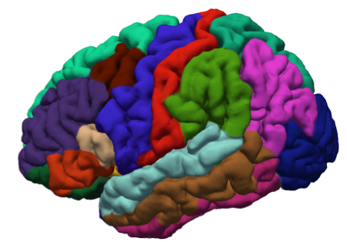





FreeSurfer Introduction

Slide 2
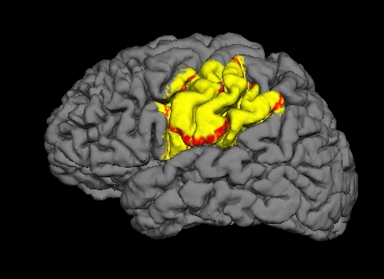
Outline
Cortical surface model
Surface-based analysis
Surface-based Inter-subject Registration
Multi-modal integration
Volume too
Course geared toward Data ->Publication
Use FreeSurfer

Slide 3
Cortex and Surface-based Analysis
Notes:
If they have more than one slide, they should use this as the second, etc. slides

Slide 4
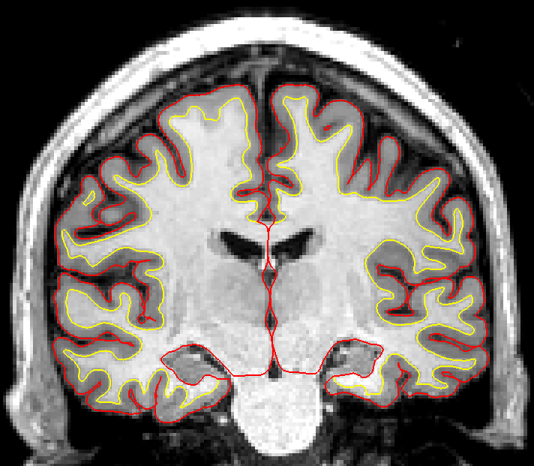
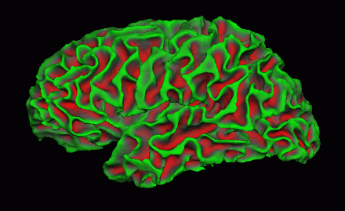
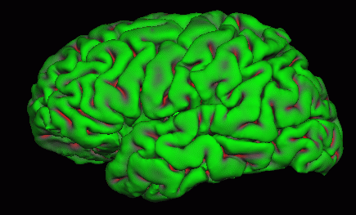
Cortex is a 2D Surface Folded in 3D space
White Surface
Pial Surface
FreeSurfer
https://surfer.nmr.mgh.harvard.edu
Notes:
If they have more than one slide, they should use this as the second, etc. slides

Slide 5
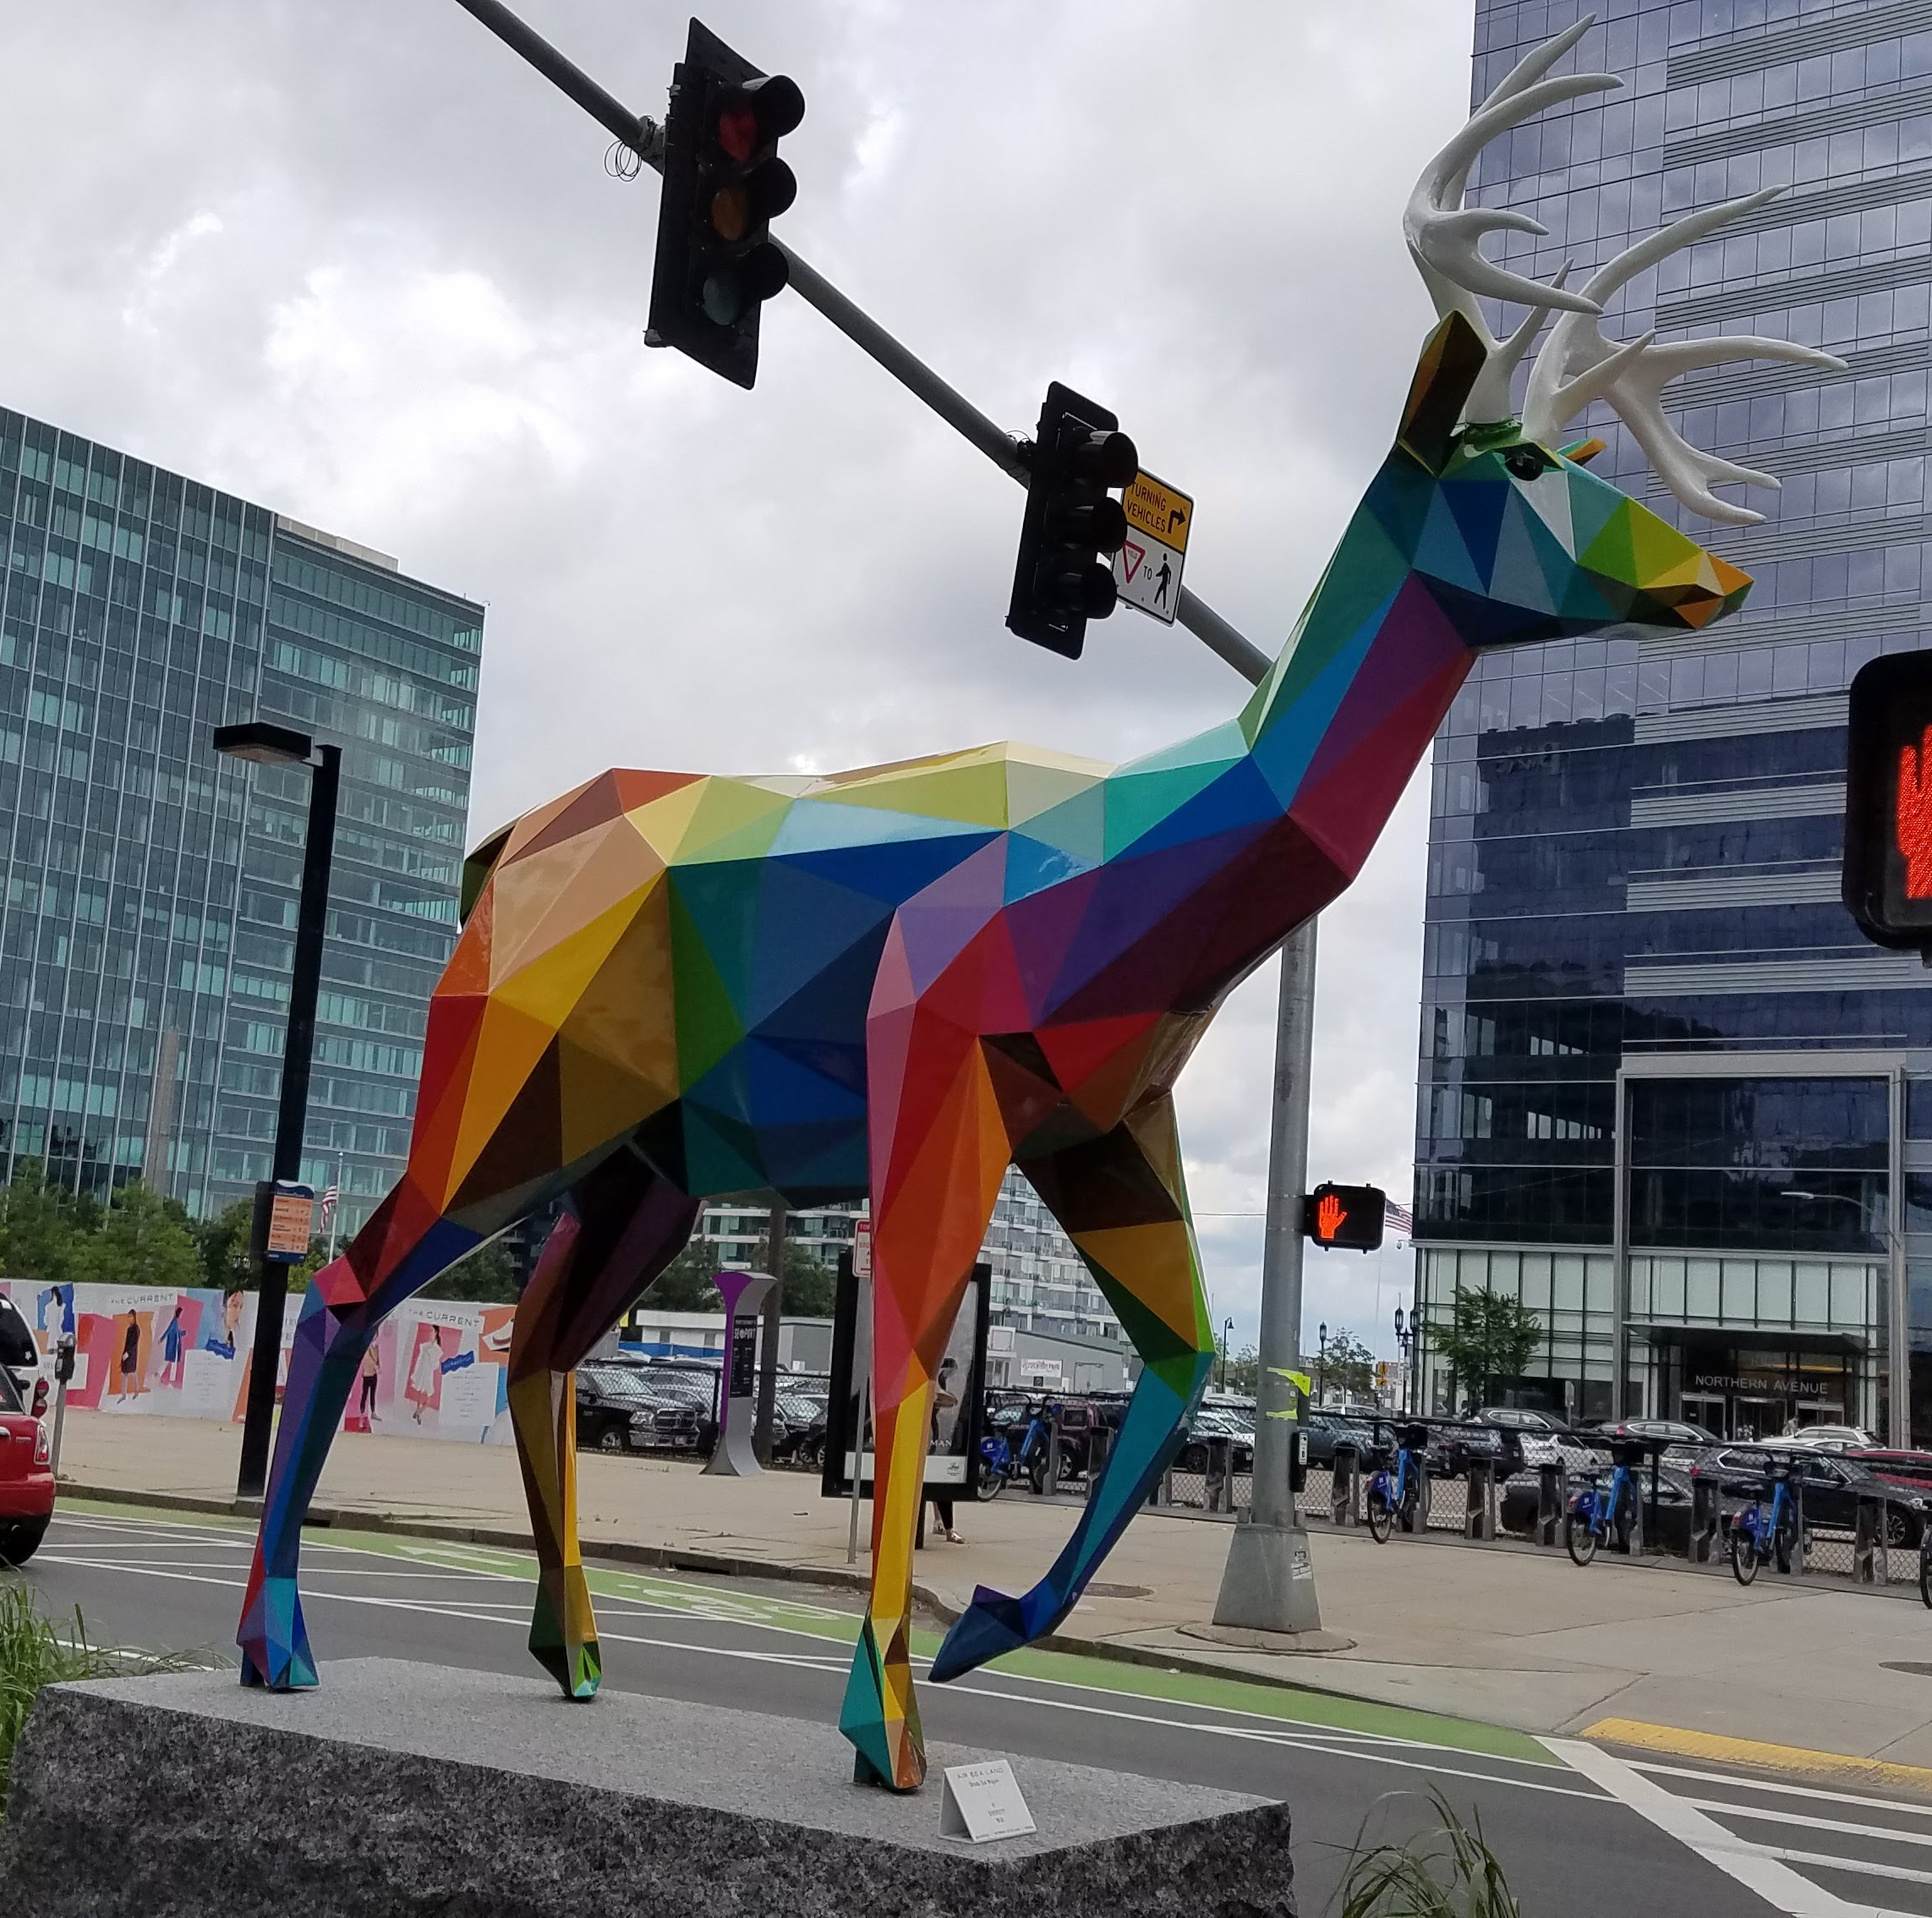
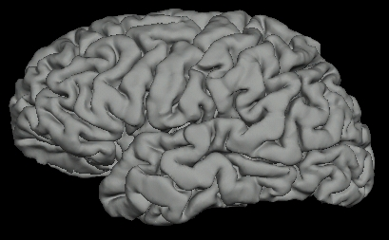
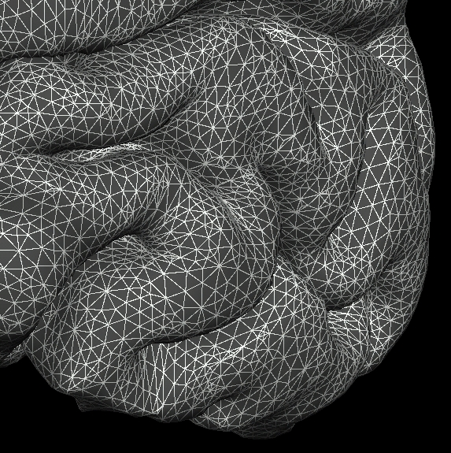
Triangular Mesh Surface Model
Okuda San Miguel
5
Notes:
5
-mesh allows FS to get various measurements
-all triangles meet at various points called vertices – measurements stored there (area = area of all triangles)
-XYZ - each vertex has a label (important for cross-subject reg)
Once the xyz of each corner of each triangle is known, then it is possible to characterize the entire cortical surface in terms of area, distance, curvature, and thickness.
The cortical surface is represented by a finite element model using triangles to cover the cortical surface. The reconstruction is the (mostly automated) process of assigning an xyz to each corner of each triangle.

Slide 6
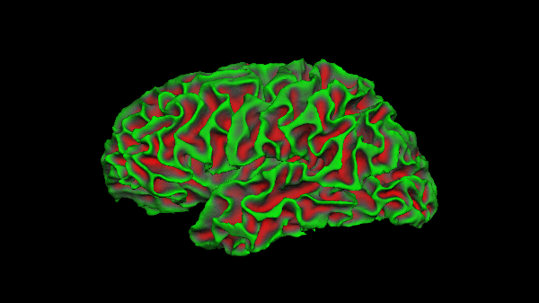
Cortex is a 2D Surface Folded in 3D space
White Surface
Pial Surface
FreeSurfer
https://surfer.nmr.mgh.harvard.edu
Notes:
If they have more than one slide, they should use this as the second, etc. slides

Slide 7
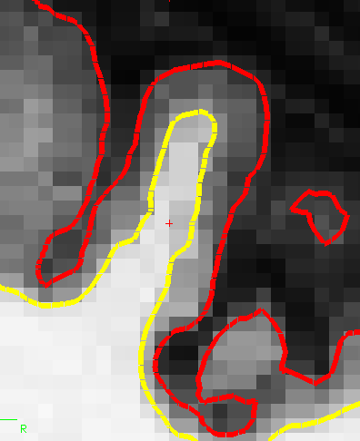
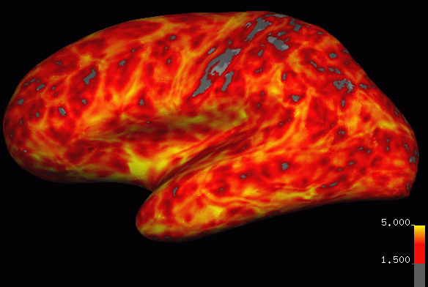
Cortical Thickness
Distance between white and pial surfaces
One value per vertex
Surface-based more accurate than volume-based
pial surface
mm
“Overlay”, “Heat map”
white/gray surface
7
Notes:
-Now that you have wm & pial surfs…get cort meas
-calculates cort thick, distance between vertices on wm and gm. blue dots are vertices (indicated by). dist from wm to gm, and gm to wm and takes average.
7

Slide 8
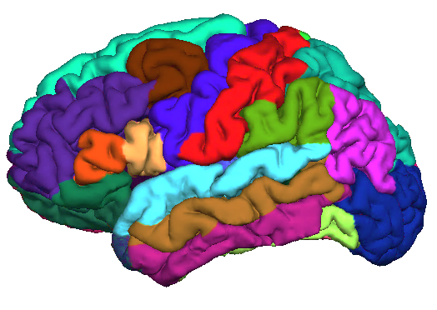
Automatic Surface Parcellation:
Desikan/Killiany Atlas (35 ROI’s)
Precentral Gyrus
Postcentral Gyrus
subject
label
Superior Temporal Gyrus
lh.aparc.annot
An automated labeling system for subdividing the human cerebral cortex on MRI scans into gyral based regions of interest, Desikan, R.S., F. Segonne, B. Fischl, B.T. Quinn, B.C. Dickerson, D. Blacker, R.L. Buckner, A.M. Dale, R.P. Maguire, B.T. Hyman, M.S. Albert, and R.J. Killiany, (2006). NeuroImage 31(3):968-80.

Slide 9
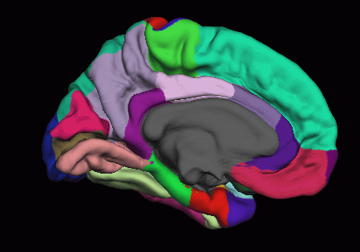
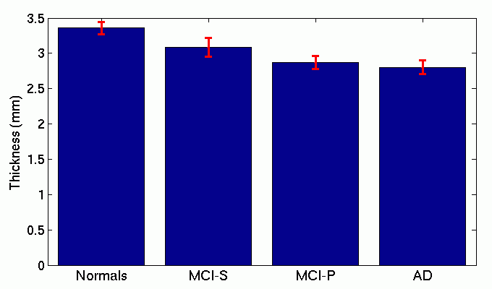
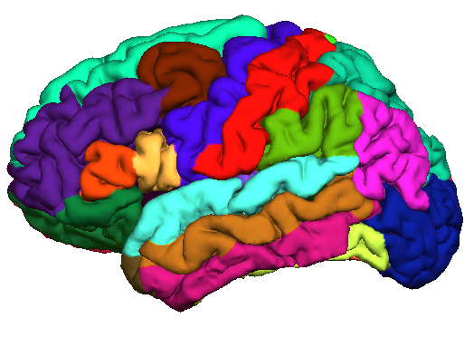
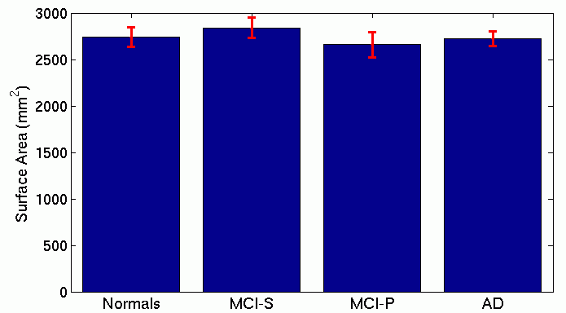
Thickness and Area ROI Studies
Thickness of Entorhinal Cortex
Entorhinal Cortex
Surface Area of MTG
Middle Temporal Gyrus
Gray matter volume also possible

Slide 10
Surface-based
Intersubject Registration
And Group Analysis
Notes:
If they have more than one slide, they should use this as the second, etc. slides

Slide 11
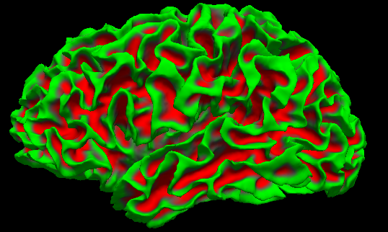
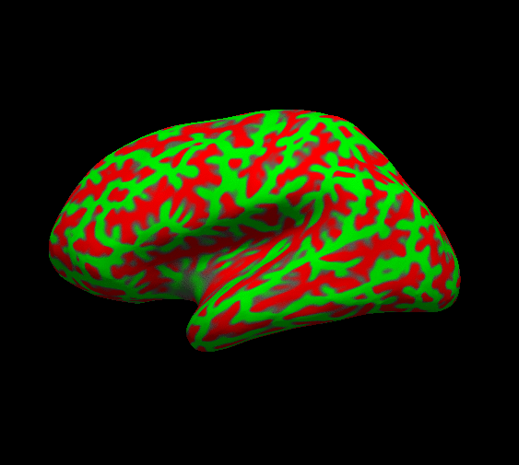
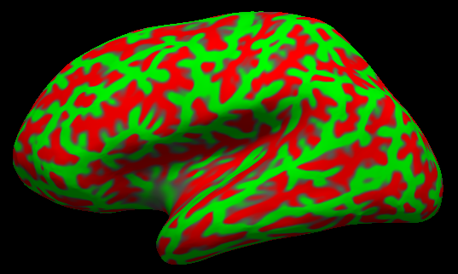
Spherical Inflation

Slide 12
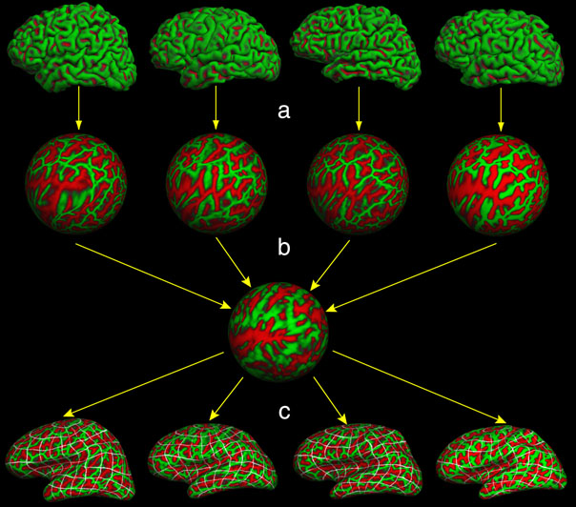
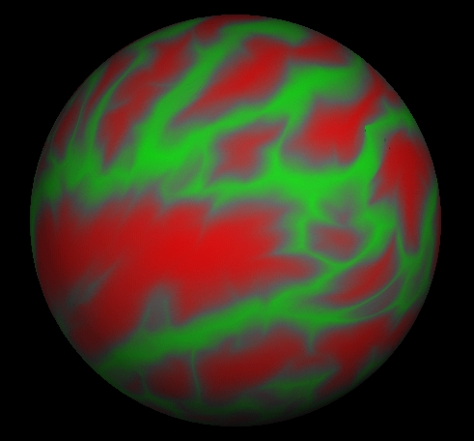
A Surface-Based Spherical Coordinate System
φ
θ
Common space for group analysis (like Talairach)

Slide 13
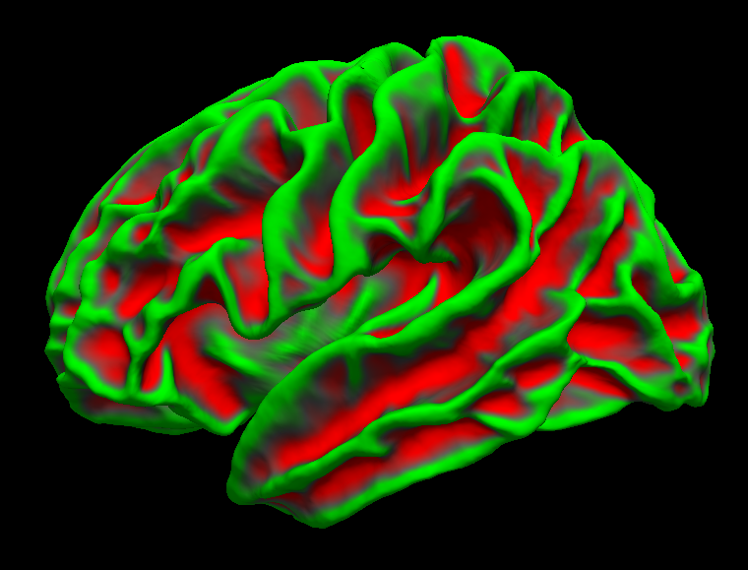
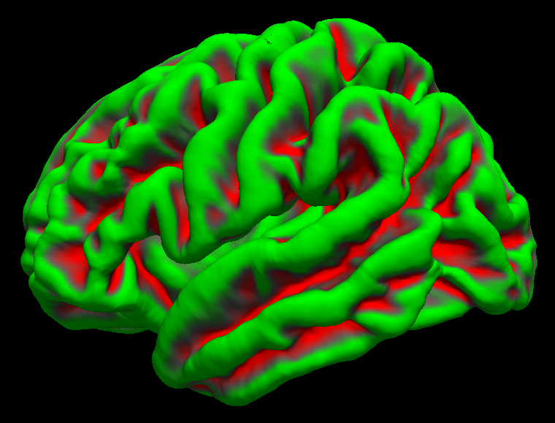
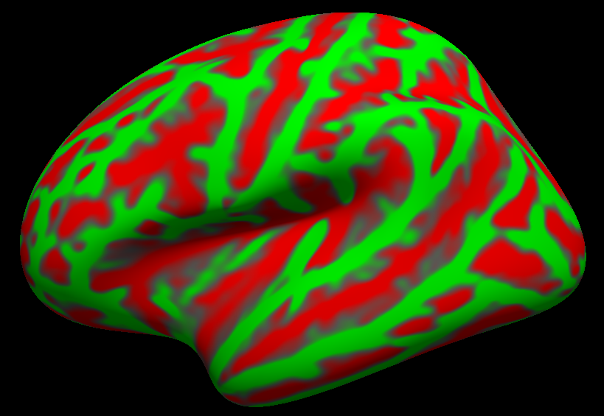
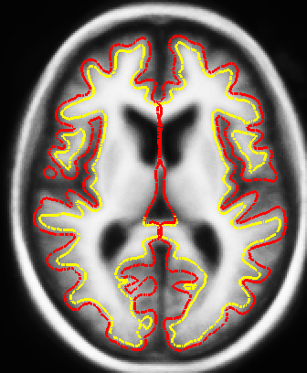
fsaverage Space
  Default registration space
  Like the MNI152 but for surfaces

Slide 14
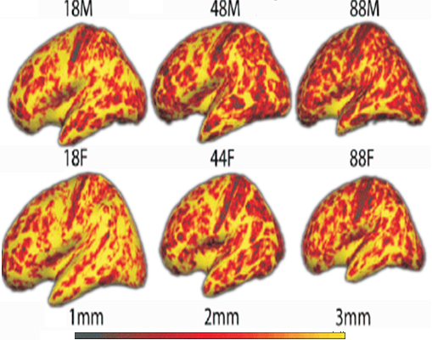
Aging Exploratory Analysis
  In which areas does thickness
  Change with age?
  Cortical Thickness vs Aging
  Salat et al, 2004, Cerebral Cortex

Slide 15
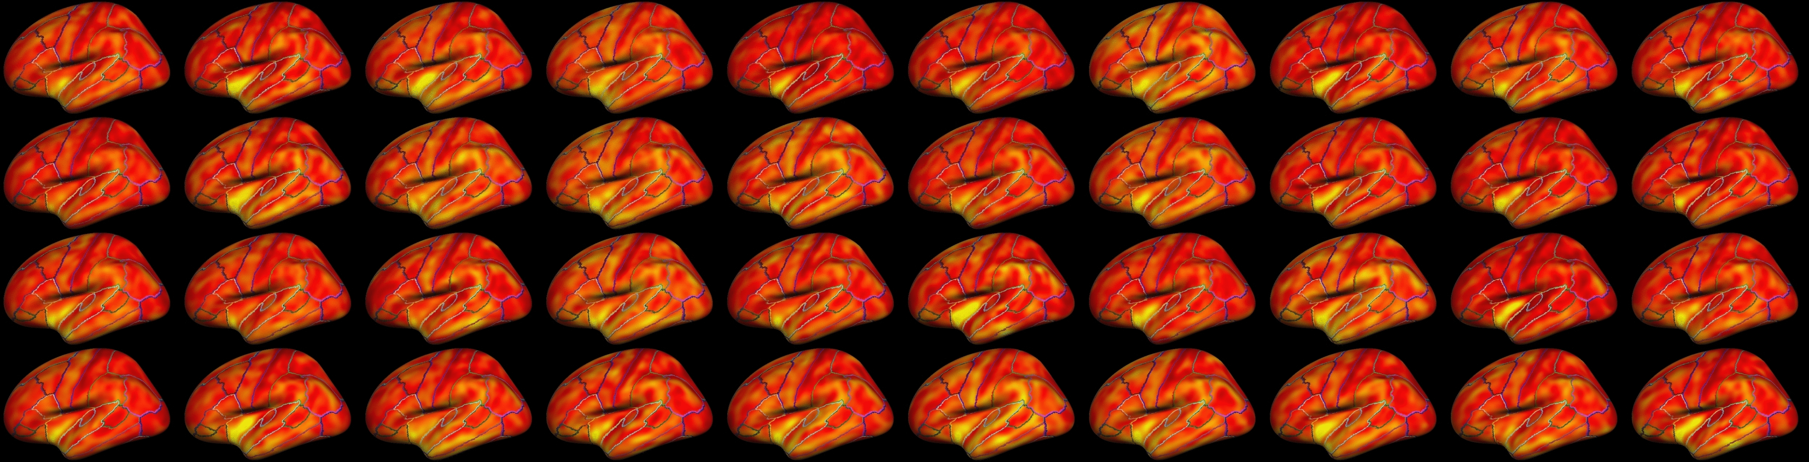
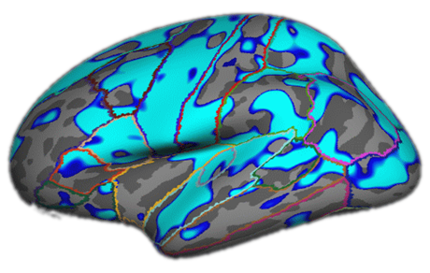
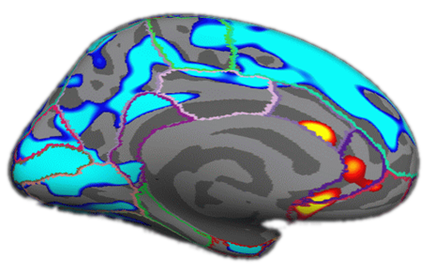
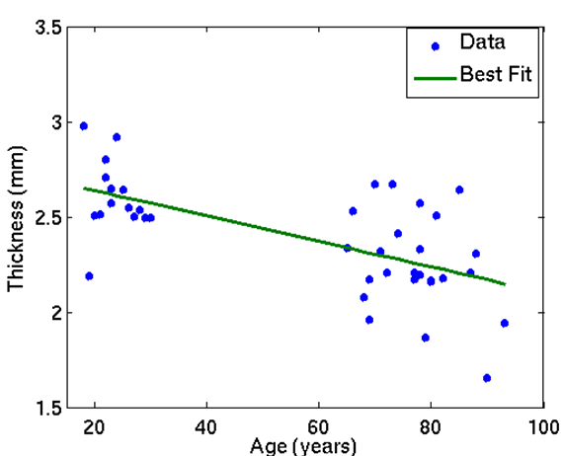
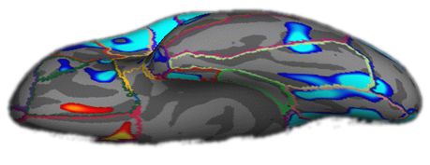
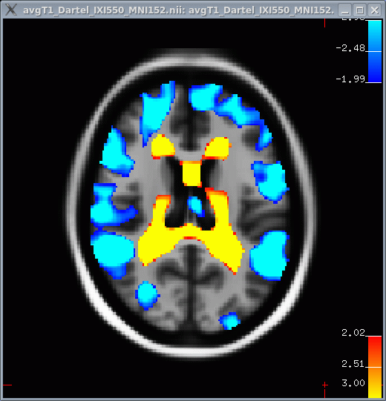
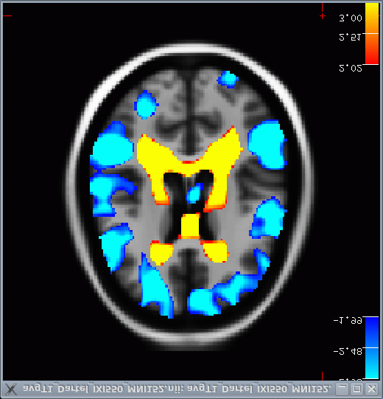
Aging Thickness Study
  N=40 (all in fsaverage space)
Negative Age Correlation
p<.01
Positive Age Correlation

Slide 16
Surface-based
Multimodal Integration
Notes:
If they have more than one slide, they should use this as the second, etc. slides

Slide 17
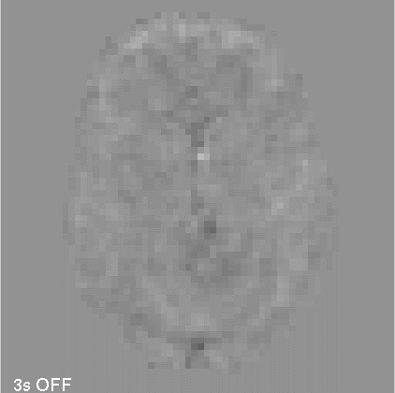
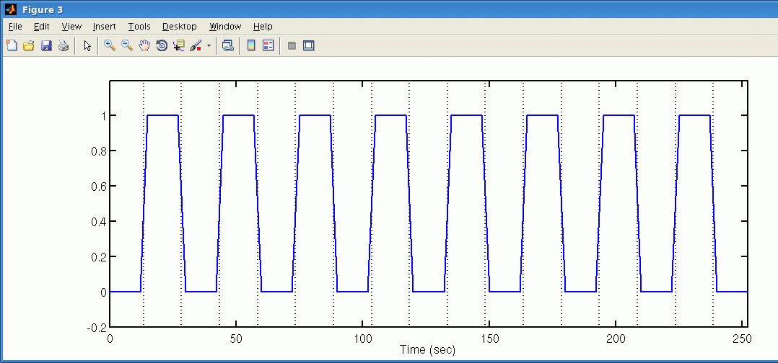
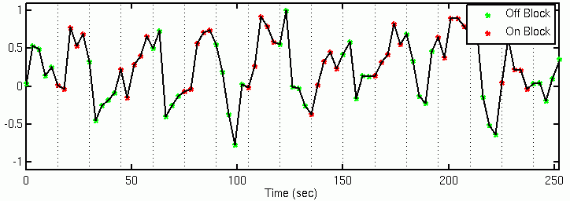
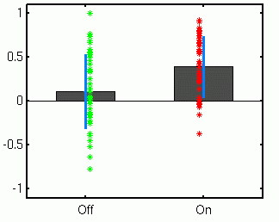
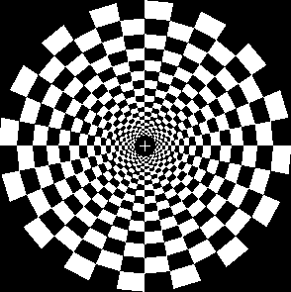
Visual/Auditory/Motor Activation Paradigm
15 sec ‘ON’, 15 sec ‘OFF’
Flickering Checkerboard
Auditory Tone
Finger Tapping
33

Slide 18
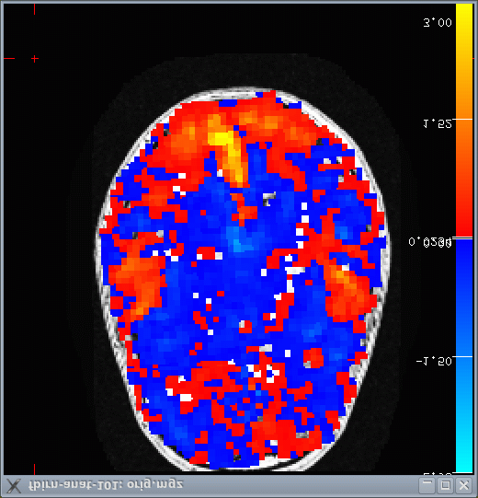
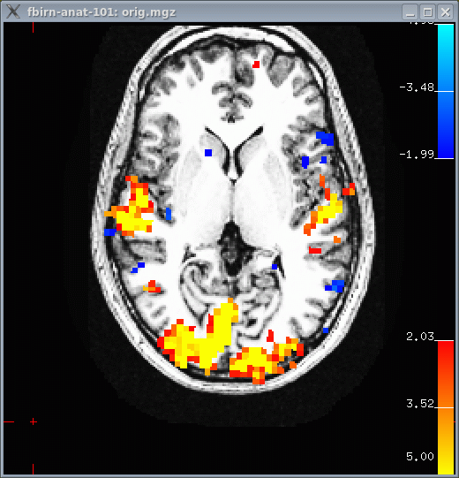
On-vs-Off
10⁻⁵
10⁻²
10⁻⁵
Significance Map
(Thresholded p<.01)
15 sec ‘ON’, 15 sec ‘OFF’
Flickering Checkerboard
Auditory Tone
Finger Tapping
34

Slide 19
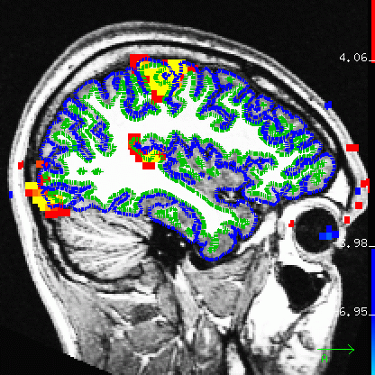
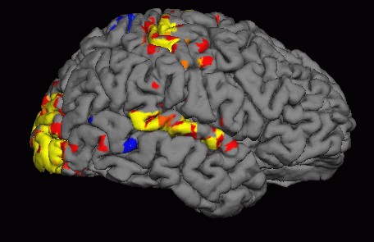
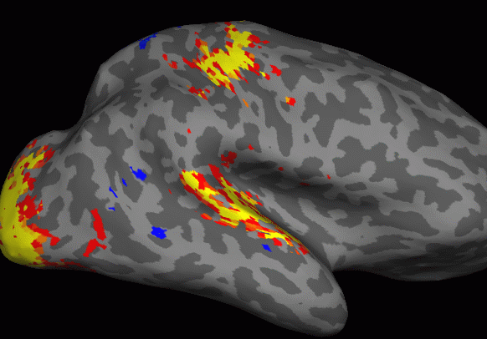
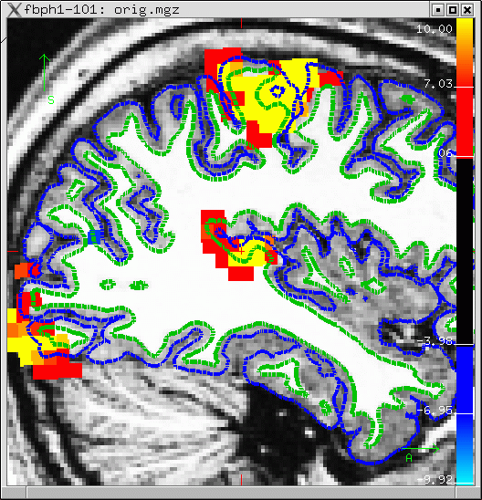
Sampling on the Surface

Slide 20
Surface-based
Spatial Smoothing
Notes:
If they have more than one slide, they should use this as the second, etc. slides

Slide 21
Volume-based Smoothing
14mm FWHM
  Smoothing is averaging of “nearby” voxels
  Mixing of tissue types
  Jumping across sulci
7mm FWHM
*

Slide 22
Surface-based Smoothing
Smooth along the surface but not normal to it.

Slide 23
Volume Analysis: Automatic Individualized Segmentation
Surface-based coordinate system/registration appropriate for cortex but not for thalamus, ventricular system, basal ganglia, etc…

Slide 24
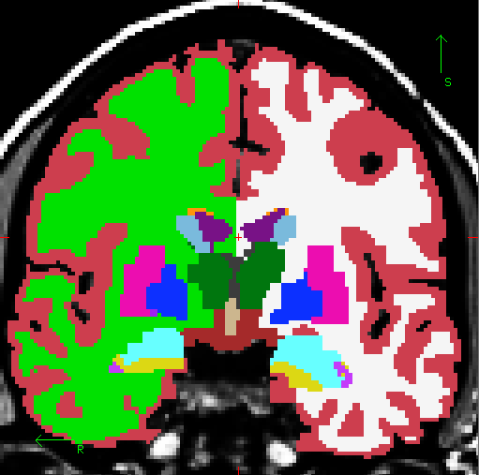
Volumetric Segmentation (aseg)
Cortex
Lateral Ventricle
White Matter
Thalamus
Caudate
Putamen
Pallidum
Amygdala
Hippocampus
Not Shown: Nucleus Accumbens

Slide 25
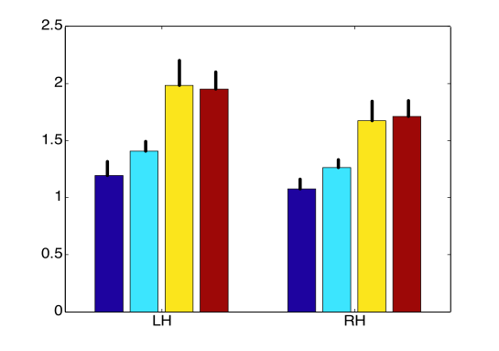
Volume Differences Predictive of AD
Lateral Ventricular Volume (Percent of Brain)
Healthy
Did NOT convert
Did convert
Probable AD
Data courtesy of Drs Marilyn Albert and Ron Killiany

Slide 26
Other Stuff
Longitudinal Analysis
fMRI Analysis (FS-FAST)
PET Analysis (PETsurfer)
Diffusion Analysis (TRACULA)
Non-linear volume registration (SynthMorph)
Skull Stripping (SynthStrip)
Segmentations
  Hippocampal and Amygdalar subfields (segmentHA_T1.sh)
  Thalamic Nuclei (segmentThalamicNuclei.sh)
  Subcortical limbic (mri_ sclimbic_seg)
  Pineal and Pituitary (mri_pglands_seg)
  Claustrum (mri_claustrum_seg)
  Arousal Nuclei (AANsegment)
  Brainstem (segmentBS.sh)
3rd Party: MNE for EEG and MEG analysis

Slide 27
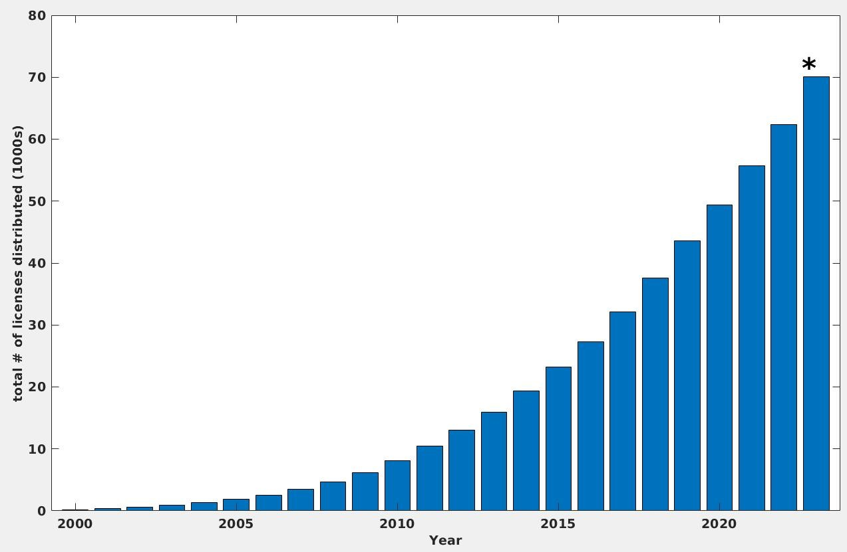
FreeSurfer Usage
Licenses (free): 90,000 total
Citations: ~50,000
Table 1: Metrics of FreeSurfer Impact and Significance (Oct 2024) and Change Since 2020 |  | Change
Core FreeSurfer Publications | Total = 51,251 citations
Cortical Reconstruction I [4] | 11668 citations | +65%
Cortical Reconstruction II [5] | 6975 citations | +45%
Surface-based Registration [6] | 3505 citations | +40%
Cortical Thickness [7] | 6498 citations | +54%
Automatic Volume Segmentation [8] | 9429 citations | +70%
Automatic Surface Segmentation [9] | 4710 citations | +57%
“FreeSurfer” Paper Fischl 2012 | 8466 citations | +230%
Major Brain Imaging Projects that use FreeSurfer
Alzheimer's Disease Neuroimaging Initiative (ADNI) | >5000 cases
Framingham Heart Study (FHS) | >10,000 cases
Human Connectome Project – Young Adult (HCP-YA) | 1200 cases
Human Connectome Project -- Aging (HCP-A) | >1500 cases
Human Connectome Project – Children (HCP-C) | >1350 cases
Superstruct Project (Dr. Randy Buckner) | 1570 cases
Open Access Series of Imaging Studies (OASIS) | 416 cases
Enhanced NeuroImaging Genetics Meta Analysis (ENIGMA) | >50,000 cases
UK Bio Bank (United Kingdom) | ~100,000 cases
Rotterdam Study (PI: Dr. Arfan Ikram) | 12,000 cases
Adolescent Brain and Cognitive Development (ABCD) | 10,000 cases
FreeSurfer Usage Statistics
Total number of licenses distributed since 2000 | 76,191 | +55%
Average number of licenses per year since 2011 | 4757
Posts to FreeSurfer mailing list | ~1500/year
Some Disorders/Diseases studied with FreeSurfer | Citations (Approx)
Alzheimer’s Disease (AD) [10-14] | 3785 | +71%
Parkinson’s Disease [15-18] | 1334 | +95%
Huntington’s Disease [19-22] | 769 | +39%
Schizophrenia [23-27] | 3170 | +62%
Major Depressive Disorder (MDD) [28-31] | 2232 | +78%
Multiple Sclerosis (MS) [32-35] | 1892 | +63%
Total # licenses distributed as of June 9, 2023

Slide 28
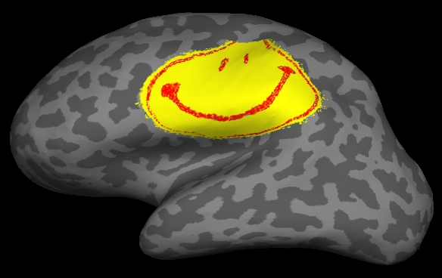
Summary
Cortical extraction and labeling
Subcortical Segmentation
Surface-based Inter-subject Registration
Fully automated
Multi-modal integration
Use FreeSurfer
Be Happy

Slide 30
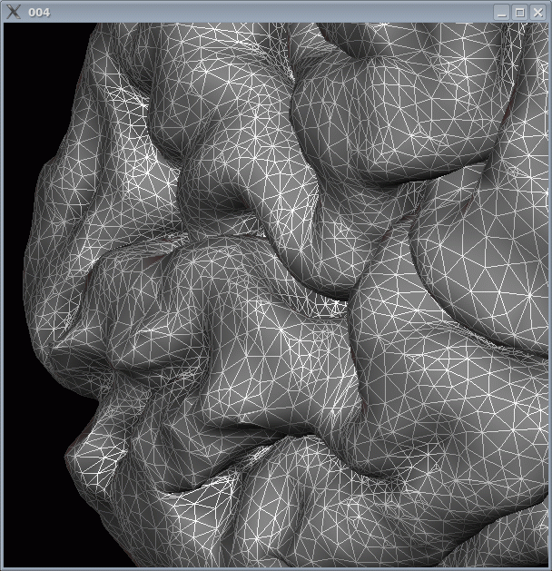
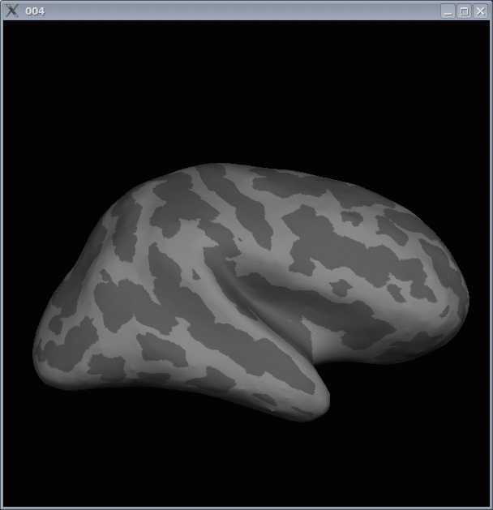















What Is FreeSurfer?
Surface Mesh
Inflation
Surface ROI
Group
Template
D
E
J
Curvature
Sphere
C
F
I
Individual T1
Spatial
Normalization
A
A
Surface
Extraction
B
Thickness
G
H
Deformation
Field
2mm
4mm
Apply
Deformation
Volume ROI
O
Statistical Map
Statistical Map
N
M
Group
Analysis
L
K
Smooth
p<.01
p<.01
Thickness
(Group Space)
Other Subjects

Slide 31

Search for Answers

Slide 32
Outline
A Brief History of FreeSurfer
What are Surfaces Good For Anyway?
Inferring Microstructural Features
Longitudinal Analysis
DWI/Tractography
fMRI

Slide 33



What Can One Do With A Surface Model?
goal: use model to imposed desired activity pattern on V1
desired shape of activity pattern
required shape of stimulus
w=k log(z+a)
left primary visual cortex
right visual
hemifield
Collaboration with Jon Polimeni and Larry Wald.

Slide 34

Tangential Resolution Measured with Surface-based Analysis
Collaboration with Jon Polimeni and Larry Wald. Polimeni, et al, 2010, NI.

Slide 35

Tangential Resolution Measured with Surface-based Analysis
Collaboration with Jon Polimeni and Larry Wald. Polimeni, et al, 2010, NI.

Slide 36



NeuroMarketing!
Aim 1 of our NCRR Center Grant, spelling:
“MGH Center for Functional Neuroimaging Technologies; and NCRR Center for Research Resources.”
(just kidding)
Thanks to Larry Wald for this slide.

Slide 37
Outline
A Brief History of FreeSurfer
What are Surfaces Good For Anyway?
Inferring Microstructural Locations
Longitudinal Analysis
DWI/Tractography
fMRI

Slide 38


Surface-based Registration Performance
Brodmann, 1909

Slide 39



Predicting Brodmann Areas: Talairach Coordinates
10 subjects overlap
1 subject overlap
BA17 (V1) BA18 (V2) BA44 (Broca’s) BA45 (Broca’s)
(Amunts et al, 2000, 2004)

Slide 40




Predicting Brodmann Areas from Folding Patterns
BA 17 (V1)
BA 18 (V2)
0%
100% Overlap
BA 44
BA 45
Fischl, et al, 2007. Thanks to Katrin Amunts, Karl Zilles and Hartmut Mohlberg for the data, and to Niranjini Rajendran and Evelina Busa for the analysis.

Slide 41

Ex vivo MRI of hippocampal subfields
Resolution as high as 0.1 mm isotropic
Allows precise manual tracing of hippocampal subfields.
The delineation only relies on geometry for subdividing the CA.
Joint work with J. Eugenio Iglesias, Koen van Leemput and Jean Augustinack
Notes:
41

Slide 42






Automated Segmentation
We use the atlas as a prior, and connect it to the image through a Gaussian likelihood term for each label.
This makes the segmentation sequence-independent.
0.6 mm isotropic T1 (Winterburn et al.)
1 mm T1 + 0.4x0.4x2 mm T2 (ADNI)
Joint work with J. Eugenio Iglesias, Koen van Leemput and Jean Augustinack
Notes:
42

Slide 43
Outline
A Brief History of FreeSurfer
What are Surfaces Good For Anyway?
Inferring Microstructural Locations
Longitudinal Analysis
DWI/Tractography
fMRI

Slide 44

Robust Registration
Target
Target
Reuter et al, 2010 NeuroImage

Slide 45


Robust Registration
Registered Src correlation ratio
Registered Src Robust
Reuter et al, 2010 NeuroImage

Slide 46

Robust Registration
Tumor data with significant intensity differences in the
brain, registered to first time point (left).
Reuter et al, 2010 NeuroImage

Slide 47




Longitudinal Processing
Create unbiased subject template (iterative registration to median)
Process template
Initialize time points
Let it evolve there
Avoid Bias: All time points are treated the same
Increases sensitivity and reliability!
Reuter et al. OHBM 2010, NeuroImage 2011 & 2012

Slide 48
Outline
A Brief History of FreeSurfer
What are Surfaces Good For Anyway?
Inferring Microstructural Locations
Longitudinal Analysis
DWI/Tractography
fMRI

Slide 49


Tractography with TRACULA
(TRActs Constrained by the Underlying Anatomy)
Completely automated modeling of 18 major fascicles
Uses prior probabilistic information on the anatomical structures that each fascicle goes through or next to
Collaboration with Anastasia Yendiki, Lilla Zöllei, Saad Jbabdi, Tim Behrens and Jean Augustinack

Slide 50
Outline
A Brief History of FreeSurfer
What are Surfaces Good For Anyway?
Inferring Microstructural Locations
Longitudinal Analysis
DWI/Tractography
fMRI

Slide 51
Sampling on the Surface
15 sec ‘ON’, 15 sec ‘OFF’
Flickering Checkerboard
Auditory Tone
Finger Tapping

Slide 52






fMRI Working Memory Paradigm Group Analysis
Probe-vs-Fixation. Data Functional Biomedical Informatics Research Network (fBIRN)

Slide 53



Group fMRI Analysis: Volume vs Surface
Affine registration to MNI305
5mm volume smoothing vs.
10mm surface smoothing

Slide 54

Why Should I Use FreeSurfer?
Please do not try this yourself without expert supervision – it can be extremely dangerous!

Slide 56


Food and such
Cafeteria in main building (Building 149)
Morning coffee and “breakfast” – muffins, bagels, fruit
Afternoon coffee and some snacks
Tuesday evening socializing at Boston Beer Works

Slide 57
To Caffeinate or not to Caffeinate?
Please don’t spill coffee (or anything else!) on the laptops. If you do, please be prepared to fund a replacement!

Slide 58










The FreeSurfer Team
Bruce
Martin
Longitudinal
Lilla
Registration/
Pediatric
Doug
fMRI/PET
Anastasia
Tractography
Software Engineers
Andre
MR Sequences
Zeke
Nick
Ruopeng
Allison
Recon Editing & Exvivo Data
58
Notes:
-Bruce: creator, implements most new code
-Doug: created & only person that works on fMRI stream; person that mostly works on group analysis code
-engineers: build & test the code; decide when to release new versions; most likely to help with installation problems
-me: expertise in manual interventions for failed datasets; oversee exvivo projects that ultimately add to atlases

Slide 59


Automated Subfield Segmentation
Leave-one-out cross-validation with 5 subjects
Dice Coefficient
Fimbria
CA2/3
CA1
CA4/DG
Presubiculum
Subiculum
Hippocampal fissure
Hippocampus
Inf. Lateral Ventricle
Choroid plexus
.8
.7
.6
.5
.4
.3
.2
.1
0
Relative Volume Difference (%)
80
70
60
50
40
30
20
10
0
high-resolution scan
of unseen subject
manual labeling
automated labeling
Collaboration with Koen van Leemput, J. Eugenio Iglesias and Jean Augustinack
27

Slide 60
Visual/Auditory/Motor Activation Paradigm
15 sec ‘ON’, 15 sec ‘OFF’
Flickering Checkerboard
Auditory Tone
Finger Tapping
33

Slide 61


On-vs-Off SPMs
+3%
0%
-3%
Contrast Amplitude
CON, COPE, CES
Contrast Amplitude
Variance
(Error Bars)
VARCOPE, CESVAR
Significance
t-Map (p,z,F)
(Thresholded p<.01)
34

Slide 62
Outline
Anatomical Analysis
Surface-based (Cortex)
Volume-based
Multi-modal integration
DWI/Tractography
fMRI – retinotopy
42

Slide 63

What does your brain do to Mona?
43

Slide 64


Left Cortical
Hemisphere
Right Cortical
Hemisphere
44

Slide 65


Map Function
VMU
Cartesian
Cortex
log(k(x+iy)+a)
HM
HM – Horizontal Meridian
VML
VMU – Vertical Meridian, Upper Field
VML – Vertical Meridian, Lower Field
45

Slide 66



V1 – Primary Visual Cortex
VML
HM
VMU
46

Slide 67

Retinotopic fMRI
Ring (Exp/Con)
(Eccentricity)
Wedge (Rot)
(Azimuth)
47

Slide 68

Retinotopic fMRI Analysis
R=Eccentricity Radius
β1=Asin(R)
β2=Acos(R)
-1
R = tan (β1/β2)
R
Eccentricity
48

Slide 69







Retinotopy Results
Eccentricity
Polimeni, NI 2010
Isoclines
Azimuth
Eccentricity
Azimuth
49

Slide 70
FreeSurfer Analysis Pipeline Overview
Surface Mesh
Inflation
Surface ROI
Group
Template
D
E
J
Curvature
Sphere
C
F
I
Individual T1
Spatial
Normalization
A
A
Surface
Extraction
B
Thickness
G
H
Deformation
Field
2mm
4mm
Apply
Deformation
Volume ROI
O
Statistical Map
Statistical Map
N
M
Group
Analysis
L
K
Smooth
p<.01
p<.01
Thickness
(Group Space)
Other Subjects
39

Slide 71
FreeSurfer Analysis Pipeline Overview
Surface Mesh
Inflation
Surface ROI
Group
Template
D
E
J
Curvature
Sphere
C
F
I
Individual T1
Spatial
Normalization
A
A
Surface
Extraction
B
Thickness
G
H
Deformation
Field
2mm
4mm
Apply
Deformation
Volume ROI
O
Statistical Map
Statistical Map
N
M
Group
Analysis
L
K
Smooth
p<.01
p<.01
Thickness
(Group Space)
Other Subjects
54

Slide 72


Quantifying Folding Patterns
Height or Depth Encodes Folding Pattern
Every vertex has a value
Central Sulcus
Gyri
Sulci
Central Sulcus
55

Slide 73
Motivation
To a large degree, function follows the folding patterns. So if you align the folding patterns between two subjects you will align the function.
56

Slide 74



Intersubject Registration
Subject 1
Subject 2
Central Sulcus
Central Sulcus
Central Sulcus
57

Slide 75



Surface Registration
Subject 1
Subject 2 (Before)
Subject 2 (After)
Shift, Rotate, Stretch
High dimensional (~500k)
58

Slide 76
What Can One Do With A Surface Model?
goal: use model to imposed desired activity pattern on V1
desired shape of activity pattern
required shape of stimulus
w=k log(z+a)
left primary visual cortex
right visual
hemifield
Collaboration with Jon Polimeni and Larry Wald.
59

Slide 77
Thanks!
Use FreeSurfer
Be Happy
77

Slide 78

Retinotopy Field Sign Maps
Changes in orientation between V1, V2, etc
From (Sereno et al, 1995, Science).

Slide 79
Surface Review
Cortex is a 2D sheet folded into 3D
Function is organized along the sheet
Visualization
Better to smooth in 2D instead of 3D
Register across subjects by aligning anatomy (folding patterns) in 2D
Common surface space (like Talairach) for group studies
62

Slide 80

Surface Registration
Subject 1
Subject 2 (Before)
Subject 2 (After)
63

Slide 81



Surfaces: White and Pial

Slide 82






Surface and Volume Analysis
Cortical Reconstruction
and Automatic Labeling
Inflation and Functional
Mapping
Automatic Subcortical
Gray Matter Labeling
Surface-based Intersubject
Alignment and Statistics
Automatic Gyral White
Matter Labeling
Surface Flattening

Slide 83

Inflation

Slide 84

Surface Flattening – Whole Hemisphere
central
anterior
posterior
sylvian
Inflated surface with cuts
superior temporal
calcarine
Metrically optimal flat map

Slide 85
Volume Differences Predictive of AD
Data courtesy of Drs Marilyn Albert and Ron Killiany

Slide 86
Why FreeSurfer?
Anatomical analysis is not like functional analysis – it is completely stereotyped.
Registration to a template (e.g. MNI/Talairach) doesn’t account for individual anatomy.
Even if you don’t care about the anatomy, anatomical models allow functional analysis not otherwise possible.

Slide 87


Why not just register to an ROI Atlas?
12 DOF
(Affine)
ICBM Atlas

Slide 88

Problems with Affine (12 DOF) Registration
Subject 2 aligned with Subject 1
(Subject 1’s Surface)
Subject 1

Slide 89
Talk Outline
Cortical (surface-based) Analysis.
Volume Analysis.
New Features in 5.1.

Slide 90


What Can One Do With A Surface Model?
goal: use model to imposed desired activity pattern on V1
desired shape of activity pattern
required shape of stimulus
w=k log(z+a)
left primary visual cortex
right visual hemifield
Collaboration with Jon Polimeni and Larry Wald.

Slide 91
Tangential Resolution Measured with Surface-based Analysis
Collaboration with Jon Polimeni and Larry Wald.

Slide 92
Tangential Resolution Measured with Surface-based Analysis
Collaboration with Jon Polimeni and Larry Wald.

Slide 93

Cortical Thickness
Distance between white and pial surfaces
One value per vertex
pial surface
white/gray surface
lh.thickness, rh.thickness

Slide 94
A Surface-Based Coordinate System

Slide 95



Inter-Subject Averaging
Spherical
Spherical
Native
GLM
Subject 1
Demographics
Surface-to-
Surface
Subject 2
Surface-to-
Surface
mri_glmfit
cf. Talairach

Slide 96

Visualization
Borrowed from (Halgren et al., 1999)

Slide 97

Rosas et al., 2002
Sailer et al., 2003
Kuperberg et al., 2003
Fischl et al., 2000
Gold et al., 2005
Salat et al., 2004
Rauch et al., 2004

Slide 98
Talk Outline
Cortical (surface-based) Analysis.
Volume Analysis.
New Features in 5.1.

Slide 99
Volume Analysis: Automatic Individualized Segmentation
Surface-based coordinate system/registration appropriate for cortex but not for thalamus, ventricular system, basal ganglia, etc…
Anatomy is extremely variable – measuring the variance and accounting for it is critical (more in the individual subject talk)!

Slide 100
FreeSurfer Version 5.1: New Features
Longitudinal Analysis (Martin Reuter).
Automated tractography with Tracula (Anastasia Yendiki).
Automated Hippocampal Subfield segmentation (Koen van Leemput).
New Architectonic Areas (entorhinal cortex, Jean Augustinack).
Open Source! (modified BSD/MIT license)

Slide 101


Unbiased Robust Registration*
The contribution of error is limited for outliers:
Squared Error
Tukey's Biweight
*Reuter, Rosas and Fischl, 2010, NeuroImage

Slide 102




New Areas: Entorhinal Cortex
Fischl et al., 2009, NeuroImage

Slide 103


Comparing Coordinate Systems and Brodmann Areas
Cumulative histogram (red=surface, blue=nonlinear Talairach)
Ratio of surface accuracy to volume accuracy
Notes:
Can use the ex vivo Brodmann delineations to assess the accuracy of a coordinate system. Of course being better than Talairach isn’t the strongest statement in the world….

Slide 104

Longitudinal Analysis: Increased Reliability
14 subjects scanned twice, two weeks apart.
Collaboration with Martin Reuter

